Slide 1

2023-2024 Accident Information
2026-2027 Continuing Education
Director Frank Foster

Slide 2

Summary Of Underground Injuries
 | 2023 | 2024
Statewide Frequency Rate | 3.17 | 3.01
Number of No Lost time Injuries | 132 | 140
Number of Lost time Injuries | 362 | 356
Number of Fatalities | 2 | 3
Total Number of Injuries | 495 | 496

Slide 3
Lost Time Injuries by Activity
 | 2023 | 2024
Reaching, Lifting, Pushing, Bending, Pulling | 53 | 42
Stumbling, Tripping, Falling, Slipping | 77 | 57
Machinery | 50 | 49
Haulage | 9 | 0
Handling Materials | 44 | 77
Struck By Falling or Flying Object | 31 | 17
Striking an Object | 6 | 4
Falls of Roof | 35 | 38
Fall of Face or Rib | 14 | 21
Fall of Highwall or Spoil | 0 | 1
Working With Hand tools | 18 | 15
Burns and Smoke Inhalation | 8 | 9
Foreign Object in eye or other Body Part | 9 | 7
Miscellaneous | 8 | 19
Total Lost Time Injuries/Fatalities | 362 | 356

Slide 4
Lost-Time UG. Injuries by Activity
 | 2023 | 2024
Less than 1 Year | 54 | 44
1 to 3 Years | 55 | 86
3.1-5 Years | 36 | 27
5.1 – 10 Years | 50 | 46
10.1 – 15 Years | 94 | 76
15.1 – 20 Years | 42 | 48
20.1 – 25 Years | 18 | 12
25.1 – 30 Years | 6 | 10
Greater than 30 Years | 7 | 7

Slide 5
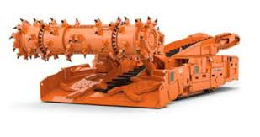
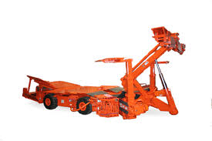
Lost Time Injury By Occupation
 | 2023 | 2024
Supervisor/Technical Personnel | 29 | 25
Mining Machine Operator | 26 | 19
Roof Bolter Operator | 62 | 80
Face Equipment Operator | 41 | 37
Maintenance Personnel | 33 | 42
General Laborer | 133 | 117
Outby Equipment Operator | 12 | 13
Surface Employee | 3 | 3
Tipple, Prep Plant Personnel | 2 | 0
All Others | 21 | 20

Slide 6
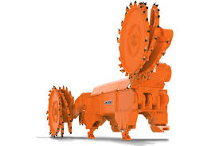
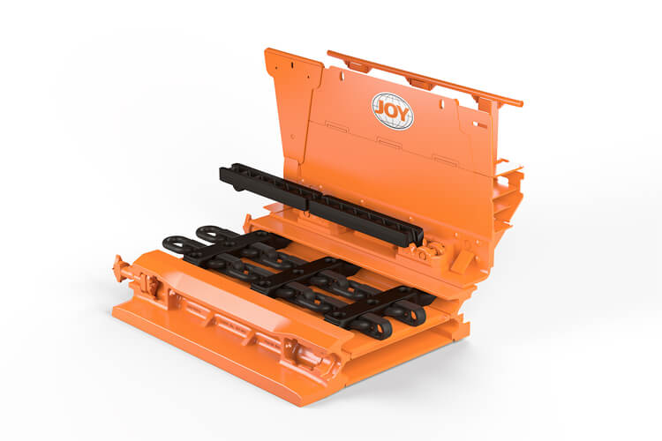
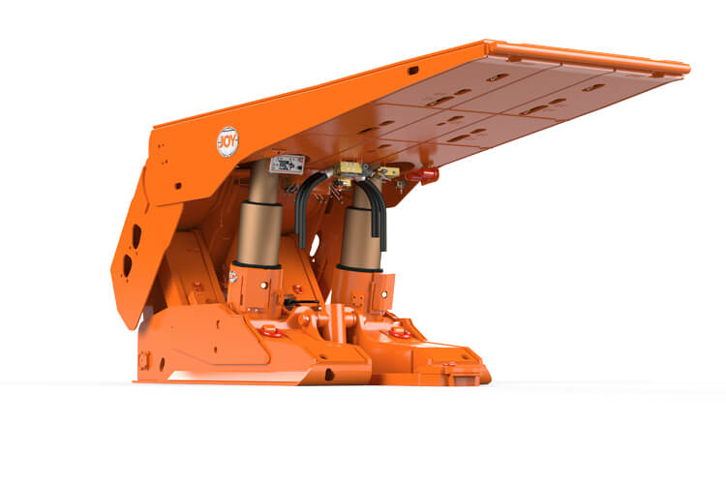
Lost-Time UG. Injuries by Mining Method
 | 2023 | 2024
Longwall | 98 | 122
Shortwall | 0 | 0
Undefined | 0 | 0
Continuous Miners With Remote | 237 | 211
Retreat Mining/Pillaring | 2 | 5
Continuous Haulage | 0 | 4
Multiple Methods | 2 | 0
Other Methods | 0 | 0

