Slide 1
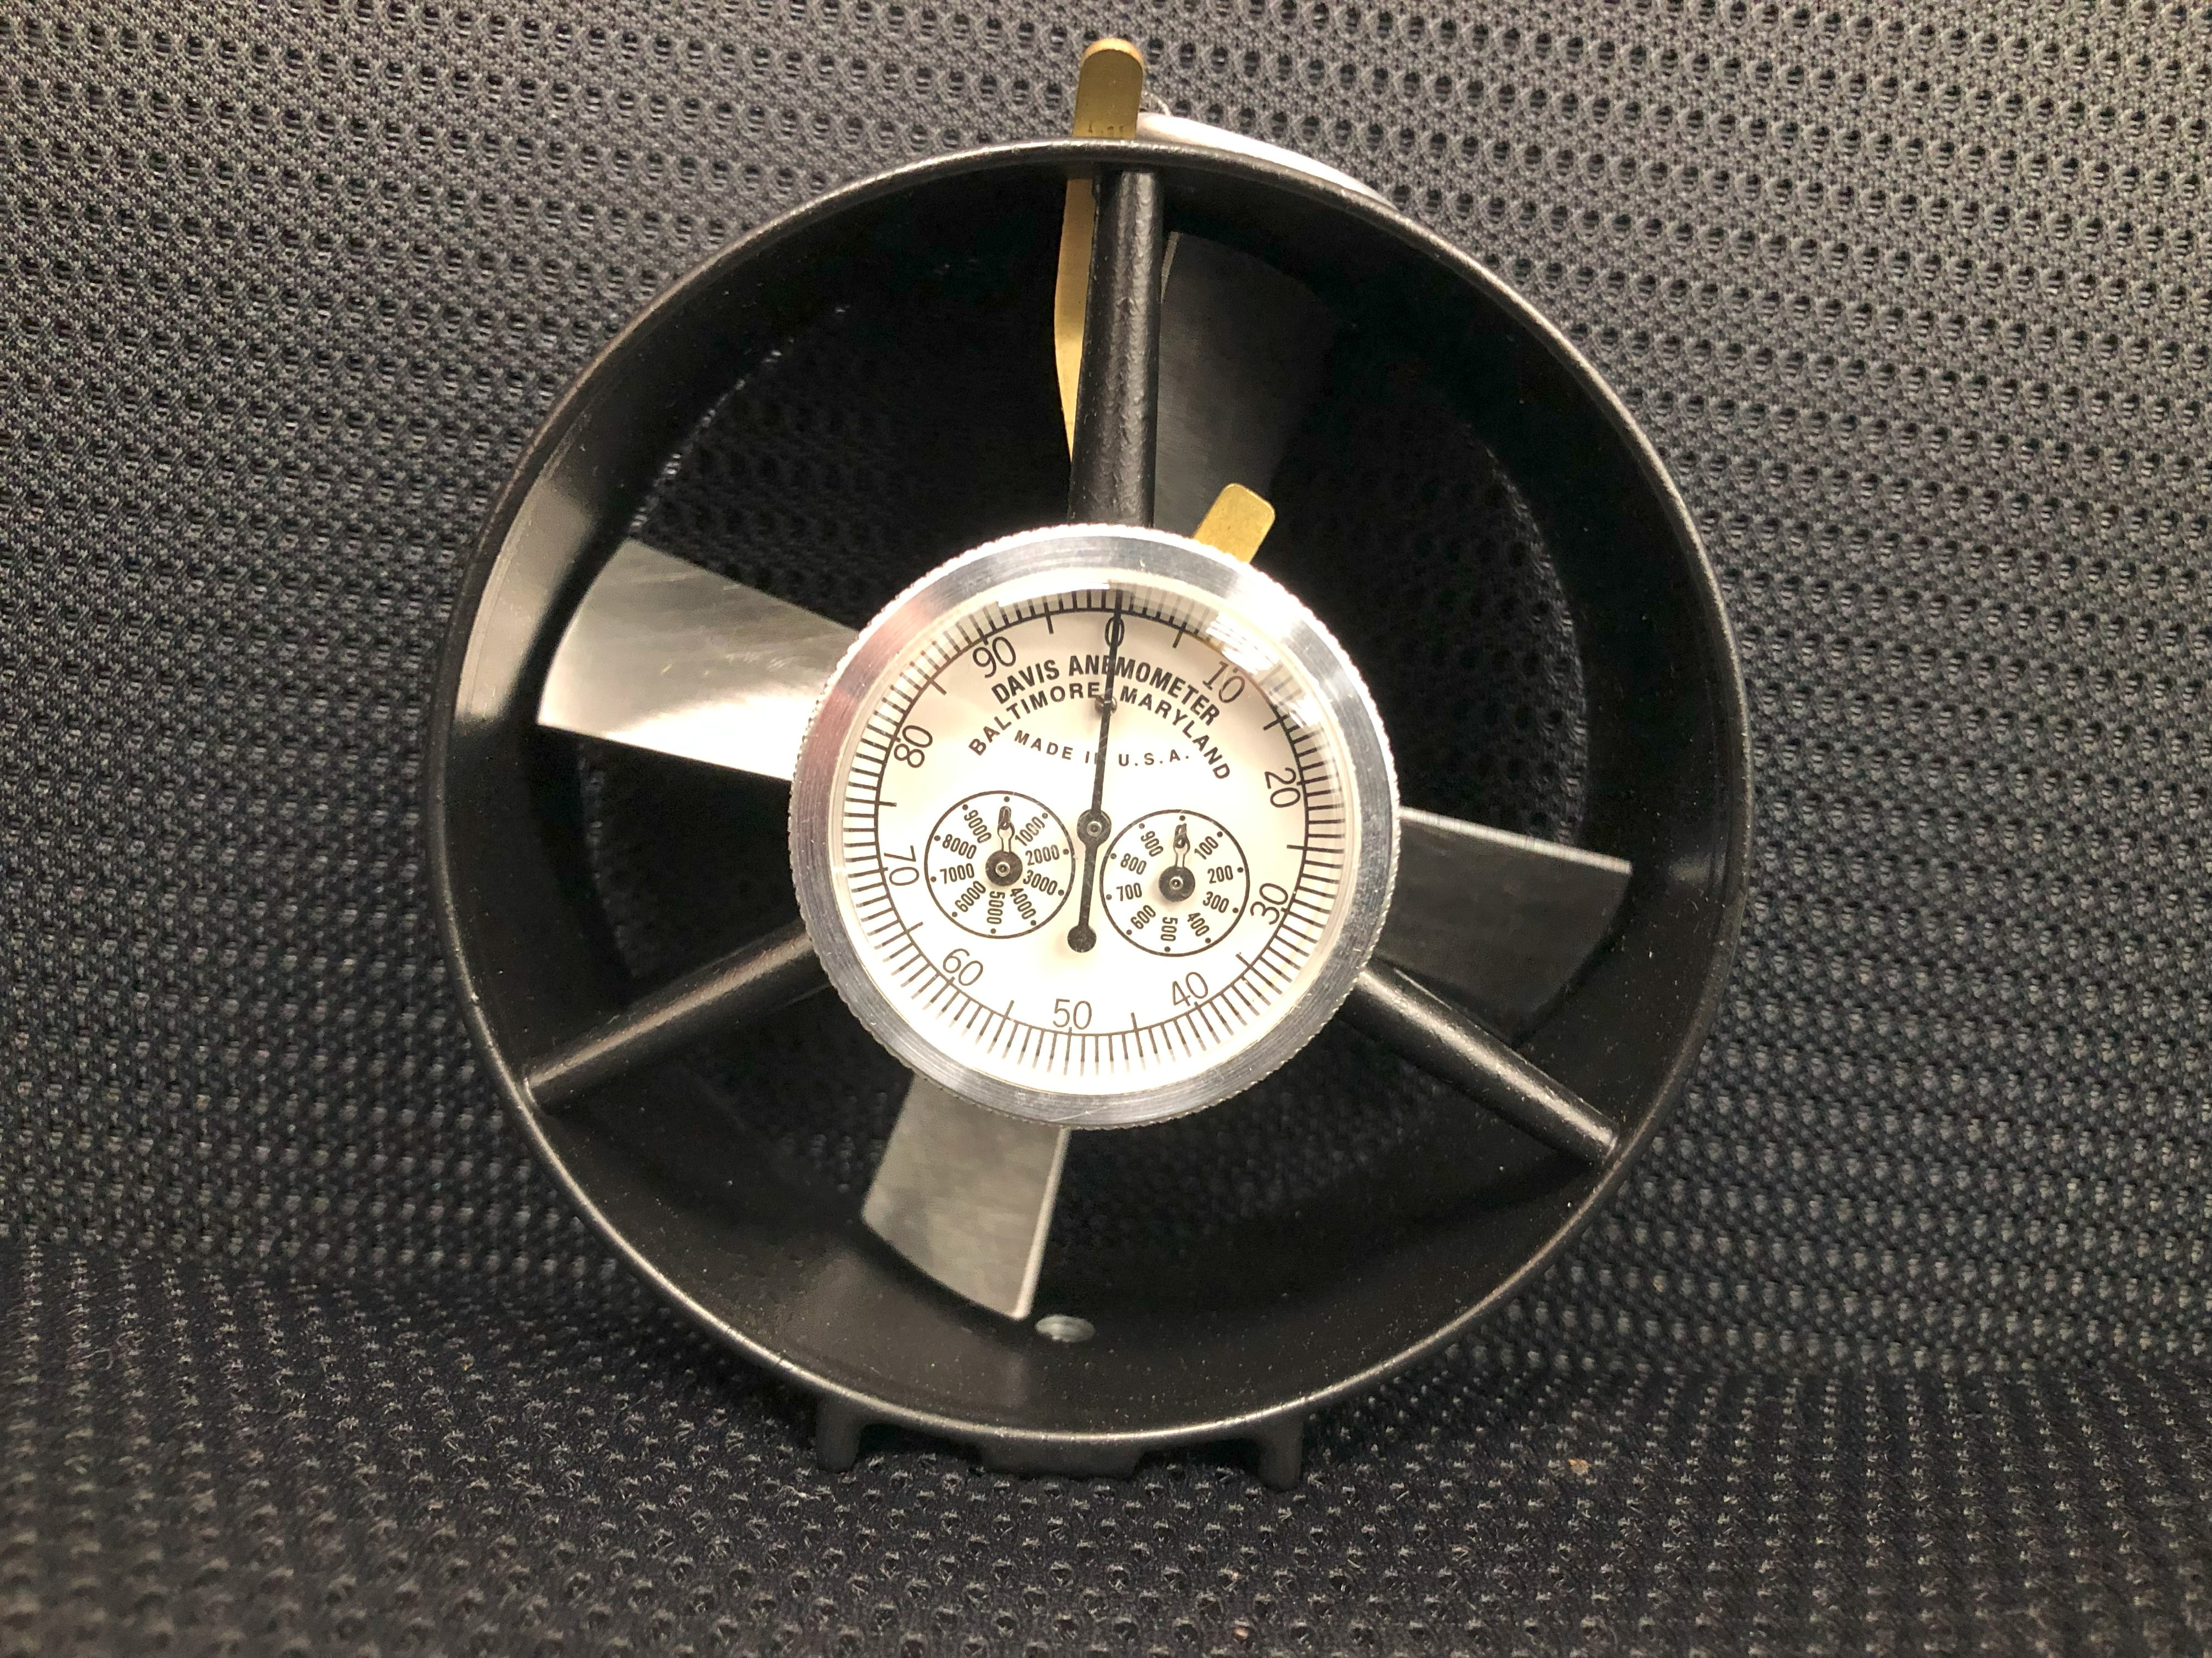
Anemometer Review
2026-2027 Continuing Education

Slide 2
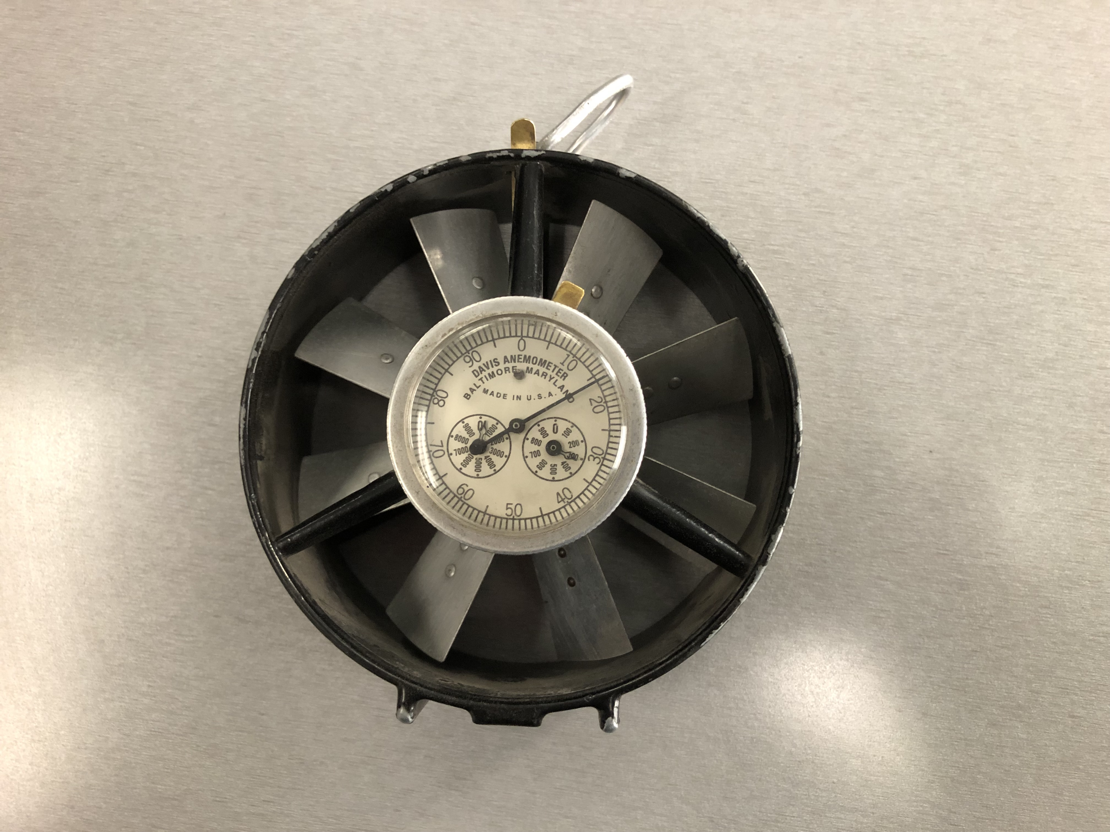
Anemometer Review
As foreman you must be proficient with an anemometer to successful obtain air readings.
This is a “low speed” anemometer. There are 8 blades with this Davis Anemometer.
This anemometer is primarily used on the section for air readings.
1,000 Dial
100’s
Dial

Slide 3
Anemometer Review
This is a “High Speed” anemometer. This type is use in high velocity areas such as regulators and fans.

Slide 4
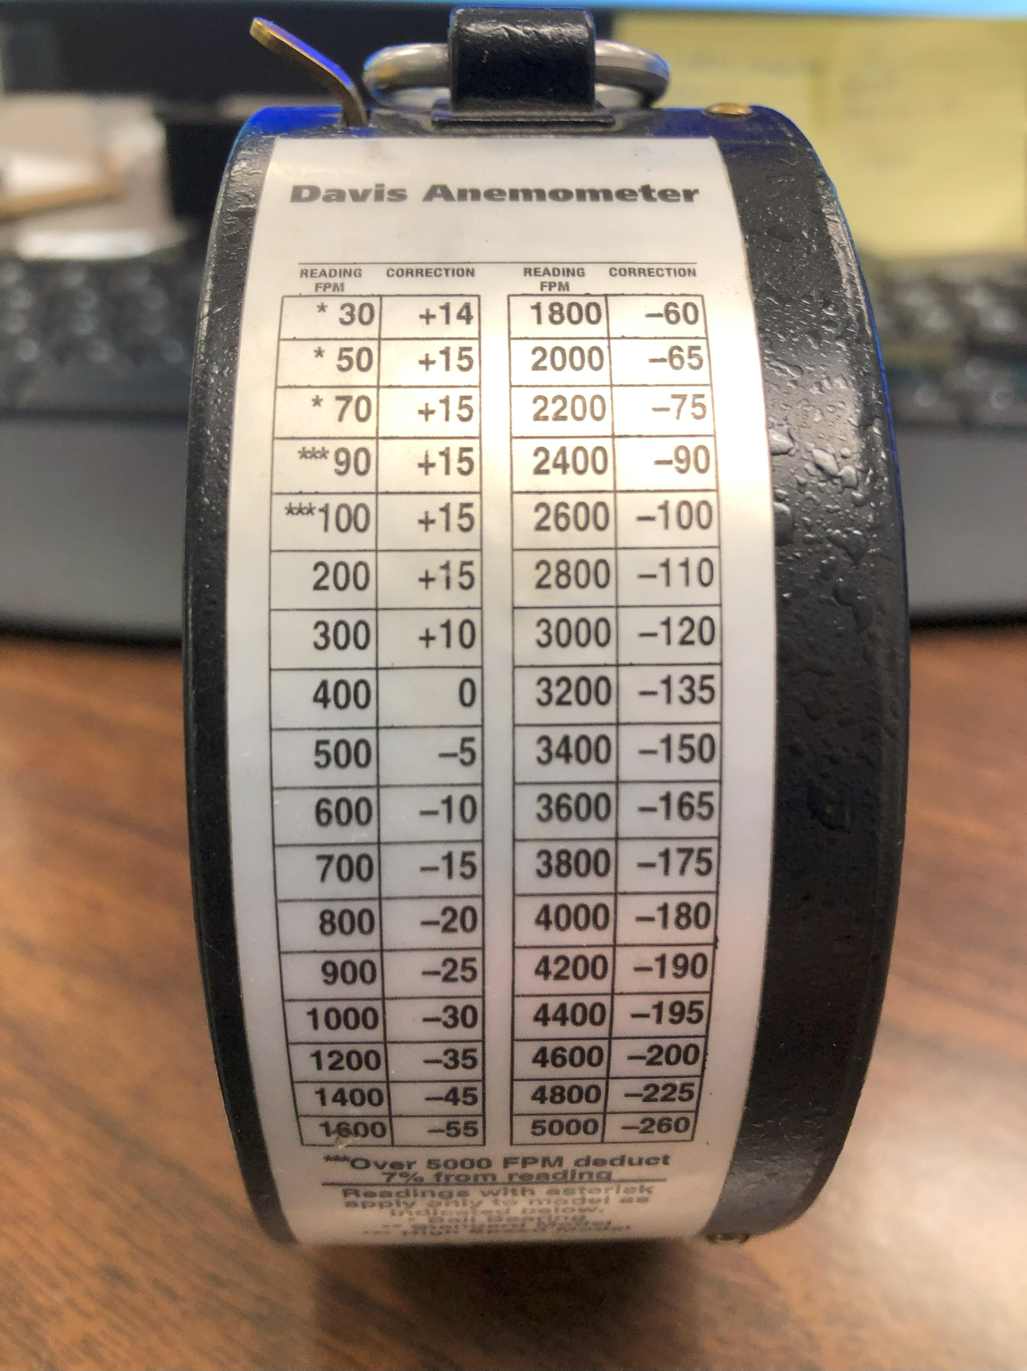
Anemometer Review
Each anemometer should have a correction chart plate on the side. You must factor this in when doing your air readings.

Slide 5
Anemometer Review
CFM = Cubic Feet Minute
FPM = Feet Per Minute
Ventilation Plans state the required minimum CFM
In order to get your CFM, you take your velocity (FPM) and multiply by your area in sq feet.
CFM = FPM * Area

Slide 6
Air Behind the curtain
Area = Height x Width
32 Sq ft = 8’ x 4’
8 feet Height
4 feet wide

Slide 7
Finding Velocity
When taking an accurate air reading, you will traverse the area in its entirety for 60 seconds.
Example:
You have successfully traversed the area behind the line curtain for 60 seconds. Your dial now shows 200.
You look at your correction chart and notice the correction chart has you apply +15 matched up to the 200 fpm. Add this to you overall reading. You now have a fpm of 215.
The formula is 215(fpm) x 32(area) = 6,880 CFM

Slide 8
MEAN Air Velocity
Wide Side
16 feet wide
AREA = 128
8 feet Height
6,880 CFM / 128 Area = 53.75 MEAN Air Average

Slide 9
Anemometer Review Tips
Make sure the anemometer is calibrated regularly
Check everyday for things that could obstruct your anemometer readings. Example; bent blades, broken dials, missing correction factors etc..
Make sure you are using the correct anemometer that is practical for the situation. Example don’t use a low speed on a high velocity regulator.
Understand your ventilation plan minimums

