Slide 1
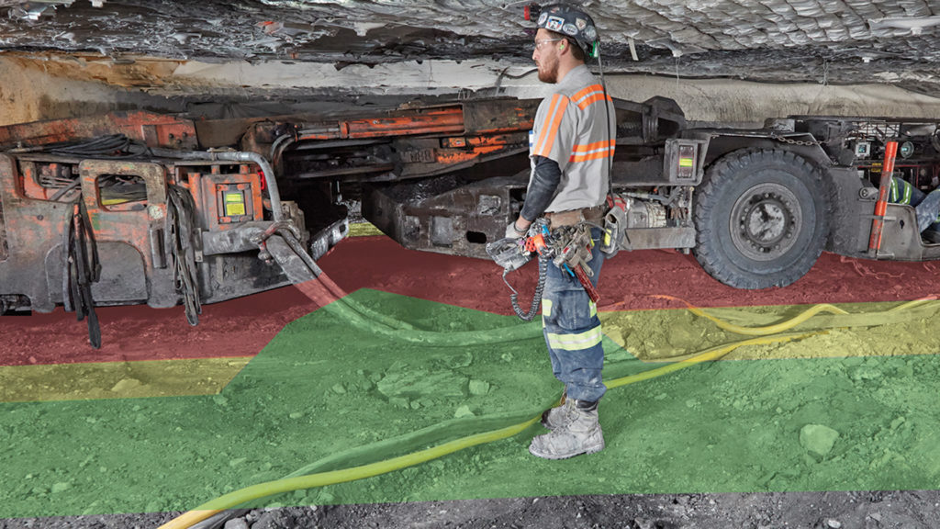
Proximity Training

Slide 2
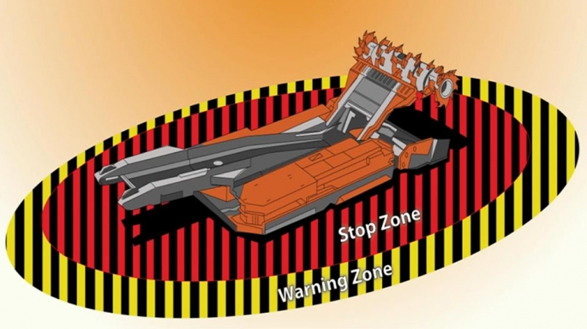
PROXIMITY
DETECTION
SYSTEMS

Slide 3
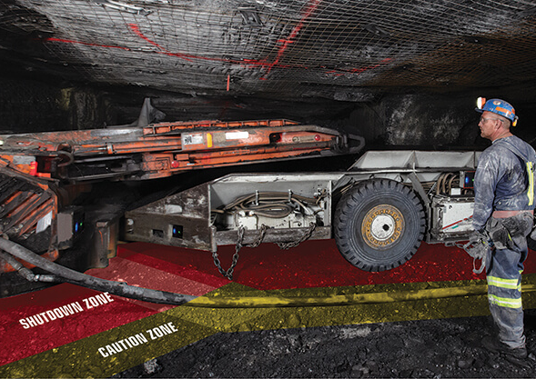
Proximity detection systems are safety measures used in mining operations to prevent collisions and accidents between mobile equipment and personnel. These systems use various technologies to detect the presence of people or vehicles near mobile equipment and trigger alerts or even stop the equipment if necessary.

Slide 4
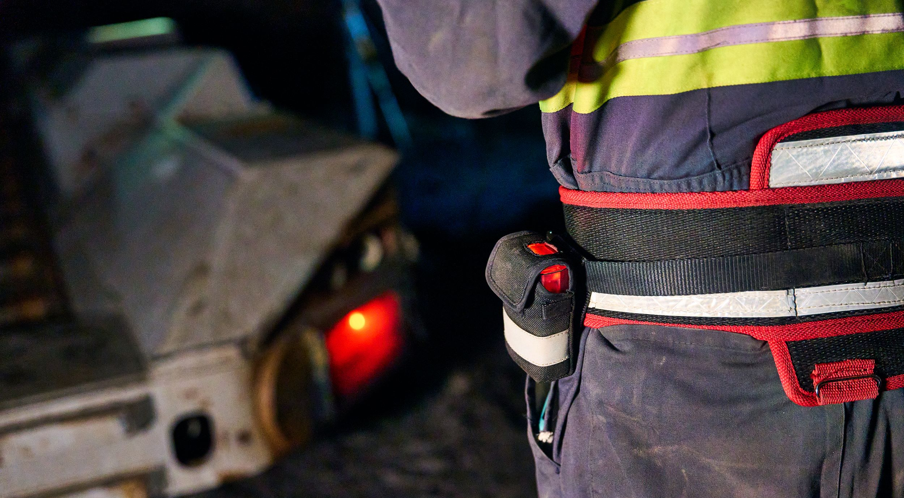
A proximity detection system includes machine –mounted components and miner-wearable components

Slide 5
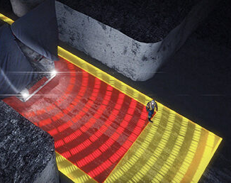
These systems must be capable of providing an audible and visual warning prior to safely shutting down mobile equipment and must be capable of stopping the mobile equipment before contacting a miner.

Slide 6
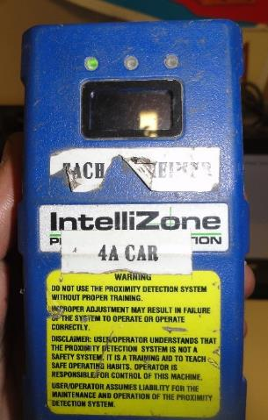
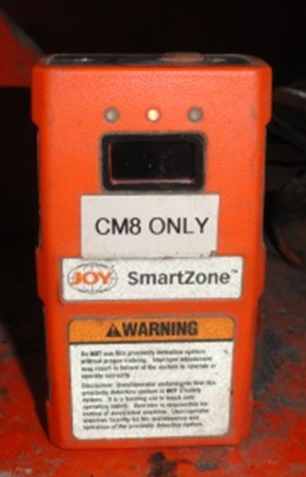
SAFETY CHECKS
Miner wearable components must be checked at the beginning of each shift.
DEFECTS MUST BE CORRECTED BEFORE USE!

Slide 7
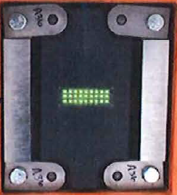
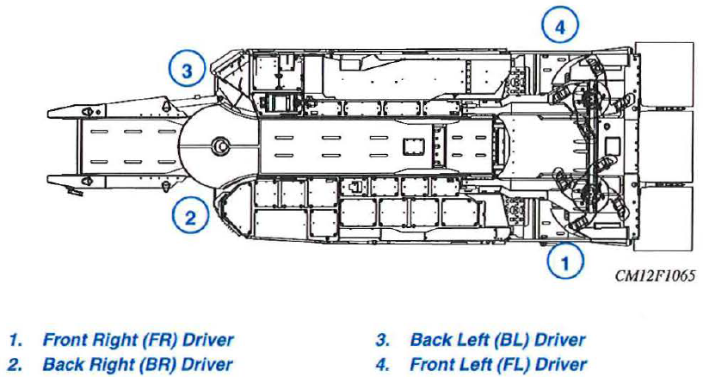
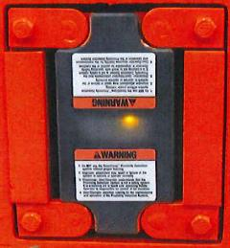
SAFETY CHECKS
Machine mounted components must be intact, checked for proper function and defects must be corrected before use.
Checked at the beginning of each shift the machine is to be used.
Checked Immediately prior to the machine being operated if the machine is not being used at the beginning of the shift.
Checked within one hour of a shift change if the shift change occurs without an interruption in production.

Slide 8
At the completion of the Machine-mounted components a certified person must certify by initials, date and time that the check was conducted.
Defects found including corrective actions and dates of corrective actions, must be recorded before the end of the shift.
Defects found including corrective actions and dates of corrective actions for miner-wearable components, must also be recorded before the end of the shift.
Maintain records for certified persons trained in the installation and maintenance of proximity detection systems.
All records maintained for one year.
RECORD
KEEPING

Slide 9
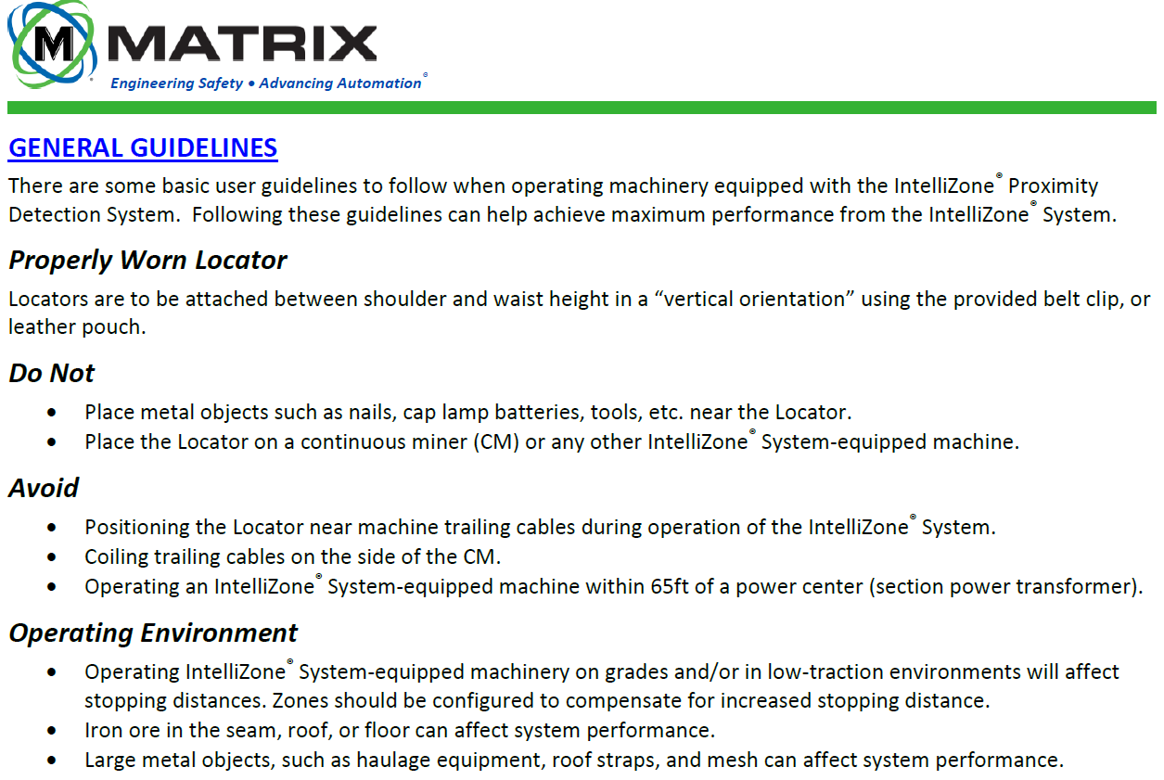
ALWAYS FOLLOW
MANUFACTURERS INSTRUCTIONS
(EXAMPLE)

Slide 10

Tampering or Attempted Tampering
The Director of WV Miners Health, Safety and Training shall impose all applicable penalties pursuant to WV Code 22A-1-21 on any person that, without the authorization of the operator or the Director or the Director’s authorized representative, knowingly tampers with a proximity detection system or related equipment approved by the Director.

Slide 11
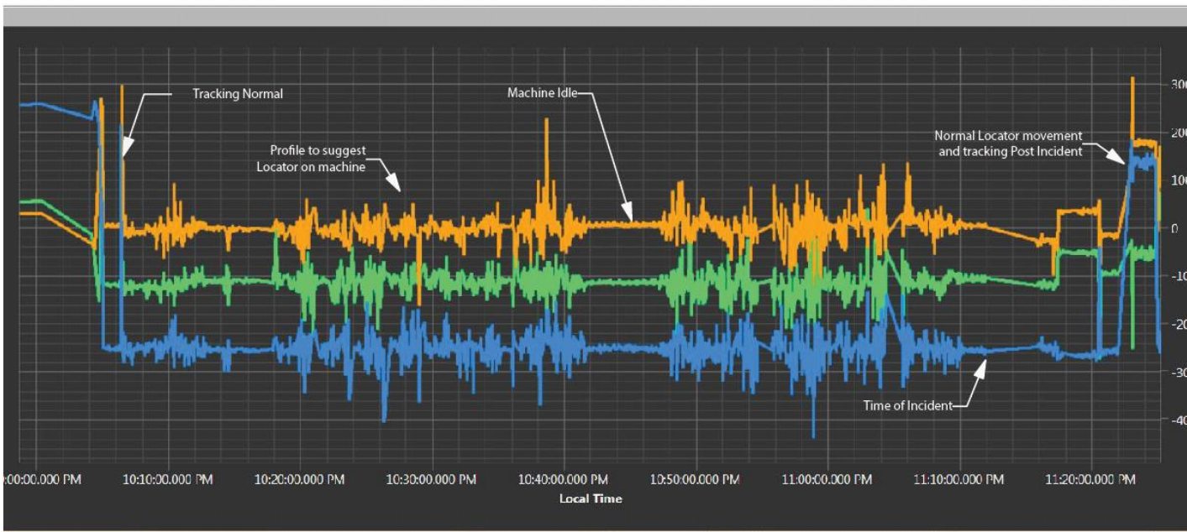
PROXIMITY DETECTION SYSTEM DATA
The Proximity Detection System operating status and all related information can be downloaded to a computer and the data then analyzed. This data once analyzed can help determine if the system was working correctly, if the miner was wearing the locator device or if it had been placed on the machine or some other location. USE THE SYSTEM PROPERLY!

Slide 12
Proximity Detection Systems
Please be advised that this is an overview of these systems and that you as a miner will learn more about these systems on the job. The Proximity Detection Systems are a great training tool. These systems train you on the proper positions to take when safely operating the machines that they are placed on. But this is not a replacement for common sense and good mining practices. Always be aware of your surroundings!

