Slide 1
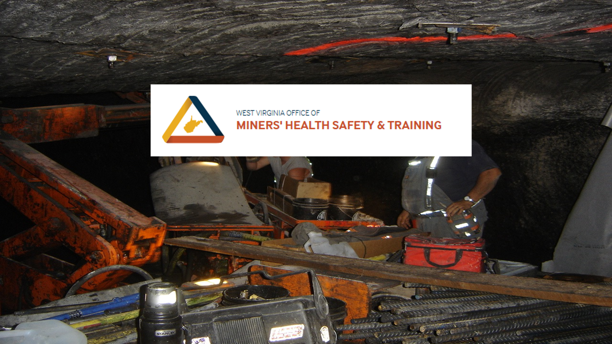

Slide 2
Responsible Person
Being a certified person can put a lot of responsibility on a person in performing their job. A certified person could find themselves being asked to serve as the Responsible Person at a mine along with their daily jobs. When that time comes, you as a certified Foreman must know what it takes to perform that duty and should never accept those duties unless you have had the proper training. The following set of slides will inform you on what is required to be a Responsible Person but does not take the place of Responsible Person training.

Slide 3
Responsible Person
While persons are underground, a
responsible person designated by the
operator shall always be at a surface
location where each main mine fan signal
can be seen or heard.

Slide 4

Responsible Persons
For each shift that miners work underground, there must be in attendance a responsible person designated by the mine operator to take charge during mine emergencies involving a fire, explosion, or gas or water inundation.

Slide 5
The Responsible Person shall
have current knowledge of:
Assigned location and expected movements of miners underground
Mine Ventilation System
Mine Monitoring System (If Used)
Locations of Firefighting Equipment
Mine Emergency Response Plan
Mine Rescue Notification Plan
Mine Emergency Evac and Firefighting Program of Instruction

Slide 6
Responsible Person
Mine Specific information a Responsible Person shall have knowledge about.
Emergency response Plan (ERP)
Emergency Notification Plan
Emergency Evacuation and Fire Fighting Plan
Mine Maps- with ventilation system and escapeway systems
Information or training materials for mine specific Atmospheric Monitoring System (AMS), if applicable
SCSR Storage Plan
Ventilation Plan
Any other site-specific plans, materials, and/or policies related to mine emergency preparedness and readiness training.

Slide 7
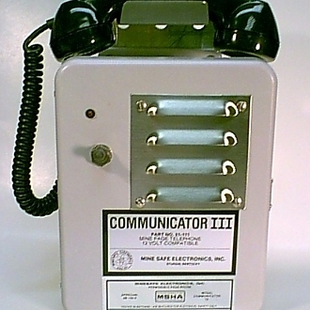
Immediate Notification
Immediate Notification means that a representative of the WV Office of Miner’s Health, Safety & Training and MSHA must be contacted within 15 minutes of the operator finding out that the situation exists.

Slide 8

List of Events that Require
Immediate Notification
Death of an individual at a mine.
Injury to an individual with a reasonable potential to result in death.
Entrapment of an individual for more than 30 minutes.
An unplanned inundation of a mine by a liquid or gas.

Slide 9
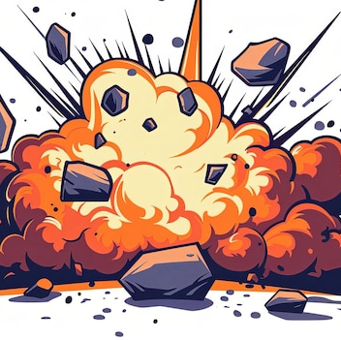
List of Events that Require
Immediate Notification
An unplanned ignition or explosion of a gas or dust.
An unplanned mine fire not extinguished within 5 minutes of ignition.
An unplanned ignition or explosion of a blasting agent or explosion.
An unplanned roof fall at or above the anchorage zone in active workings where roof bolts are used, or in active workings that impairs ventilation or impedes passage.

Slide 10
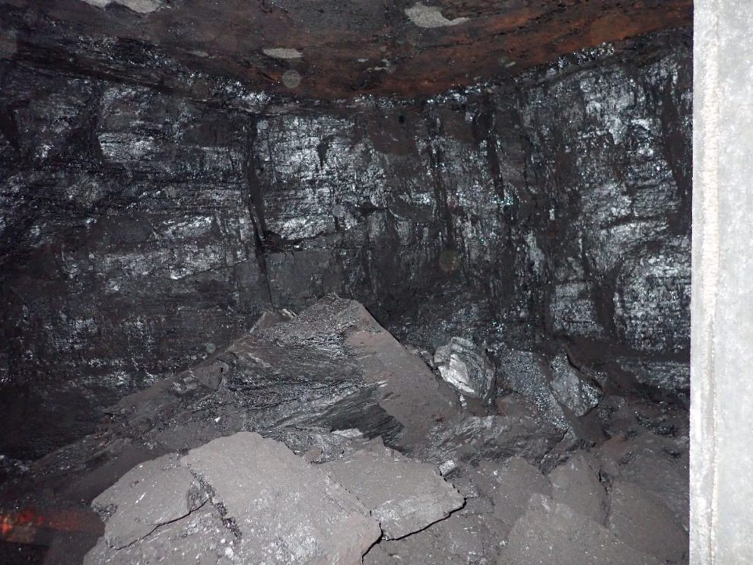
A coal or rock outburst that causes withdrawal of miners or which disrupts regular mining activity for more than one hour.
An unstable condition at an impoundment, refuse pile, or culm bank which requires emergency action in order to prevent failure or which causes individuals to evacuate an area, or failure of an impoundment, refuse pile or culm bank.
List of Events that Require
Immediate Notification

Slide 11
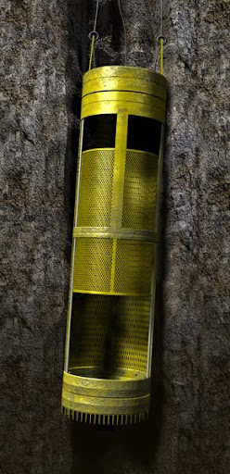
List of events that require
immediate notification
Damage to hoisting equipment in a shaft or slope which endangers an individual or interferes with use of the equipment for more than 30 minutes.
An event at a mine which causes death or bodily injury to an individual not at the mine at the time the event occurs.

Slide 12
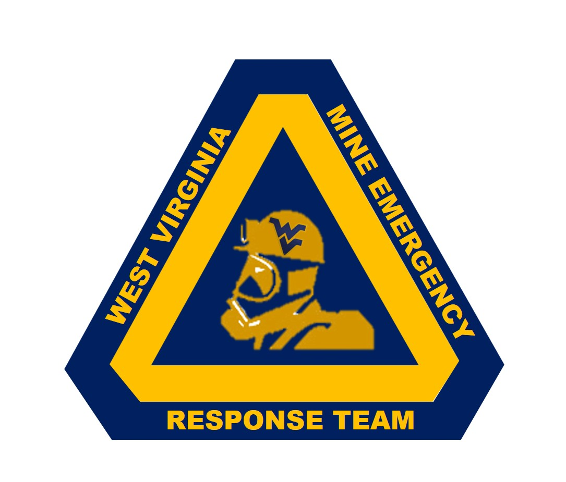
An up-to-date list of emergency contact numbers must be readily available and visible at specified locations. At a minimum, this list must include:
State 1-866-987-2338
MSHA 1-800-746-1553
Mine Management
Mine Rescue Teams
Numbers will be listed in your ERP Plans

Slide 13

The Operator shall certify by signature and date after each responsible person has completed the training and keep the certification at the mine for 1 year.

Slide 14
Responsible Person
The Responsible Person shall initiate and conduct an immediate mine evacuation when there is a mine emergency which presents an imminent danger to miners due to fire or explosion or gas or water inundation. Only properly trained and equipped persons essential to respond to the mine emergency may remain underground

Slide 15

Fan Stoppage Reminder
§22A-2-3. Fans.
(a) The ventilation of mines, the systems for which extend for more than 200 feet underground, and which are opened after the effective date of this article, shall be produced by a mechanically operated fan or mechanically operated fans. Ventilation by means of a furnace is prohibited in any mine. The fan or fans shall be kept in continuous operation, unless written permission to do otherwise be granted by the director. In case of interruption to a ventilating fan or its machinery whereby the ventilation of the mine is interrupted, immediate action shall be taken by the mine operator or the operator’s management personnel, in all mines, to cut off the power and withdraw the men from the face regions or other areas of the mine affected. If ventilation is restored in 15 minutes, the face regions and other places in the affected areas where gas (methane) is likely to accumulate, shall be reexamined by a certified person; and if found free of explosive gas, power may be restored and work resumed. If ventilation is not restored in 15 minutes, all underground employees shall be removed from the mine, all power shall be cut off in a timely manner, and the underground employees shall not return until ventilation is restored and the mine examined by certified persons, mine examiners, or other persons holding a certificate to make pre-shift examination. If ventilation is restored to the mine before miner search the surface, the miners may return to underground working areas only after an examination of the areas is made by a certified person and the areas are determined to be safe.

Slide 16

Responsible Person
The mine operator shall instruct all miners of the identity of the Responsible Person designated by the operator for their work shift. The mine operator shall instruct miners of any change in the identity of the Responsible Person before the start of their work shift

Slide 17
Responsible Person List
(Example)
RESPONSIBLE PERSON TITLE ONLY
DAY SHIFT SUPERINTENDENT
DAY SHIFT BACKUP MINE FOREMAN
EVENING SHIFT SHIFT FOREMAN
EVENING SHIFT BACKUP DISPATCHER
MIDNIGHT SHIFT SHIFT FOREMAN
MIDNIGHT SHIFT DISPATCHER

Slide 18
Responsible Person Change
(Example)
If there are any changes in the Responsible Person, then mine management will notify the underground miners through posting on the bulletin boards and through direct contact with shift meetings. If the Responsible Person must leave during the shift, miners underground will be notified by mine phone or direct communication that the identity of the Responsible Person has changed.
A list of Responsible Persons will be maintained at the office on the bulletin board. All miners will be notified of any changes before entering the mine.

Slide 19
Responsible Person
Best Practices
Make sure your responsible persons have the proper training
MSHA required training
Responsible persons should attend Mine Rescue Mock Emergency Response Drills (MERD) training exercises for hands on training. These exercises are held annually by the Mine Rescue team providing coverage for your mine.
Take part in all Fire Drills conducted at the mine.

Slide 20
Responsible Person
The next two slides are the only places in the WV law that a responsible person is talked about. The requirements of a Responsible Person required by MSHA require annual retraining and a record that that training be kept for one year at the mine site. That training does not follow you to another mine because parts of the training is mine specific.

Slide 21
Responsible Person/Dispatcher
The dispatcher’s only duty shall be to direct traffic: Provided, That the dispatcher’s duties may also include those of the responsible person required by §22A-2-42 of this code: Provided, however, That the dispatcher may perform other duties which do not interfere with his or her dispatching responsibilities and do not require him or her to leave the dispatcher’s station except as approved by the Mine Safety and Technical Review Committee.

Slide 22
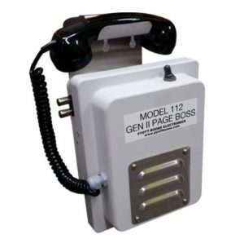
A telephone or equivalent two-way communication facility shall be located on the surface within five hundred feet of all main portals and shall be installed either in a building or in a box-like structure designed to protect the facilities from damage by inclement weather. At least one of these communication facilities shall be at a location where a Responsible Person who is always on duty when miners are underground can hear the facility and respond immediately in the event of an emergency. “Two-way communication facility” shall mean a system maintained to allow voice contact to come in and out of the working section at all times.

