Slide 1
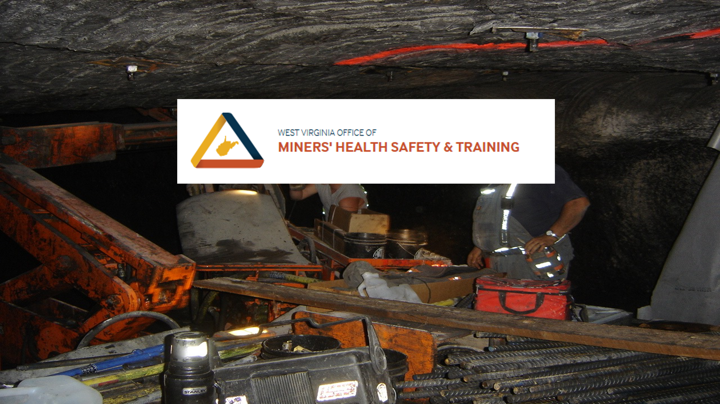
2023-2024 Fatal Review UGMF Con-Ed 26-27

Slide 2
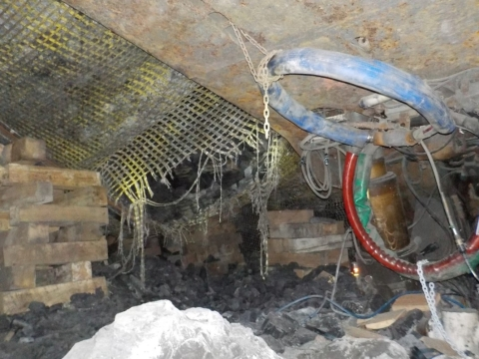
ILLINOIS COAL MINE FATALITY – On March 18, 2023, a miner died when the mine roof collapsed during the installation of standing roof support (crib) as part of the longwall recovery cycle. The accident occurred in an area adjacent to a longwall shield.
Best Practices
Follow the approved Roof Control Plan.
Design, install, and maintain roof support where miners work or travel.
Never travel or work under unsupported roof.
Conduct a visual examination of the roof, face, and ribs immediately before starting work in an area.
Be alert to changing roof conditions, especially during longwall recovery.

Slide 3

OVERVIEW
On March 18, 2023, at approximately 2:05 a.m., a 41-year-old roof bolter operator with over eight years of mining experience, died when a section of roof fell while he and others were building cribs (roof support) during the recovery of longwall shields.

Slide 4
DESCRIPTION OF THE ACCIDENT
On March 17, 2023, The victim arrived at Mine No. 1 along with other members of the longwall recovery crew (Crew) to begin work on the third shift, starting at 11:00 p.m. Mine Manager, assigned the Crew to work on the longwall recovery. The Crew traveled underground with the Longwall Foreman, and arrived at the 6 Right longwall face at 11:34 p.m. The Crew took over work duties from the second shift crew, recovering the longwall on the Headgate side. The Crew pulled shield 64 out and installed cribs to support the mine roof. The Crew repeated the process with shields 63 and 62. The Mule Operator, pulled shield 61 out of place and positioned it in front of shields 55 through 58 to prepare it for transport from the face area. After shield 61 was pulled out of place, The victim, the Ventilation Tube Man, and the Shieldman, observed a six-inch to ten-inch hole in the roof mesh near the end of a four-inch I-beam. Based on interviews, investigators determined the victim told the vent man not to stand under the hole in the mesh. The victim, and some of the crew with a Longwall Outby man, entered the “pit” (the area between the walking shield, shield 60, and the gob) to start installing cribs. A walking shield is a single longwall shield specially positioned parallel to the longwall face and dedicated to aiding in supporting the recovery room roof during the longwall recovery process. A walking shield advances toward the head gate as each subsequent longwall shield (shield) is removed from the face.

Slide 5
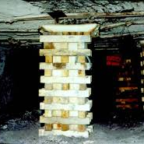
Miners stated they typically install three cribs simultaneously after they remove the shield.
Miners were intending to build one crib near the gob next to shield 60 and two cribs towards the walking shield, underneath a four-inch I-beam. Two men were working in the pit area, installing a crib away from shield 60, near the gob. The vent man was handing crib blocks to the victim. The victim was working in the pit area, handing crib blocks to two men building the crib. The victim was positioned near the hole in the roof mesh close to the end of an I-beam, near the crib the two men were building. At approximately 2:05 a.m. on March 18, 2023, loose rock in the mine roof directly above the six-inch to ten-inch hole in the roof mesh fell and covered the victim. The falling rock tore the roof mesh and made the hole in the roof mesh larger. The rock fall covered the feet of one miner who was building the crib, trapping him. The rock fall struck the other miner, but he was not injured.

Slide 6
Location of the Accident
The accident occurred at crosscut ten of the headgate entries, on the 6 Right District 3 Panel 10 teardown face of the longwall (see Appendix B). Miners were working adjacent to shield 60, between the walking shield, and the gob. The hole in the roof mesh was located where shield 61 had been located (see Appendix C). The rock fall was located approximately 21 feet from the face, three and a half feet from shield 60, and nine feet from the walking shield.

Slide 7
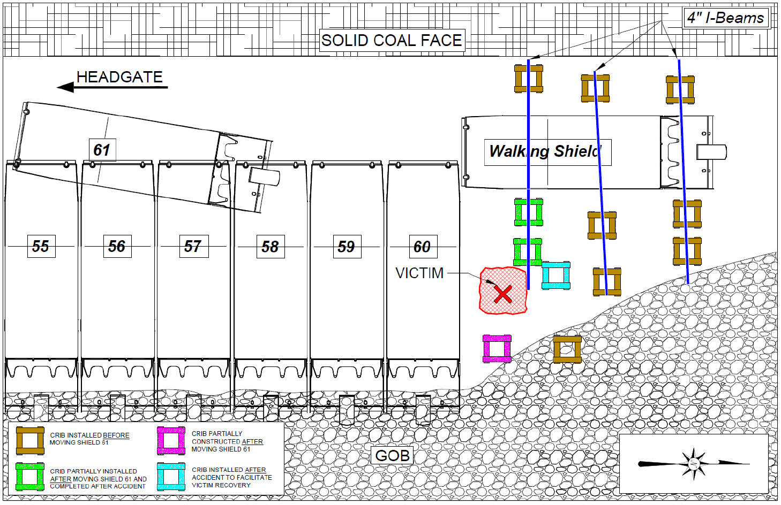
Appendix A

Slide 8
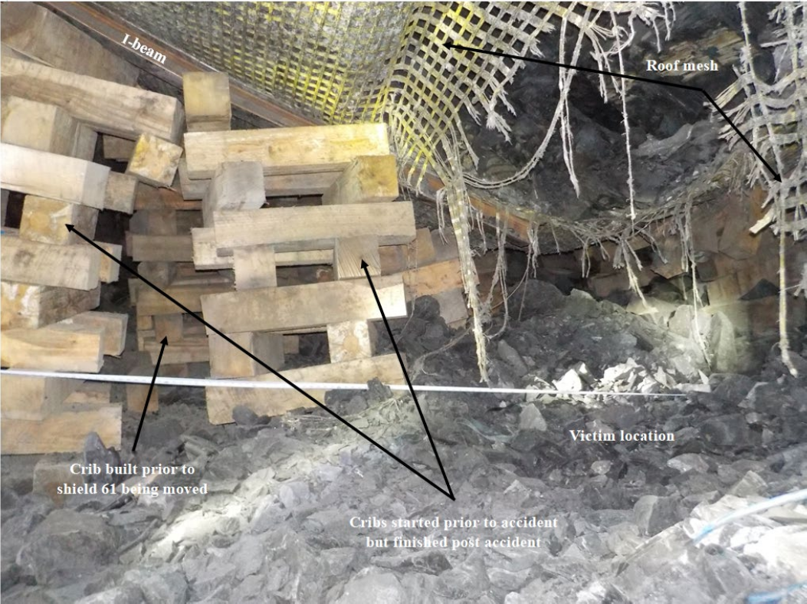
Appendix B

Slide 9
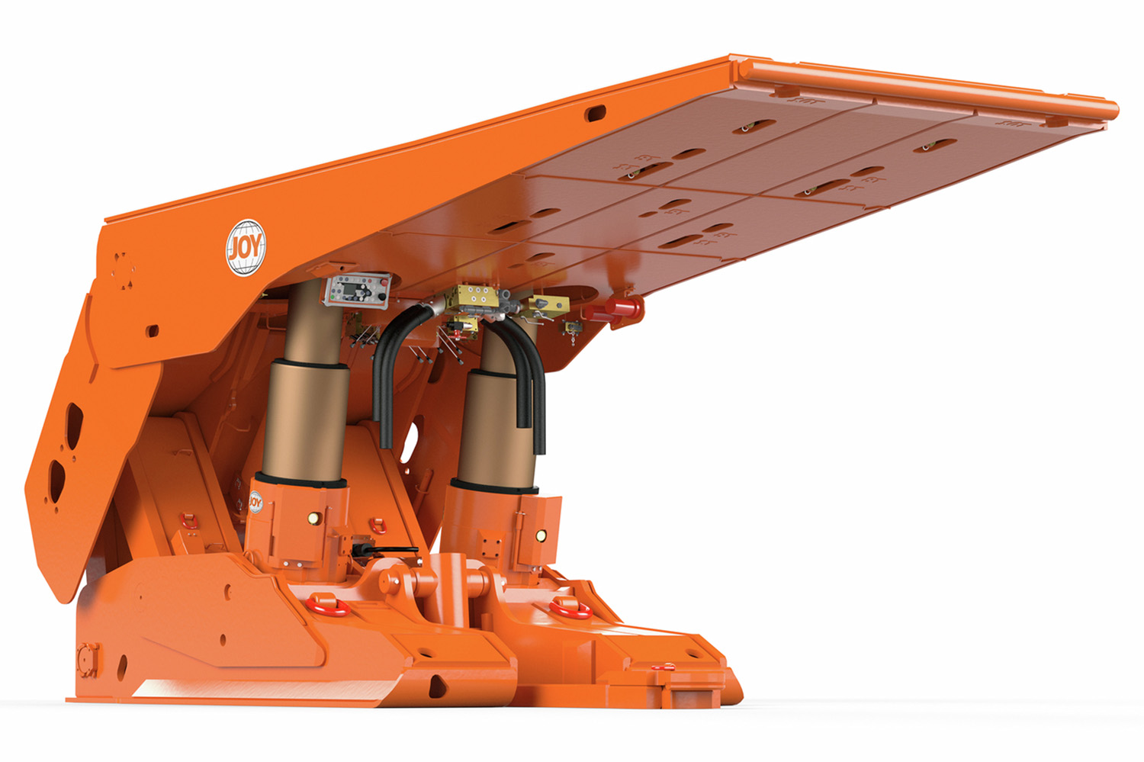
Longwall Recovery
The longwall face support system consisted of 210 two-legged shields manufactured by
Komatsu. The shields are 78.1 inches wide and rated at 1,310-ton support capacity. Longwall
crews had completed mining in the current panel and started the process of recovering shields on March 13, 2023.
The mine operator was using a shield recovery method that involved recovering shields from
each direction beginning near mid-face. The mine operator started at shield 99 and worked in
both directions. One group of miners worked from the headgate side while another group of
miners worked from the tailgate side.
The mine operator uses one walking shield in the headgate side of the recovery area during
shield removal. The Crew advances the walking shield parallel with the longwall face as another
longwall shield is removed. Prior to removing the next shield, miners were installing cribs, floor
to roof, and a steel four-inch I-beam against the roof to support the roof mesh and facilitate the
installation of cribs in the area. This was done to support the mine roof so the next shield could
be removed.

Slide 10
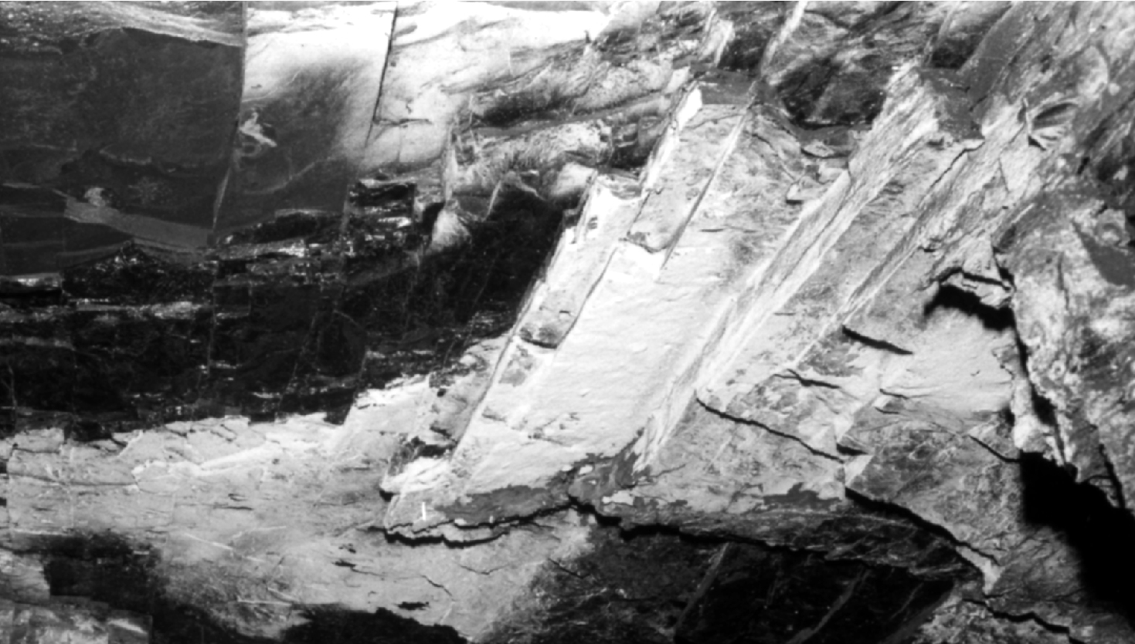
Geology
The immediate roof (layer of roof immediately above the mined area) in the fall area is comprised of Energy ‘gray’ shale that varies in thickness from zero to four feet, five inches and Anna ‘black’ shale that varies in thickness from zero to three feet, three inches. The Energy and Anna shales are inherently weak and difficult ground to support. A layer of Brereton Limestone that varies in thickness from one foot, four inches to six feet, five inches is located above the shale. The average mining height is eight feet, ten inches and the average cover over the coal seam is 950 feet.

Slide 11
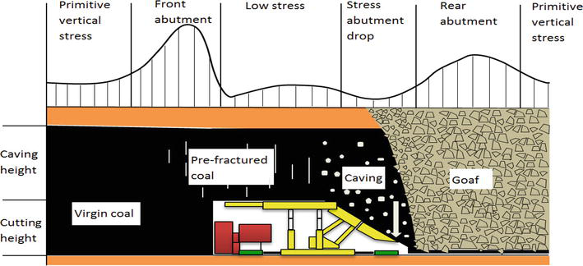
Longwall mining creates abutment loads from the extracted area which increase the stress on the face during the mining process and in the area where longwall equipment recovery occurs. As each shield is recovered, the roof it had been supporting can cave into the active work area. Wide sections of synthetic roof mesh are installed above the shields to provide roof support and help control the loose roof rock. The mesh is bolted to the roof on the solid coal side of the longwall face and held against the roof by the remaining pressurized shields on the gob side. Each recovered shield is also replaced with two to three cribs. The cribs also serve to keep the mesh held tightly against the roof. The miners constructing the cribs rely on the walking shield, the closest remaining pressurized shield, the previously installed cribs, and the roof mesh all to control the roof while they are working in this area.

Slide 12
The rock that fell through the mesh created a void in the mine roof that was measured to be approximately four feet in diameter and four feet high. Investigators calculated the fallen rock to weigh approximately five tons.
The mine operator installed polyurethane grout into the mine roof in the longwall area on the day shift and second shift of March 12, 2023, to consolidate loose rock strata. The grout is injected into the mine roof where it expands and sets to consolidate and seal broken rock. Twenty-one holes were drilled, and three tons of grout was injected into the mine roof to stabilize the area over shields 53 through 83.

Slide 13
Roof Control Plan and Support
The mine operator installed two rows of primary roof bolts as permanent roof support in the mine roof next to the longwall face. The mine operator also installed rib bolts in the solid coal face. The mine operator installed roof mesh, manufactured by Huesker Minegrid, in the accident location prior to the recovery, as the longwall completed mining to provide skin control roof support. The 46-foot-long roof mesh extended from the mine floor, up the coal face rib, along the mine roof, behind the shields that the mine operator was recovering, and into the gob. The high strength polyester fabric roof mesh is installed to protect miners when the powered roof support is pulled away for transport. The mesh over the shields is intended to hold the gob rubble and loose rock out of the work area.
Huesker Minegrid 400/300 – 3/4S roof mesh was installed to cover the mine roof prior to the accident occurring to prevent rock intrusion. The mesh has a minimum ultimate tensile strength of 23,365 pound/foot, which exceeded the requirements of the Roof Control Plan. The hole in the roof mesh was near the end of an I-beam that had been pressed against the mine roof by shield 61 prior to the removal of that shield. Miners stated the roof mesh can be damaged when installing the I-beam.

Slide 14
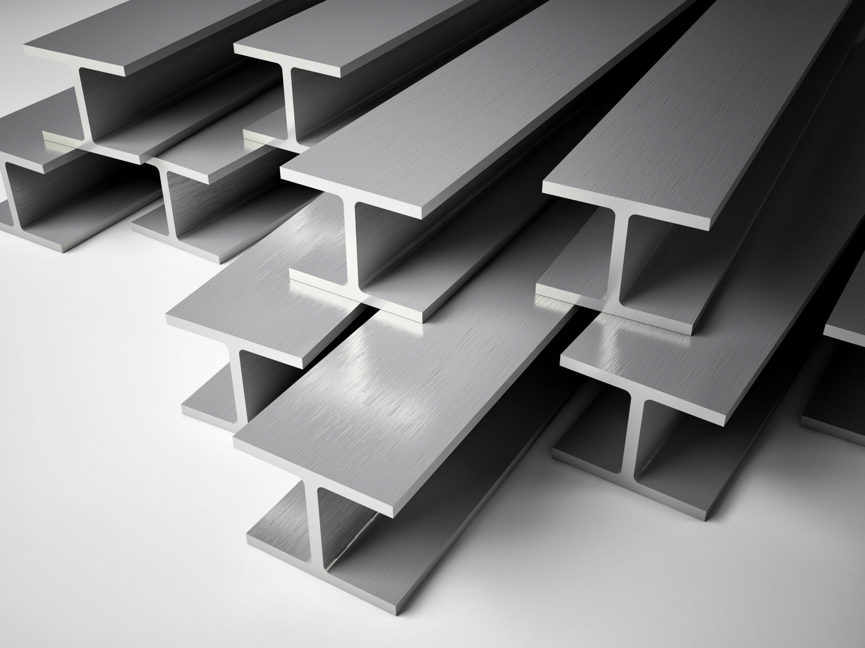
Miners were installing four-inch steel I-beams as the mine operator thought they were needed, based on mine roof conditions. Miners installed one I-beam per shield where the accident
occurred. Miners placed the steel I-beam on top of the shield and against the mine roof prior to shield removal. As the walking shield advanced under the I-beam, miners constructed wooden
cribs underneath each end of the I-beam to support it. The I-beams located in the accident area were pre-installed during the previous shift.
Miners were installing wooden cribs by hand when the accident occurred. The wooden cribs were built using wood blocks that were six inches wide by six inches tall by 30 inches long. Miners were passing wood blocks to each other and constructing square cribs. The crib installation began by miners placing two wood blocks in parallel with a space between them on the mine floor. Miners would stack two more parallel wood blocks perpendicular to and on top of the previous blocks. They repeated this stacking process until the stacked assembly of wood blocks (a wooden crib) provided support between the mine floor and mine roof. Investigators determined that miners were constructing the three cribs closest to shield 60 simultaneously, but none had been completed when the accident occurred. Miners interviewed stated that they installed additional cribs to support the mine roof as miners worked to recover the victim.

Slide 15
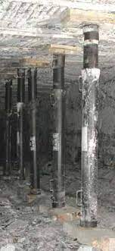
The mine operator’s approved Roof Control Plan states, “The installation of the cribs/posts shall be done from the shields, permanently supported roof or from the previously installed temporary support. If necessary, simplex-type jacks may be set to provide personnel temporary roof support during crib/post installation.” Based on interviews, investigators determined that simplex-type jacks were not being set to provide personnel temporary roof support during crib installation. Miners also stated that they did not provide additional support or take additional measures to address the hole in the roof mesh. The mine operator did not ensure the mine roof was adequately supported around the damaged roof mesh to protect miners from the hazards of falling rock.

Slide 16
Additionally, miners were installing cribs away from under the support of the shields,
permanently supported roof, or from previously installed temporary supports (cribs/posts). The
mine operator stated they interpreted their approved Roof Control Plan to mean miners could
work up to five feet away from a shield, permanently supported roof, I-beams, or from
previously installed cribs and posts as they installed new crib sets. According to interviews with
miners and mine management, the normal longwall recovery practice on this shift was for
multiple miners to enter the pit area, under unsupported roof, to build multiple cribs
simultaneously. Mine management instructed miners to build cribs simultaneously, rather than
sequentially, from the shields or other roof support. The investigators determined that the hazardous conditions of the damaged roof mesh and loose rock in the mine roof, the roof not adequately supported to protect miners from hazards of falling rock, and the mine operator not following the approved Roof Control Plan contributed to the accident.

Slide 17
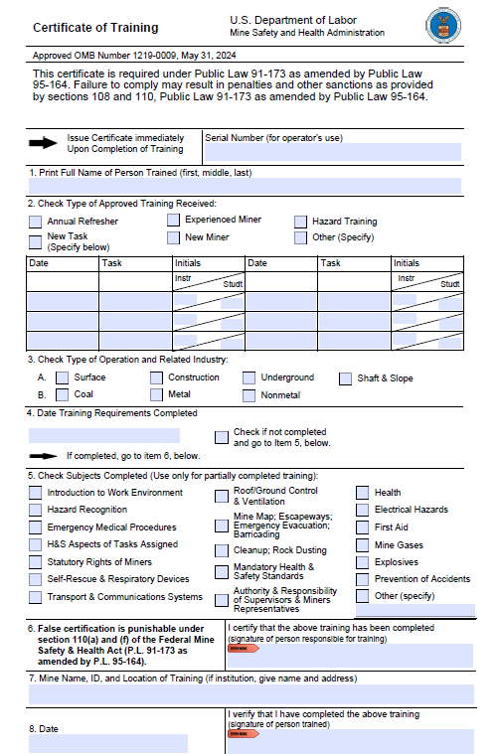
Training and Experience
The victim had over eight years of mining experience with approximately one and a half years at Mine No. 1. The Mine Safety and Health Training Specialist, reviewed the victims training records. This was the victims third longwall recovery at Mine No. 1, and he performed the same work activities during the other two recoveries. The victim received task training on the longwall recovery process, and inspectors previously observed miners installing one crib at a time while protected by roof support. Investigators determined that training was adequate; however, the mine operator instructed multiple miners to enter the pit area, while not protected by roof support, to build multiple cribs simultaneously.

Slide 18
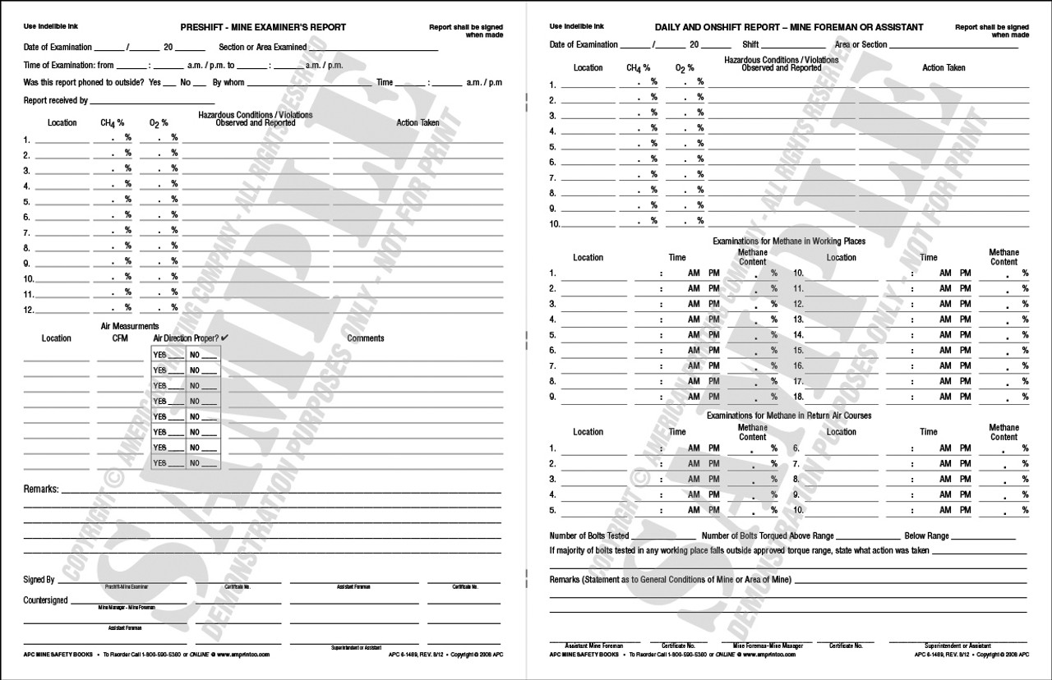
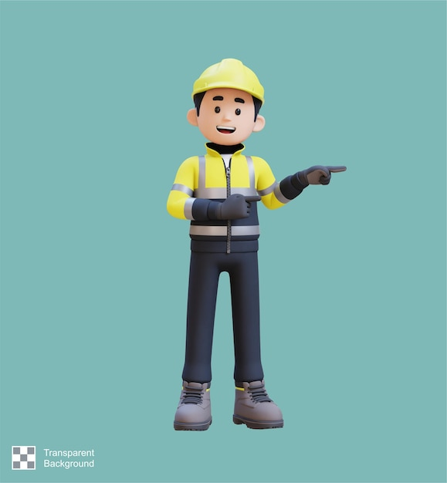
Examinations
A pre-shift examination was conducted by the mine Examiner, on the second shift on March 17, 2023, and no hazards were recorded. Shield 61 was in place at the time of the pre-shift examination. The hoot owl Longwall Foreman conducted an on-shift examination on the third shift at 12:00 a.m. and 2:00 a.m. on March 18, 2023, and he did not record any hazards. Shield 61 had not yet been removed at that time.
When miners removed shield 61 minutes before the accident, they observed a hole in the roof mesh. The mine operator did not correct the hazardous roof condition before miners worked in the affected area. Investigators determined this contributed to the accident.

Slide 19
ROOT CAUSE ANALYSIS
The accident investigation team conducted an analysis to identify the underlying causes of the accident. The team identified the following root causes, and the mine operator implemented the corresponding corrective actions to prevent a recurrence.
1. Root Cause: The mine operator did not ensure that miners followed the approved Roof
Control Plan.
Corrective Action: The mine operator developed and implemented revised safety procedures in the Roof Control Plan for longwall recovery. Revisions included a certified mine foreman dedicated to the shield recovery area during shield removal and standing support installation, a certified mine foreman to inspect and identify any roof mesh damage immediately after shield removal and prior to the installation of any floor to roof support, and cribs/posts will be built in sequence beginning from the walking shield. Miners were trained on the revised Roof Control Plan.

Slide 20
2. Root Cause: The mine operator did not ensure the roof was adequately supported to protect
miners from hazards of falling rock.
Corrective Action: The mine operator developed and implemented revised safety procedures
in the Roof Control Plan for longwall recovery. Revisions included support for the longwall recovery area by incorporating higher tensile strength roof mesh, a certified mine foreman dedicated to the shield recovery area during shield removal and standing support installation, a certified mine foreman to inspect and identify any roof mesh damage immediately after shield removal and prior to the installation of any floor to roof support, and cribs/posts will be built in sequence beginning from the walking shield. Miners were trained on the revised Roof Control Plan.

Slide 21
3. Root Cause: The mine operator did not correct the hazardous roof condition before miners
worked or traveled in the area.
Corrective Action: The mine operator revised the Roof Control Plan to require a certified
mine foreman, who is trained and familiar with longwall equipment recovery procedures, will be dedicated to the shield recovery area during shield removal and standing support installation. This person will be responsible to inspect and identify any roof mesh damage immediately after shield removal and prior to the installation of any floor to roof support. The certified mine foreman will ensure that the installation of the cribs/posts shall be done from the shields, permanently supported roof, or from previously installed temporary supports, prior to traveling under the identified damaged mesh.

Slide 22
CONCLUSION
On March 18, 2023, at approximately 2:05 a.m., a 41-year-old roof bolter operator with over eight years of mining experience, died when a section of roof fell while he and others were building cribs during the recovery of longwall shields.
The accident occurred because the mine operator:
1) did not ensure that miners followed the approved Roof Control Plan,
2) did not ensure the roof was adequately supported to protect miners from falling rock hazards, and
3) did not correct hazardous roof conditions before miners worked or traveled in the area.

Slide 23
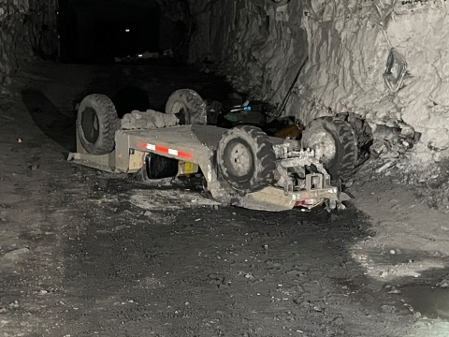
WV COAL MINE FATALITY – On March 22, 2023, a miner died when the personnel carrier he was riding overturned. Another miner riding on the personnel carrier accidentally actuated the emergency stop causing the personnel carrier to drift backwards down a grade. The personnel carrier struck a coal rib and overturned, pinning the victim beneath it. The victim was not riding in a designated seating area.
Best Practices
Maintain steering and braking components.
Perform functional tests of brakes and other safety devices during the pre-operational examination.
Tag out and remove equipment from service when defects affecting safety are found.
Do not exceed the maximum designed seating capacity of personnel carriers.
Operate mobile equipment at speeds consistent with roadway conditions.
Task train miners on all equipment they operate.

Slide 24
At approximately 8:40 a.m., the victim and another surveyor started travelling outby and the surveyor drove the Stryker in the No. 2 entry toward the Northeast Mains with the victim sitting in the passenger’s seat. They picked up an Engineer, who was walking inby to assist them for the day. The victim sat on top of the Stryker with his feet down behind the seats and the engineer sat in the passenger seat.
According to interviews, the surveyor continued to drive the Stryker outby and started up a grade. See Appendix A for a map of the accident scene. At approximately 15½-block, the engineer accidentally depressed the emergency stop button (E-stop) located between the seats on the center console (see Appendix B). The E-stop shut the power off to the Stryker, which came to a stop and began drifting backwards downhill. The engineer pulled the E-stop button back out, restoring power to the Stryker. The lights came back on, but the tram control, including the regenerative braking did not work. The surveyor applied the foot brake and the hand activated parking brake but neither functioned. The Stryker began to pick up speed and the surveyor attempted to keep it in the center of the entry as it rolled backwards so the Stryker would not contact the entry ribs and overturn. The Stryker travelled approximately 210 feet and entered the 17-block intersection and veered toward the passenger side rib.

Slide 25
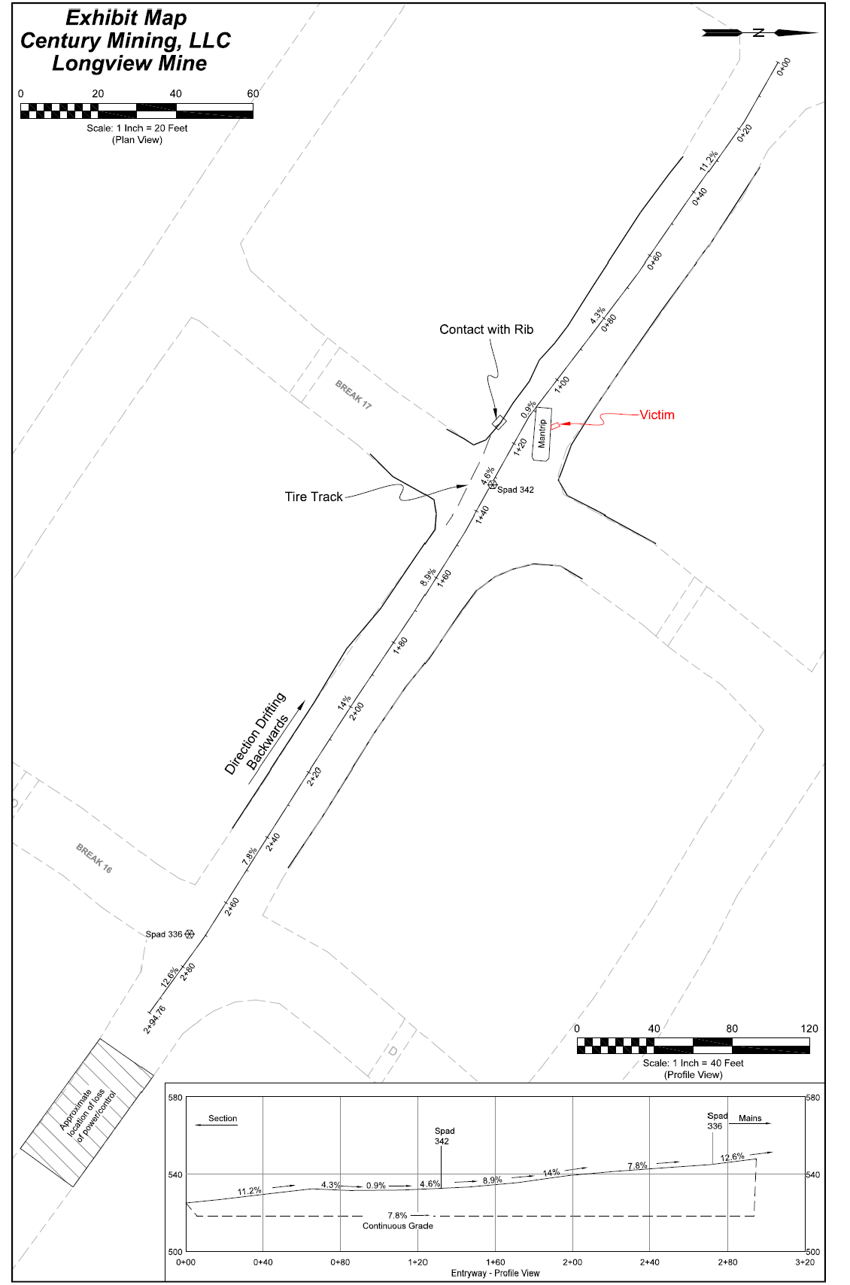
Appendix A

Slide 26
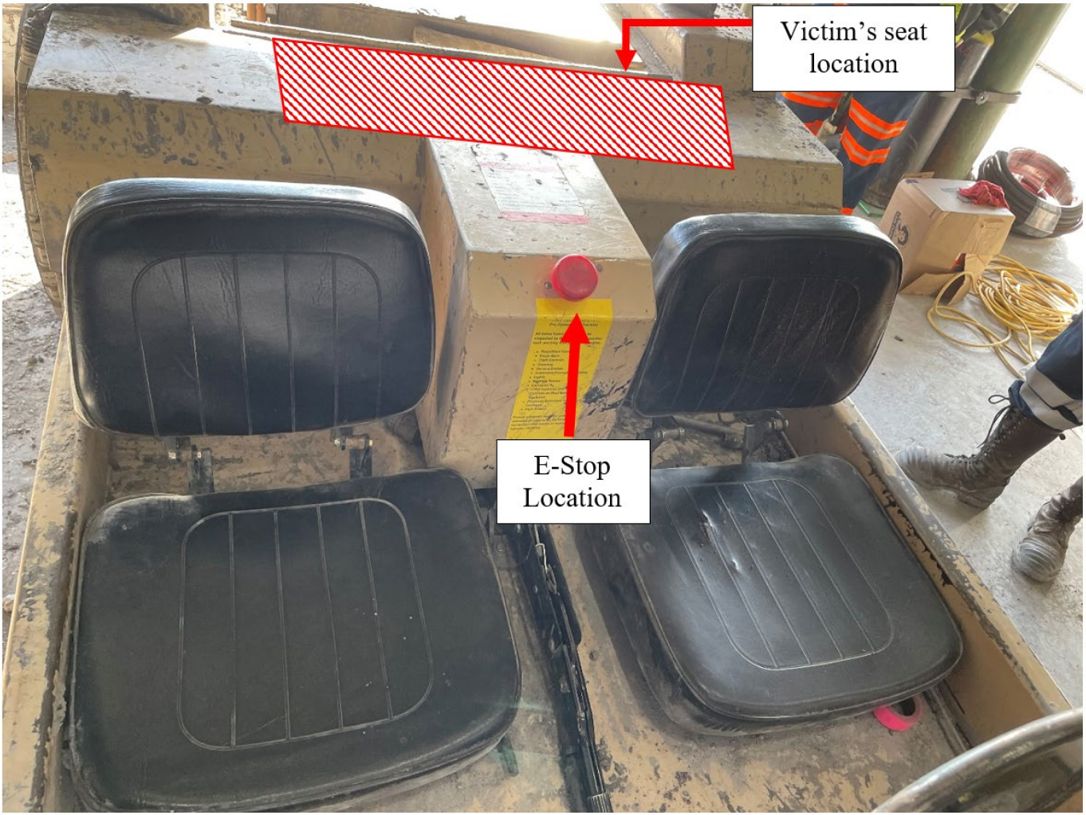
Appendix B

Slide 27
At approximately 8:50 a.m., the rear passenger side of the Stryker impacted the rib inby the 17- block intersection. The passenger side rear tire travelled up the rib, causing the Stryker to overturn. The victim and the driver (the surveyor) ended up underneath the Stryker and the engineer was thrown clear. The driver crawled out from under the Stryker and yelled for the victim and the engineer but only got a response from the engineer. The driver ran around the Stryker and found the victim pinned under the passenger side. The driver checked the victim's pulse, could not detect one, and started cardiopulmonary resuscitation (CPR).

Slide 28

DISCUSSION
Location of the Accident The accident occurred at 17-block in the No. 2 entry of the Tailgate section (see Appendix A). The section has varying grades along its entire length, but the overall grade from the working face of the section to the Northeast Mains is uphill. Based on interviews, investigators determined that the Stryker lost power and began drifting backwards at 15½-block. The distance from this location to the impact point at 17-block is approximately 210 feet with an average grade of approximately 9.5%. Allegheny Surveys, Inc, a surveying contractor, surveyed the accident scene.

Slide 29

Equipment Involved
The Stryker personnel carrier involved in the accident was delivered to the mine in December 2022. The Stryker had a seating capacity of two persons and was being used to transport miners to and from the Tailgate section from the Northeast Mains track. Three miners were riding on the Stryker at the time of the accident. The mine operator has a Comprehensive Mine Safety Program that states, “No employee shall ride in the scoop bucket, or on top of the scoop, or any equipment that does not provide adequate seating.” the victim was not in a designated seat and was sitting on top of the personnel carrier directly behind the seats. The mine operator did not ensure the number of miners traveling on each personnel carrier did not exceed the available number of seats when transporting miners, which contributed to the severity of the accident.

Slide 30
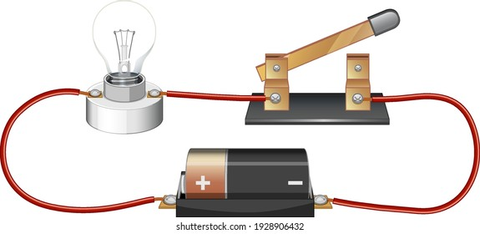
Stryker Electrical System
The Stryker was equipped with an electrical propulsion system that includes a lead-acid battery pack, a 3-phase induction motor, and a motor controller. The motor controller initiates a regenerative braking system that recharges the batteries as a miner releases the accelerator pedal. The regenerative braking system also slows the Stryker down as the motor charges the batteries.
When the E-stop button is depressed, it deenergizes the motor controller. The motor controller is incapable of providing regenerative braking when it has no power. The service or parking brake systems would be the only means to slow or stop the Stryker. The Stryker was designed so that it must come to a complete stop before the controller can fully reset after the E-stop is pulled back out. This design was incorporated to prevent damage to the drive axle.

Slide 31
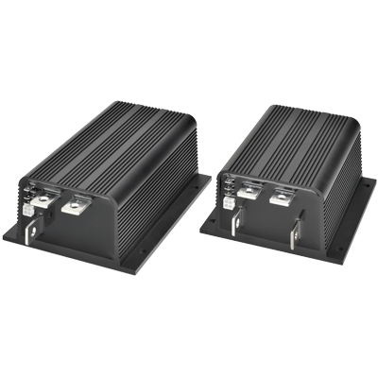
The Stryker rolling backwards down the grade prevented the regenerative braking system from resetting after the E-stop button was pulled back out. Curtis Instruments Inc., the motor controller manufacturer, conducted testing and data extraction of the controller and did not detect any faults or abnormalities throughout the testing process. MSHA Technical Support observed this testing, reviewed the data, and did not find any electrical deficiencies that could have resulted in a failure of the regenerative braking system or a loss of system propulsion.

Slide 32
Stryker Braking System
The Stryker had a wet brake system consisting of a wet brake assembly (brake pack) on each side of the rear axle. The brake packs contain the discs that slow or stop the personnel carrier. The wet brake system is designed to activate by either of two methods: hydraulically by a service brake foot pedal or mechanically by a parking brake hand lever. Both methods activate the same set of brake packs on the rear axle. MSHA Technical Support and WVOMHST personnel examined and tested the components of the braking system. The rear axle brake components were observed to be in operable condition and the brake discs were observed to have minimal wear. Based on interviews with miners, the regenerative braking system was used almost exclusively to slow or stop the Stryker.

Slide 33
The service brake is activated through a foot brake master cylinder that pushes hydraulic oil to the brake packs. The investigators applied the service brake foot pedal and manually rotated the rear wheel. The application of the service brake foot pedal did not create any hydraulic pressure and did not prevent the rear wheels from rotating. Additionally, when the service brake foot pedal was released, there was no pressure that returned it to the fully released position as designed. Maintenance records obtained during the investigation show the foot brake master cylinder was replaced on January 17, 2023. The master cylinder that was replaced on the Stryker was not the designed master cylinder for the wet brake system. The wet brake system was designed to work with a foot brake master cylinder compatible with mineral based hydraulic oil. The replacement master cylinder is designed to operate with DOT 3/4 brake fluid according to the reservoir cap (see Appendix D).

Slide 34
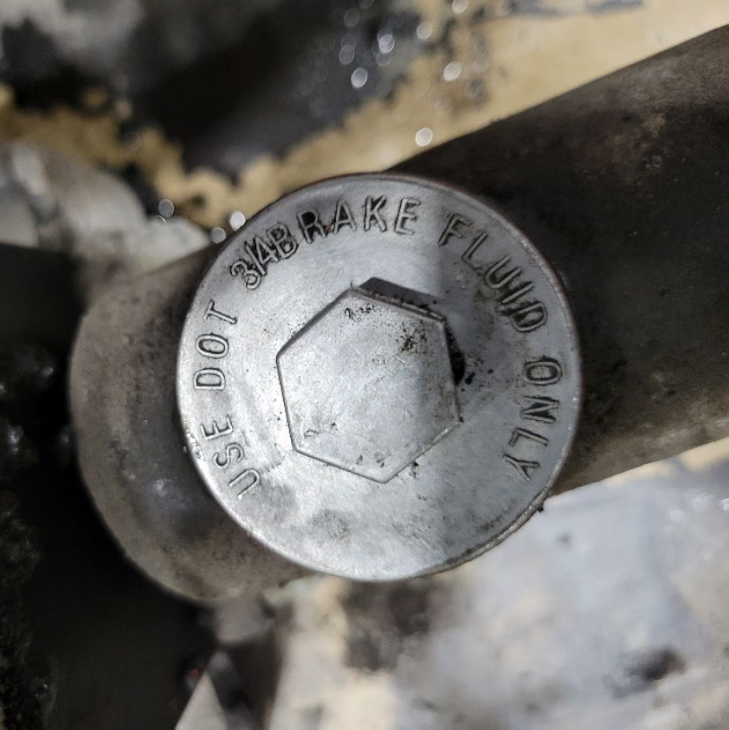
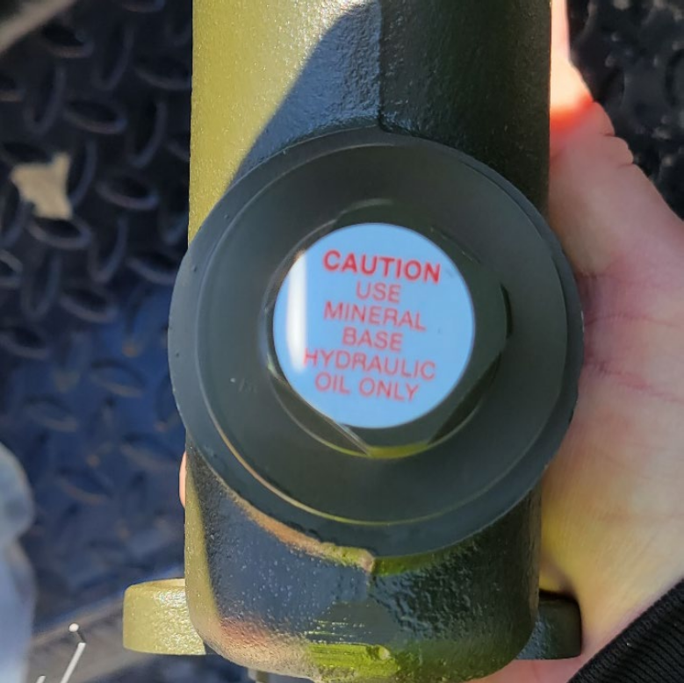
APPENDIX D – Brake Master Cylinders
Figure 1: Brake Master Cylinder on Stryker at the time of the accident
Figure 2: Brake Master Cylinder designed for Stryker service brake system

Slide 35
MSHA Technical Support’s lab analysis determined that mineral based hydraulic oil was inside of the recently installed master cylinder reservoir at the time of the accident. The piston spring cup inside the brake master cylinder was found to be damaged when inspecting the internal components (see Appendix E). An analysis conducted by an independent laboratory contracted by Technical Support, determined the piston spring cup to be made of Ethylene-Propylene (EP), which is not compatible with mineral based hydraulic oil. The mineral based hydraulic oil inside the brake master cylinder caused the piston spring cup to swell and eventually fail over time. This failure of the piston spring cup would not allow the brake master cylinder to build pressure to engage the service brake. Investigators determined this condition contributed to the accident but were unable to determine how long the condition existed.
The investigators moved the parking brake lever into the applied position and attempted to manually rotate the wheels at the accident scene. The parking brake provided no resistance to the rear drive axle due to slack in the parking brake cable. Investigators determined that it was out of adjustment and contributed to the accident.

Slide 36
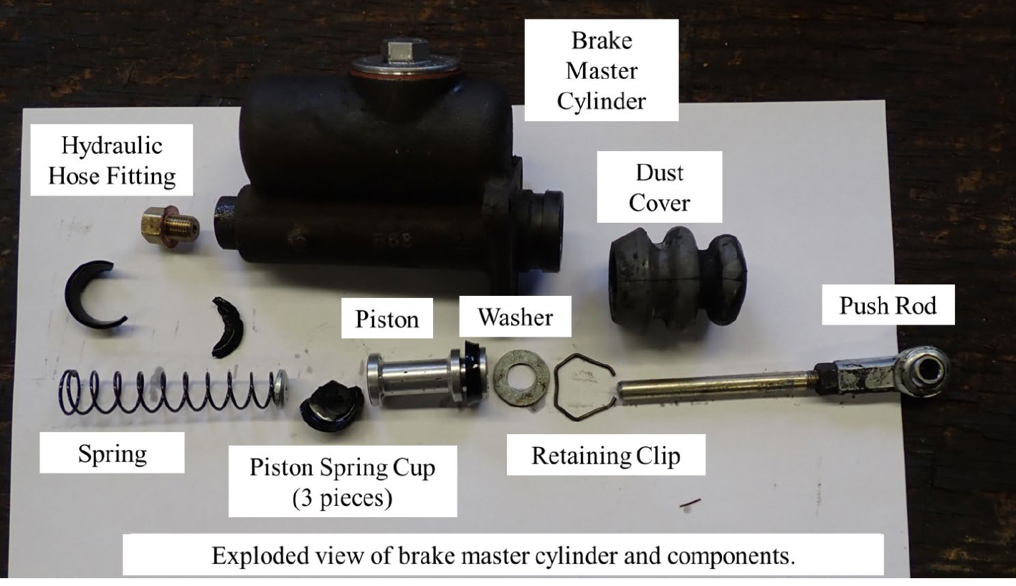
APPENDIX E – Stryker Brake Master Cylinder Disassembled

Slide 37
Examinations
An electrician, conducted the last required weekly electrical examination on the Stryker on March 20, 2023. No hazards were reported.
MSHA regulations do not require pre-operational examinations on this type of equipment. The mine provides a checklist located on the equipment for miners to use when conducting pre-operational examinations on Stryker personnel carriers; however, they do not record the examinations. The checklist includes a requirement to inspect both the service and parking brakes. According to interviews, a pre-operational examination was not conducted on the Stryker before operating it prior to the accident. Investigators determined this contributed to the accident.
Jack & Bar
Communications
Fire Extinguisher
Brakes
Controls & Steering
Lights
Rescuers
Tires & Rims
SAMPLE

Slide 38
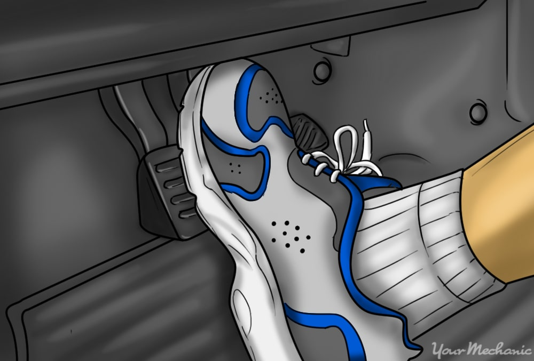
According to interviews, a utility man operated the Stryker on the shift prior to the accident and identified a deficiency in the brakes in that the foot brake pedal had to be pushed real hard and it would not spring back all the way when you let off. He verbally reported to the CM Maintenance Supervisor, that the brakes were not working properly. He parked the Stryker near the mainline track and drove the Company No. 2 EMU back to the Tailgate section.
The maintenance supervisor later took the EMU to where the Stryker was parked and drove the Stryker back to the Tailgate section. She told investigators there were no issues with the brakes and that she rarely used the foot brake due to the regenerative brakes. The Stryker was never taken out of service after the utility man told the maintenance supervisor the brakes were not working properly.

Slide 39
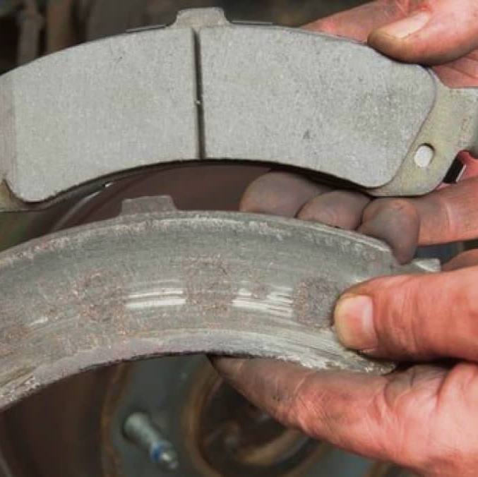
The driver (Surveyor) also told investigators there was a deficiency in the brakes at the time of the accident. The driver described the same problem with the brakes that the utility man told to investigators. Because of the interview statements, and the examination, testing, and findings by MSHA Technical Support, investigators determined that the mine operator did not maintain the Stryker in safe operating condition or remove it from service immediately. Investigators determined that this contributed to the accident.
No violations were observed in the No. 2 entry that would have contributed to the accident. Investigators determined that the examinations of the No. 2 entry did not contribute to the accident.

Slide 40
Training and Experience
The victim had more than 17 years of mining experience, including over ten months at the Longview Mine. A Mine Safety and Health Training Specialist, conducted a review of the training records. The victim received annual refresher training on March 10, 2023. The victim, the surveyor, and the engineer had no record of task training for operating the Stryker. However, investigators determined the surveyor (the driver) had knowledge and experience operating the Stryker and this did not contribute to the accident.

Slide 41
ROOT CAUSE ANALYSIS
The accident investigation team conducted an analysis to identify the underlying causes of the accident. The team identified the following root causes, and the mine operator implemented the corresponding corrective actions to prevent a recurrence.
1. Root Cause: The mine operator did not maintain the Company No. 2 Stryker personnel
carrier in safe operating condition.
Corrective Action: The mine operator examined all personnel carriers to ensure they were
maintained properly, particularly the braking systems. The mine operator also conducted task training with all miners on the pre-operational examinations of all personnel carriers in the mine. This training included procedures for removing equipment from service when identifying safety defects. The mine operator also installed a second independent front brake system and brass tags that identify the type of oil required for each master cylinder on all rubber-tired personnel carriers in the mine and trained miners on the proper oil required for each master cylinder.

Slide 42
2. Root Cause: The mine operator did not conduct adequate pre-operational examinations.
Corrective Action: The mine operator conducted task training with all miners on the pre-
operational examinations of all personnel carriers in the mine. This training included procedures for removing equipment from service when identifying safety defects.
3. Root Cause: The mine operator did not ensure the number of miners traveling on each
personnel carrier did not exceed the available number of seats when transporting miners.
Corrective Action: The mine operator updated the written procedure requiring that all
passengers on personnel carriers do not exceed the number of designated seats available. The mine operator trained all miners on the new procedures.

Slide 43

CONCLUSION
On March 22, 2023, at approximately 8:50 a.m., a 62-year-old surveyor with over 17 years of mining experience, died when a battery powered personnel carrier on which he was riding, overturned.
The accident occurred because the mine operator did not: 1) maintain the Company No. 2 Stryker personnel carrier in safe operating condition, 2) conduct adequate pre-operational examinations, and 3) ensure the number of miners traveling on each personnel carrier did not exceed the available number of seats when transporting miners.

Slide 44
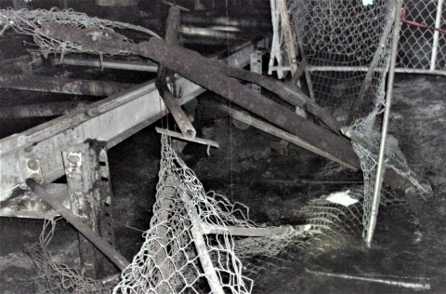
ALABAMA COAL MINE FATALITY – On August 30, 2023, a belt foreman died when a belt conveyor take-up unit component broke and struck him.
Best Practices
Examine work areas for hazards found during the shift. Report hazards and defects immediately and do not work in unsafe conditions.
Ensure there are no obstructions in the travel path of the belt conveyor take-up system prior to tensioning.
Examine any belt or linkage assembly for signs of deformation such as cracking, lateral deflection or distorted connections.
Train miners to recognize and avoid potential hazards from sudden releases of stored energy.

Slide 45
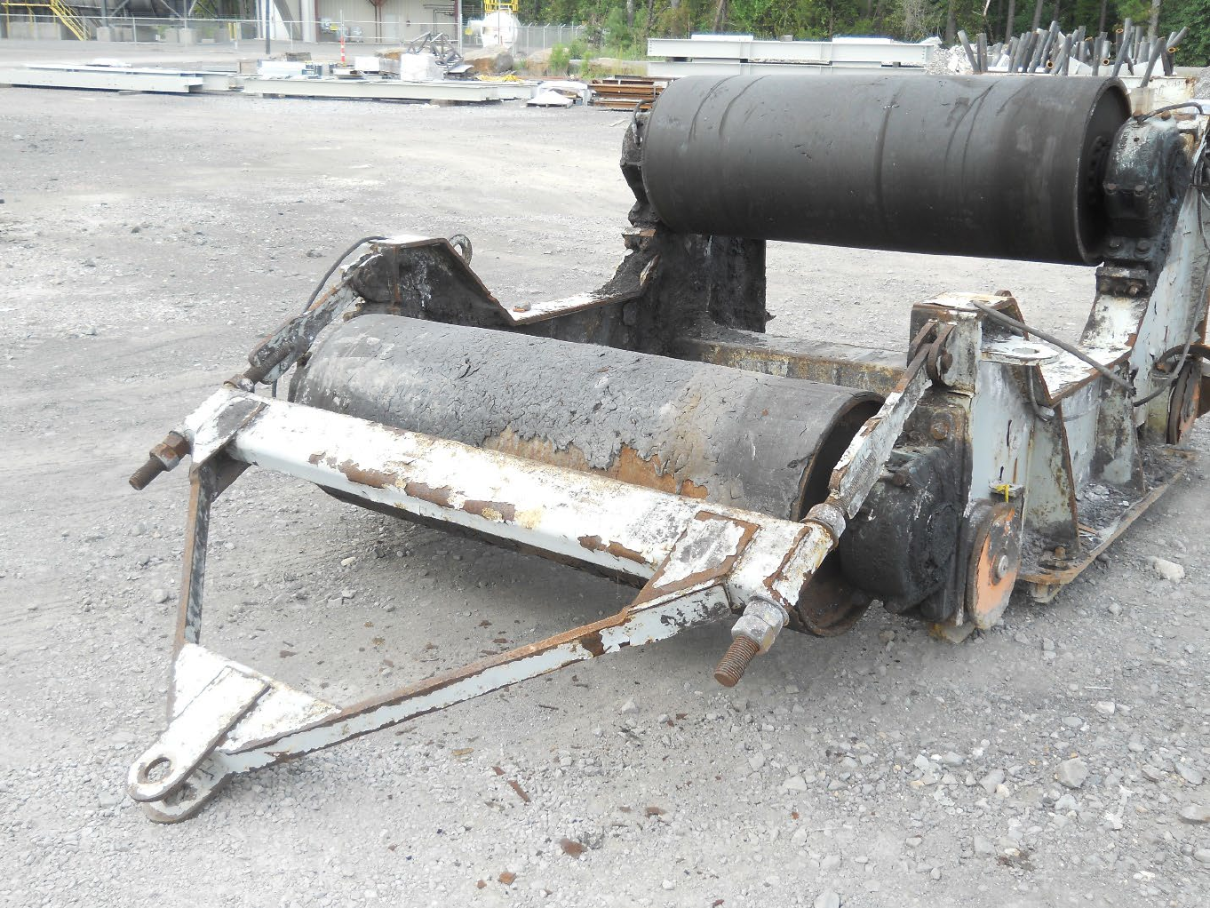
OVERVIEW
On August 30, 2023, at approximately 6:50 a.m., a 34-year-old belt foreman with over 13 years of mining experience, died when a longwall belt conveyor take-up unit (take-up) component, the bridle, broke and struck him.

Slide 46
DESCRIPTION OF THE ACCIDENT
On August 30, 2023, at 6:00 a.m., the victim arrived at the mine to work on repairs to the take-up located on the C1 Longwall section (see Appendix A). The crew working with him on these repairs consisted of two belt repairman; two new miners at No. 4 Mine; and two men from a contractor one a laborer and the other a foreman.
The victim, two repairman and the laborer entered the belt conveyor entry through airlock doors and walked to the back side of the take-up between the chain link guarding panels (guards) and the coal rib. Based on interviews and evidence observed at the accident scene, investigators determined that while looking through the guards at the worksite, the victim observed an orange glow (later to be found as a damaged roller) and possibly flames near the movable carriage of the take-up. The victim, followed by the two repairmen and the laborer, walked toward the glow to investigate. Arriving near the location of the take-up carriage, the victim yelled, “Shut the belt off.” The laborer turned and ran to the belt conveyor stop switch and shut off the belt conveyor. Hearing the belt conveyor drive slowing down, the laborer began walking back toward the victim when he suddenly heard a loud noise, got knocked off his feet, and was engulfed by heavy dust.

Slide 47
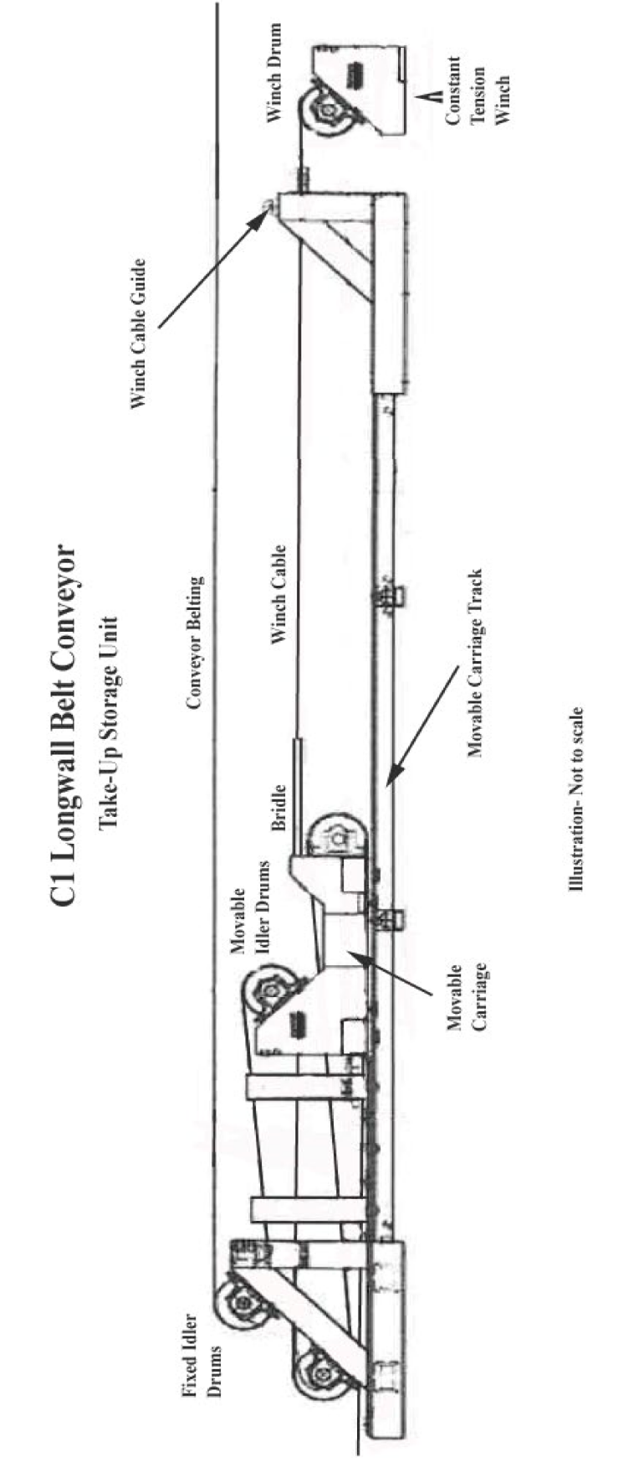

Slide 48
According to interviews, at approximately 6:50 a.m., the bridle connecting the constant tension winch cable (winch cable) to the carriage broke free at the attachment points to the carriage (see Appendix B). Due to the sudden release of stored tension in the winch cable, the bridle recoiled through the guards, breaking the guards loose and striking the miners. After regaining his composure, the laborer realized the guards had him pinned underneath, along with the victim, and two repairmen. The laborer heard the take-up winch running and realized the bridle and winch cable were pulling the guards along the beltline.
The foreman and the two new miners arrived outside the airlock doors, heard the loud noise, and entered the belt conveyor entry through the doors. The laborer saw the foreman enter the doors and yell, “Shut the BTU off,” referring to the winch. The foreman went to the control box for the winch and shut it down, stopping the winch from dragging the damaged guards. The laborer and one of the repairmen crawled out from under the guards and flipped the damaged guards off the other repairmen and the victim. The foreman and two new miners went to the other repairmen and the victim to check on them and saw that when the bridle broke free from the carriage, the bridle passed through the guards and struck the victim. The laborer exited the belt conveyor entry, ran to the personnel carrier, and radioed for help.

Slide 49
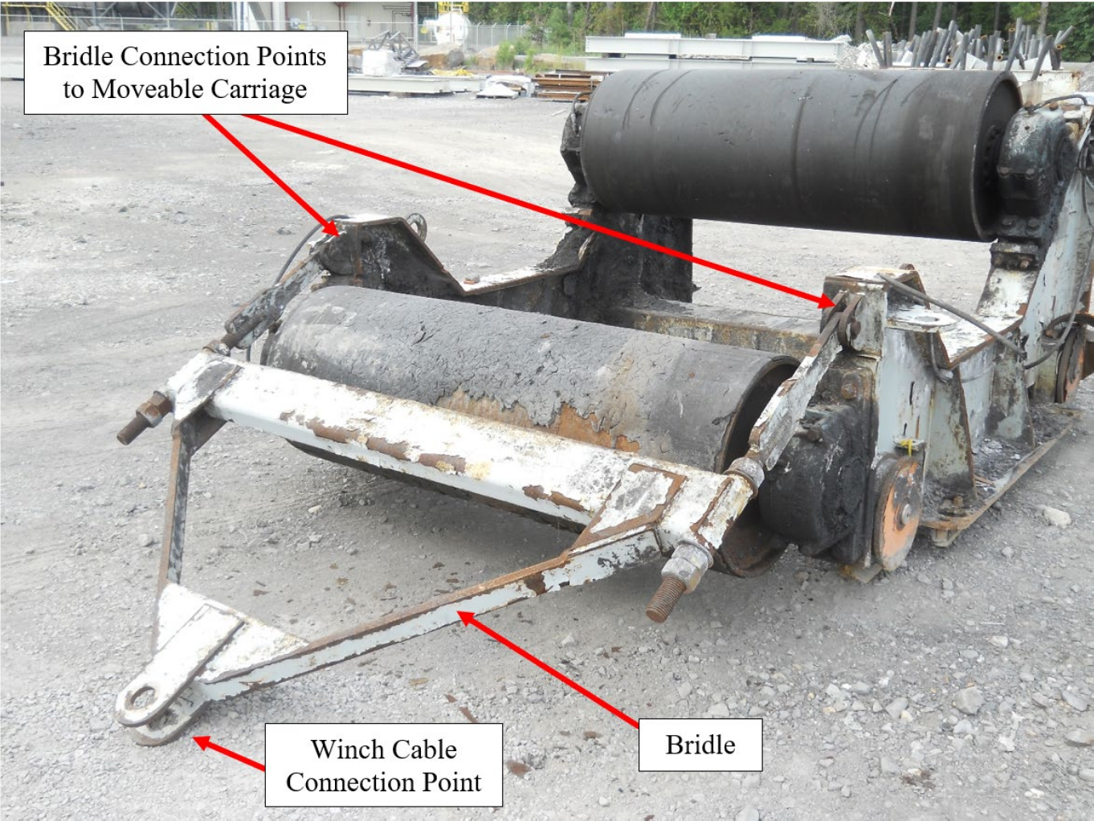
APPENDIX B – Similar Movable Carriage with Bridle

Slide 50
Events Before the Accident
Investigators determined that events occurred before the accident resulting in damage to belt take-up system components contributed to the occurrence of the fatal accident.
Approximately four weeks before the accident, the pin in the bridle at the winch cable
connection on the take-up unit slipped out of the bottom eye at the connection point. This caused the winch cable to pull out of the bridle, bending the top eye at the connection point and the bridle upward due to the force exerted by the winch, and causing the winch cable to backlash on the winch cable drum. The mine operator untangled and inspected the winch cable and heated the top of the bridle with a torch to hammer it back down parallel to the bottom, aligning the holes for a pin. Instead of the mine operator repairing the top eye at the connection point to reinstall a pin from the manufacturer, the mine operator installed a different pin, approximately twice the length of the original pin provided by the manufacturer. The longer pin protruded several inches below the bottom of the bridle.

Slide 51
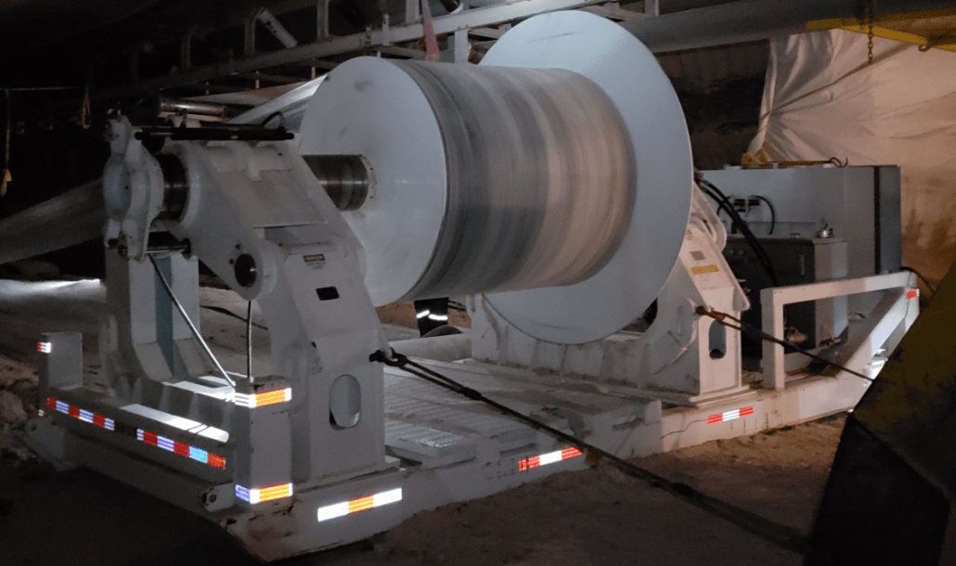
Approximately two weeks prior to the accident, the winch cable broke. The mine operator
installed a new winch cable and again used the longer pin at the winch cable connection on the bridle.
On August 28, 2023, A Belt Foreman, was working with a belt crew and operating the belt winder to remove excess belting from the conveyor belt. This is required as the longwall retreats from the mine, which results in less overall belt length being needed as mining continues. The take-up winch tension was released to allow for the belt winder to begin winding the excess belting. When the tension was released, the bridle dropped down, contacting cross braces in the take-up track frame. The longer pin previously installed in the bridle, hooked one of the cross braces. As the foreman began winding the belt, the track frame cross brace that was hooked by the bridle pin, was ripped out of the track frame. This caused severe damage to the track frame on both sides of the system and weakened the bridle at the connection points to the moveable carriage. The foreman knew the longer pin installed at the bridle connection caused the damage to the track frame. However, management did not check for additional damage caused by this event, and they allowed the continued use of the longer pin. Investigators determined this contributed to the accident.

Slide 52
Even though the foreman saw the damage to the track frame, he determined that the movable carriage was beyond the damaged section of the track frame and would not prevent the conveyor belt from being operated. He continued to wind the belt out of the take-up. Then he reconnected the belt and restarted the belt conveyor. The foreman knew it would be a few days before enough belt would be accumulated in the take-up from the retreat mining process to reach the damaged area of the take-up.
On the shift before the accident, a crew of workers removed damaged rails and cross braces, then slid new rails in place, but did not attach them. The crew reinstalled the guarding and started the belt conveyor back up. When the victim’s crew de-energized the loaded belt conveyor immediately before the accident, the additional stress on the bridle connection points caused the bridle to break free and strike him.

Slide 53
Investigators determined the damage created by the longer pin contacting the track frame
weakened the bridle attachment connections and contributed to the accident. MSHA Technical
Support took representative sections of the bridle for laboratory testing and evaluation, and the
findings were consistent with those of the MSHA investigators. Specifically, laboratory testing
found:
1) The link bars in the bridle met the minimum strength requirements for ASTM A36 steel.
2) Differences in pinhole size and the extent of the steel yielding caused the winch cable tensile load to unevenly transfer to the bridle and resulted in an imbalanced loading of the link bars. These differences were the result of the incident where the tow bar caught on a track cross-member prior to the accident.
3) The unequal load distribution caused the track-side link bar to receive more of the belt tension load, which caused the track-side link bar to fracture first and release from the mobile carrier.
4) The damage to the walk-side link bar was consistent with lateral loading and tensile overload, which would have occurred after the failure of the track-side link bar.
5) The walk-side link bar was unable to carry the full belt tension load of 33,800 pounds following the fracture of the track-side link bar; therefore, the walk-side link bar was fractured, failed, and released from the mobile carrier.

Slide 54
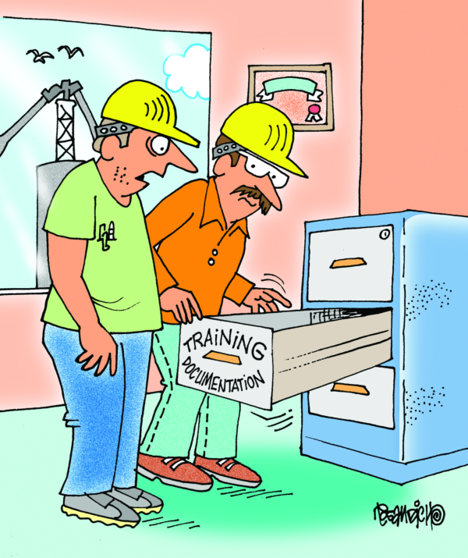
Training and Experience
The victim had over 13 years of mining experience, including three years of experience at this mine as a belt foreman. Investigators reviewed training documentation and determined he received all training in accordance with MSHA Part 48 training regulations.

Slide 55
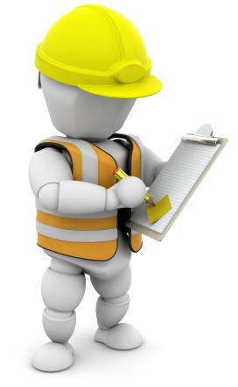
Examinations
Investigators determined that pre-shift and on-shift examinations were conducted in the belt conveyor entry during the shift before the accident. Miners worked at the same work site on the previous shift; therefore, the belt conveyor would not have been in operation when these examinations were conducted. There was no report of hazardous conditions in the work area recorded in the record book. Due to the location of the damaged rollers in the belt conveyor take-up, investigators determined it was unlikely that damaged rollers would have been observed by an examiner because the belt was not running to produce audible or visual indications of hazards. The components of the take-up system and the belt conveyor would conceal the area of the damaged rollers when the take-up winch was released.
Also, the mine operator originally installed the longer pin to repair the system. Under normal operations, an examiner would have seen the pin elevated above the take-up rails and would not have recognized this as a hazard. Investigators determined that examinations did not contribute to the accident.

Slide 56
ROOT CAUSE ANALYSIS
The accident investigation team conducted an analysis to identify the underlying cause of the accident. The team identified the following root cause, and the mine operator implemented the corresponding corrective action to prevent a recurrence.
Root Cause: The mine operator did not maintain components of the take-up in safe operating condition.
Corrective Action: The mine operator: 1) installed a new bridle on the moveable carriage. The new bridle is provided with gussets, which prevent the bridle from dropping down and contacting the track frame of the take-up when there is slack in the winch cable, 2) installed a two-inch diameter plasma rope to the moveable carriage and bridle to prevent the bridle from breaking free if the connections break again, and 3) developed and implemented a written policy prohibiting any miner from being in the belt conveyor entry between the belt drive and take-up winch when the belt conveyor is intentionally started or stopped, to reduce exposure.

Slide 57
CONCLUSION
On August 30, 2023, at approximately 6:50 a.m., a 34-year-old belt foreman with over 13 years of mining experience, died when a longwall belt conveyor take-up unit (take-up) component, the bridle, broke and struck him.
The accident occurred because the mine operator did not maintain components of the take-up in safe operating condition.

Slide 58
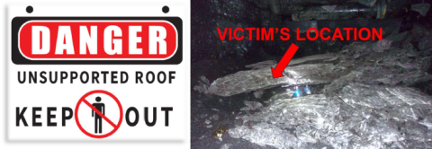
VIRGINIA COAL MINE FATALITY On May 31, 2024, A miner received fatal injuries from a rock fall while traveling under unsupported roof. The rock measured approximately nine feet by four feet by fourteen inches.
Best Practices
NEVER go under unsupported roof!
Mine Management:
Prohibit work or travel under unsupported roof.
Train all miners and supervisors on the hazards of working and traveling into areas
of unsupported roof.
Identify and correct unsafe work practices.
Roof Control Plans should include:
Identifying the next to last full row of permanent roof supports with highly visible
markers at all approaches.
Installing and maintaining adequately designed roof/ground control where miners
work or travel.
Guidance ensuring miners are safely positioned while setting temporary support.
Installing temporary supports under the direct supervision of a certified foreman

Slide 59
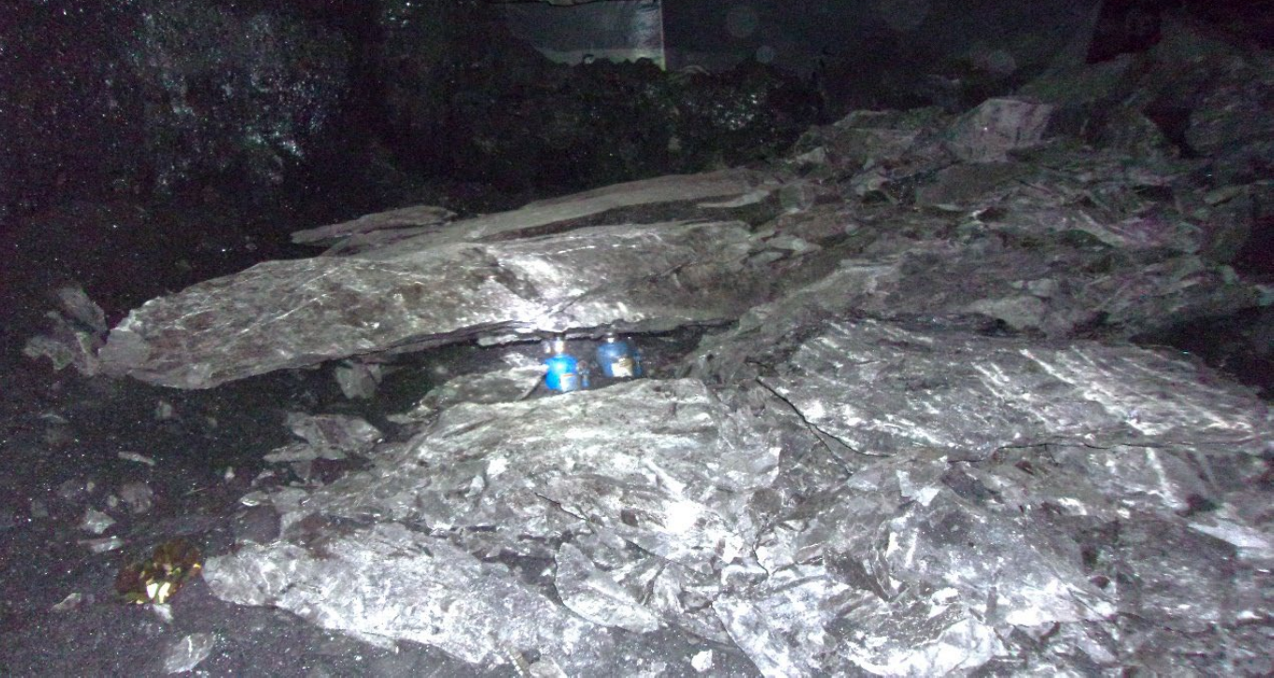
OVERVIEW

Slide 60
On May 31, 2024, at approximately 4:20 p.m., a 27-year-old roof bolter with
Over three years of mining experience, died when a portion of mine roof fell on him. The accident occurred as he was traveling on foot through an area of unsupported roof.

Slide 61
According to interviews, after the safety talk, the victim proceeded to the last row of bolts in the No. 2 Right crosscut with a roof bolter and miner man. The miner man arrived at the continuous mining machine located in the No. 2 Right crosscut. After the miner man arrived, the roof bolter saw the victim starting to walk into the area of unsupported roof. The roof bolter said, “You are not going to go through that break.” However, the victim walked through the unsupported area of the No. 2 Right crosscut to the No. 3 Entry at Survey Station 41348. He then walked over to the right-side roof bolting machine located in the face of the No. 4 entry inby Survey Station 41349.
According to interviews, the victim saw two other roof bolters and asked if they had any cable bolts, but they told him they did not. The victim then left the No. 4 Entry and traveled the same route to the No. 2 Right crosscut. The miner man and the roof bolter warned the victim not to travel back through the unsupported area. While traveling back through the area of unsupported roof in No. 2 Right crosscut, the victim was struck by a section of mine roof. The investigator measured the fallen section of mine roof that struck the victim to be approximately six feet long, by four feet wide, and an average of fourteen inches thick.
According to interviews, the roof bolter witnessed the roof fall and traveled under unsupported roof to the victim. The roof bolter stayed with the victim while the miner man traveled on foot outby in the No. 2 Entry to get help.

Slide 62
Roof Control Plan and Roof Support
The immediate mine roof is supported with fully grouted 72-inch bolts installed with a minimum six-inch by six-inch bearing plate. These bolts are installed on a minimum four-foot by four-foot pattern. The Buchanan Mine #1’s roof control plan, on page 18, illustrates the requirement that two cable bolts are to be installed during the normal bolting cycle in the area where the accident occurred. The investigator determined the reason the victim went to the other roof bolting machine was that there were no cable bolts on his roof bolting machine.
The Buchanan Mine #1’s roof control plan on page six, item F, requires that no miner travel under unsupported roof. Also, page six, item C, requires warning devices (red reflective ribbons) that are readily visible or physical barriers to be conspicuously placed to warn miners approaching an area which is not permanently supported upon the completion of the loading cycle. Additionally, page 15, item Z, number 4, requires warning devices that are readily visible or physical barriers to be conspicuously placed to warn persons approaching an unsupported intersection prior to being mined through. The devices or barriers shall be placed outby the intersection with at least one row of permanent roof support between the projected intersection and indicators or barriers. The investigator saw these warning devices, and based on the interviews, determined the warning devices were installed prior to the victim traveling through the unsupported area.

Slide 63
Examinations
A pre-shift examination of the 16 East Section was conducted by the Section Foreman, between 12:30 and 1:30 p.m., and no violations or hazardous conditions were recorded.
Training and Experience
The victim worked as a roof bolter for Buchanan Minerals, LLC for over 28 weeks and had over three years of experience as an underground miner. The victim held certifications through the Virginia Department of Energy of General Miner Underground Only and Qualified Gas Detector. The victim received annual refresher training on March 24, 2024. He was task trained on a roof bolting machine and the roof control plan on February 5, 2024. The investigator determined that the victim received training in accordance with MSHA Part 48 training regulations.

Slide 64
ROOT CAUSE ANALYSIS
The accident investigator conducted an analysis to identify the underlying causes of the accident. The investigator identified the following root cause, and the mine operator implemented the corresponding corrective action to prevent a recurrence.
Root Cause: The operator did not ensure that all miners were working or traveling under supported roof.
Corrective Action: The mine operator has developed and implemented a revision to the approved roof control plan. This revision includes more visible warning devices and physical barriers to all approaches leading to unsupported areas. All miners have been trained on the revision to the approved roof control plan which included a reemphasis that miners are not to travel under unsupported roof.

Slide 65
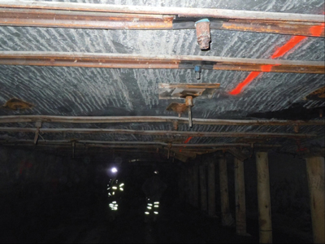
CONCLUSION
On May 31, 2024, at approximately 4:20 p.m., a 27-year-old roof bolter operator with over three years of mining experience, died when a portion of mine roof fell on him. The accident occurred as he was traveling on foot through an area of unsupported roof.
The accident occurred because the operator did not ensure that all miners were working or traveling under supported roof.

Slide 66
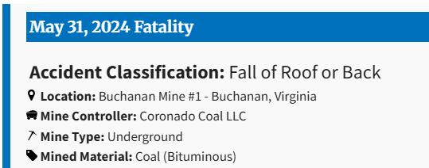
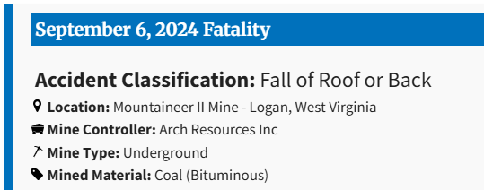
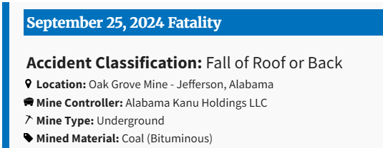
3 Fatals In 2024
Under
Unsupported Roof!!!

Slide 67
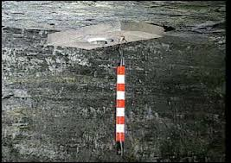
NEVER GO INBY!!!

Slide 68
Best Practices
NEVER go under unsupported roof!
Mine Management:
Prohibit work or travel under unsupported roof.
Train all miners and supervisors on the hazards of working and traveling into areas
of unsupported roof.
Identify and correct unsafe work practices.
Roof Control Plans should include:
Identifying the next to last full row of permanent roof supports with highly visible
markers at all approaches.
Installing and maintaining adequately designed roof/ground control where miners
work or travel.
Guidance ensuring miners are safely positioned while setting temporary support.
Installing temporary supports under the direct supervision of a certified foreman

Slide 69
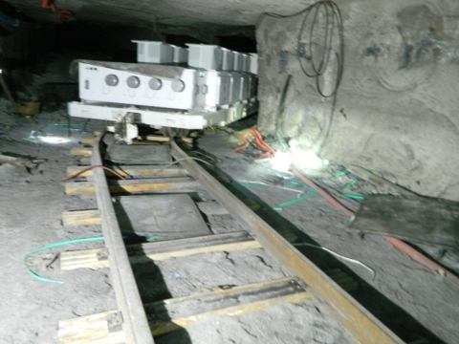
WEST VIRGINIA COAL MINE FATALITY – On August 5, 2024, a miner was seriously injured when an air lifting bag he was using to rerail the conveyance that was carrying the longwall electrical power center suddenly dislodged. The miner died from his injuries on August 7, 2024.
Best Practices
Block or secure equipment against hazardous motion.
Provide miners with proper tools for rerailing track equipment.
Train miners on safe work procedures and to identify hazards associated with their assigned tasks.

Slide 70
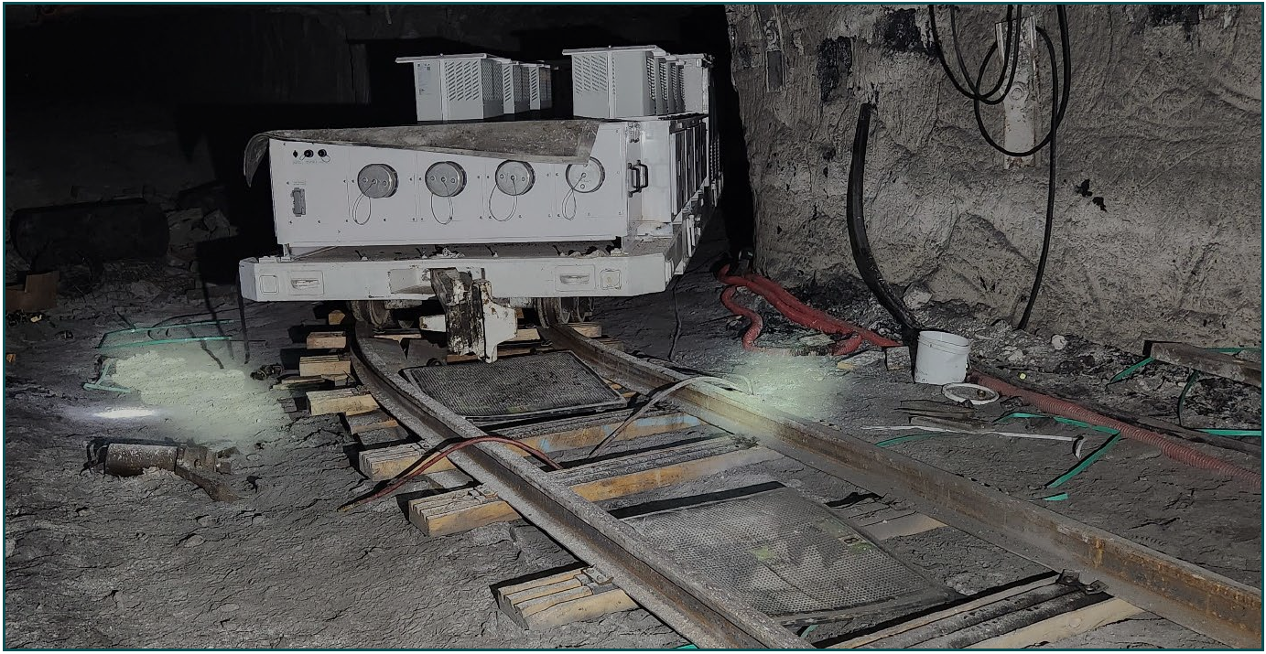
OVERVIEW
On August 5, 2024, at 5:55 a.m., a 57 year-old locomotive operator with 11 years of mining experience, was seriously injured when rubber air lifting bags (airbags) suddenly dislodged while work was being performed to rerail a longwall electrical power car. The unanticipated movement of the airbags caused the power car drawbar to strike the victim in the head. He died from his injuries on August 7, 2024.
The accident occurred because the mine operator did not: 1) properly install the track rails to accommodate all equipment that would use them, 2) properly train all miners on the use of airbags to rerail track mounted equipment, and 3) have adequate written guidance to ensure the proper use of airbags to rerail track mounted equipment.

Slide 71
DESCRIPTION OF THE ACCIDENT
On August 4, 2024, at 7:00 p.m., the victim started his shift and participated in a safety instruction meeting given by the Weekend Shift Foreman. According to interviews, the Weekend Shift Foreman assigned the victim and a Locomotive Operator, to transport the track mounted longwall pump cars and power cars to the No. 16 crosscut (No. 16) track spur on the 10 Left section and park them there. At 7:30 p.m., the Victim and the Locomotive Operator entered the mine to begin their assignment.
On August 5, 2024, at approximately 4:00 a.m., the Midnight Shift Supervisor, was notified that the Victim and the Locomotive Operator were derailed at the No. 14 crosscut on the 10 Left section track. According to interviews, the Victim and the Locomotive Operator rerailed the cars prior to Midnight Shift Supervisor arriving at the No. 14 crosscut. The Midnight Shift Supervisor arrived at approximately 4:20 a.m., observed the cars back on track, and saw the Victim and the Locomotive Operator blocking up the low spot in the track that caused the cars to derail.

Slide 72
The Victim, the Locomotive Operator and the Midnight Shift Supervisor traveled inby to the No. 16 track spur. The Locomotive Operator used the No. 17 locomotive to push the power cars into the spur. The Locomotive Operator and the Victim positioned themselves in the No. 3 entry where they could watch the power car being pushed around the curve (see Appendix A next slide). The right-side wheels on the inby end of the power car went off track in the curve to the No. 3 entry. The miners made two attempts to rerail the car by placing wooden blocks under the wheels and pulling the car outby but were unsuccessful.
The Victim, the Locomotive Operator and the Midnight Shift Supervisor retrieved three airbags, air hoses, and a controller from the No. 14 crosscut. According to interviews, the miners coupled all three air hoses together to reach from the No. 11 locomotive to the inby end of the power car. The Locomotive Operator placed wooden blocking between the track rails as a base for an airbag and placed the two airbags under the inby frame of the power car and the drawbar. They realized two airbags would not be high enough to lift the power car wheels over the track rails. By this time, Battery Repair Technician for Production Efficiency Corporation, had arrived at the No. 16 track spur looking for a ride to the portal bottom. The Battery Repair Technician offered the third airbag to the Locomotive Operator, and he placed it between the other two airbags.

Slide 73
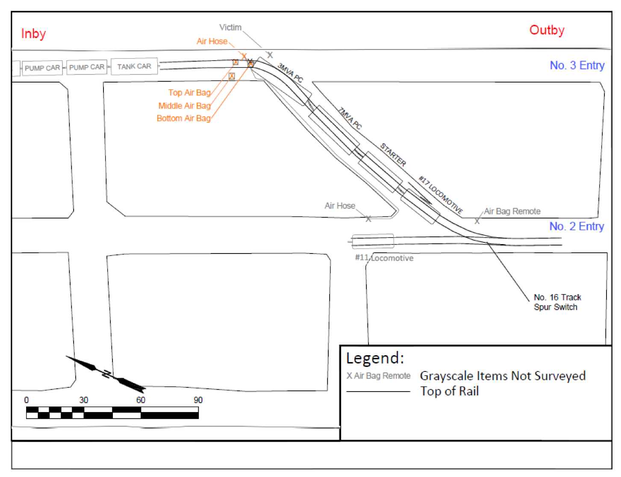
Appendix A

Slide 74
The Locomotive Operator was inby the drawbar and was using the air hose to inflate the airbags. The Midnight Shift Supervisor was just outby the Locomotive Operator helping inflate the airbags by holding his fingers over the inflation nozzles to keep the airbags inflated. The Victim was just outby the Locomotive Operator, near the corner of the power car, and was watching for the wheels to be raised higher than the track rail. According to interviews, the Victim was going to align the wheels of the power car with the track rails once the wheels were above the rails. The Victim was heard saying, “That’s high enough,” moments before a loud noise occurred and dust filled the air.
The Locomotive Operator’s hard hat was knocked off and broken and he received a laceration to the forehead. The Victim stood up and then fell on the ground near the Battery Repair Technician. The Victim was breathing but unconscious with a head injury. The Midnight Shift Supervisor called on the radio for help, and the Battery Repair Technician provided aid to the Victim. The Locomotive Operator went to retrieve the first aid supplies. The Dispatcher, called 911 at approximately 5:55 a.m.
An Electrician, and a Forklift Operator, traveled to the accident location. The Electrician, Forklift Operator and The Battery Repair Technician placed the Victim onto a man door, because they could not locate the backboard, and carried him toward the personnel carrier, located at the No. 16 track spur switch. The Longwall Production Foreman/Emergency Medical Technician (EMT); and two other Electricians, brought first aid supplies to the No. 16 track spur switch where the Victim was being placed onto a personnel carrier. The Victim was transported to the surface, transferred to the care of Taylor County Emergency Medical Services, and taken to the hospital. He was pronounced dead on August 7, 2024, by Dr. Nathaniel Mohney, MD at 1:49 p.m.

Slide 75
DISCUSSION
Location of the Accident:
The accident occurred in the 10 Left No. 16 track spur. The track installation in the spur was completed on August 1, 2024. The track was elevated above the mine floor and adequately blocked. The grade of the mine floor within the spur is relatively flat and did not contribute to the accident.
The track spur traveled through the No. 16 crosscut and curved into the No. 3 entry. The curve radius was too tight for the longwall electrical power car’s length and mobility, causing it to derail. Four shorter pump cars were pushed into the spur earlier in the shift with no issue. The investigators determined that the installation of the track curve in the spur contributed to the accident.

Slide 76
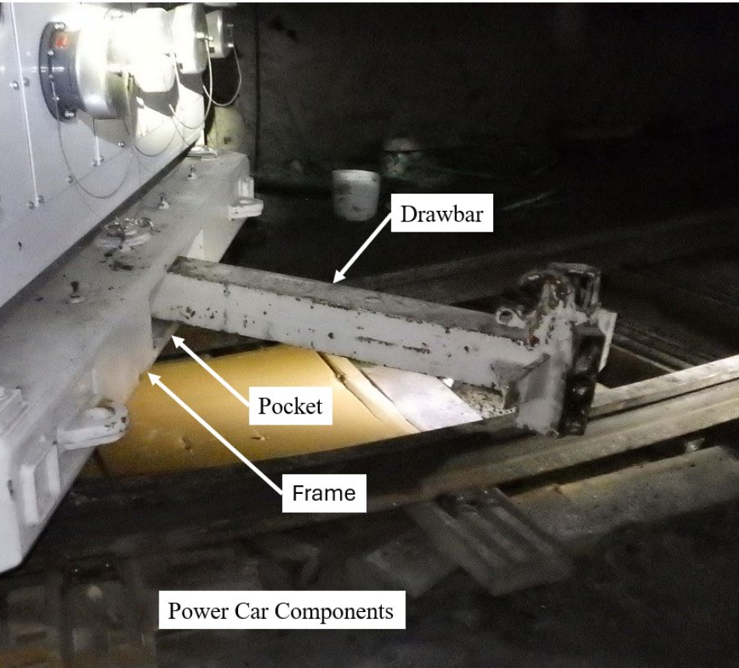
Appendix C
Longwall Electrical Power Car
The equipment involved in the accident was a track mounted 3 MVA PC, longwall electrical power car. The length of the power car measured 33 feet 5 inches. Investigators inspected the inby wheel assembly and did not identify any defects. However, the rotation of the wheel assembly was limited by the power car’s frame due to cross members that acted as stops and prevented unlimited rotation of the wheel assembly. As the power car traversed the tight curve, the wheel assembly contacted a cross member causing the power car to derail.
The power car was equipped with a drawbar and coupling on both ends to facilitate connections between cars. The drawbar was attached to the frame of the car with a pin inside a pocket. The pin allowed the drawbar to swing from side to side in the confines of the pocket as the car traversed track curves in the mine (see Appendix C).

Slide 77
Investigators identified the following physical evidence during the investigation (see Appendix D and E next few slides):
1. There were multiple rubber scuff marks on the underside of the power car frame and drawbar. There were also scuff marks on the side of the drawbar indicating sudden movement of the airbags.
2. The power car was recently painted during its electrical component modification. A distinct mark was identified on the drawbar where it contacted the edge of the pocket. The paint on the pocket was loose and flaked off with little to no effort when touched. Flakes of matching paint were present on the mine floor and on the wooden blocking that was used for the airbags.
3. The coupler had an area that measured 1-7/8 inches wide by nine inches high that was covered in grease. An area on the Victim’s hardhat had a thin film of grease that measured 1-7/8 inches wide where the hard hat was damaged.
4. Two small fragments of reflective material were present on the 1-7/8-inch area of the coupler that were matched to the reflective material on the Victim’s hardhat in the location where the hard hat was damaged.
Investigators concluded the sudden dislodgment of the airbags caused the power car to move and the drawbar to swing violently, striking the Midnight Shift Supervisor and the Victim.

Slide 78
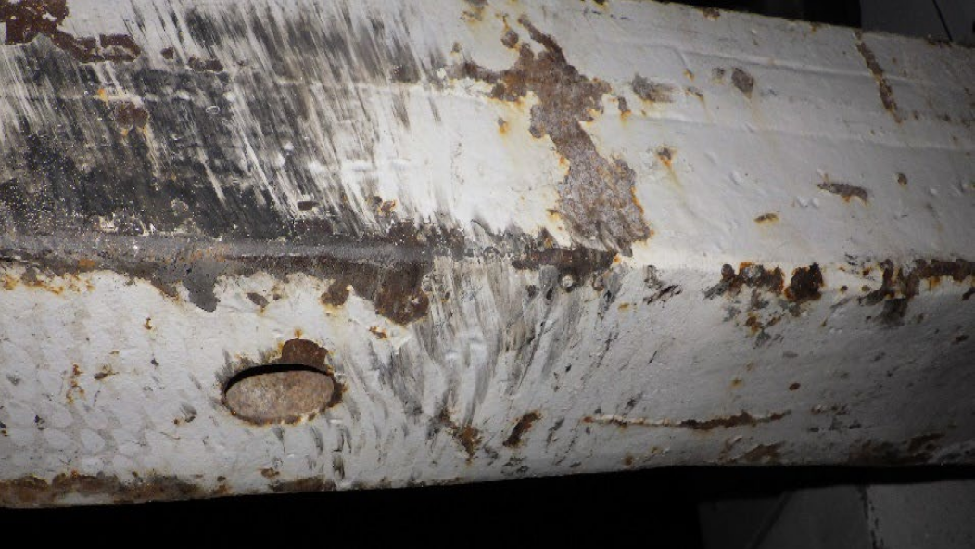
Rubber Scuff Marks on Draw Bar

Slide 79
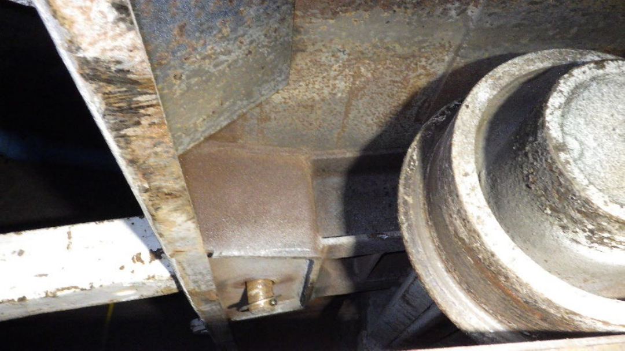
Rubber Scuff Marks on Power Car Frame

Slide 80
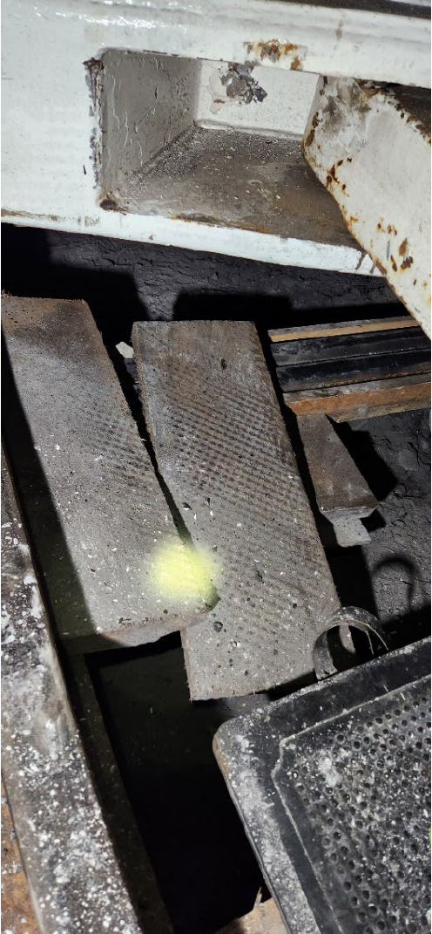
Impact Mark on Pocket with Paint Chips Below

Slide 81
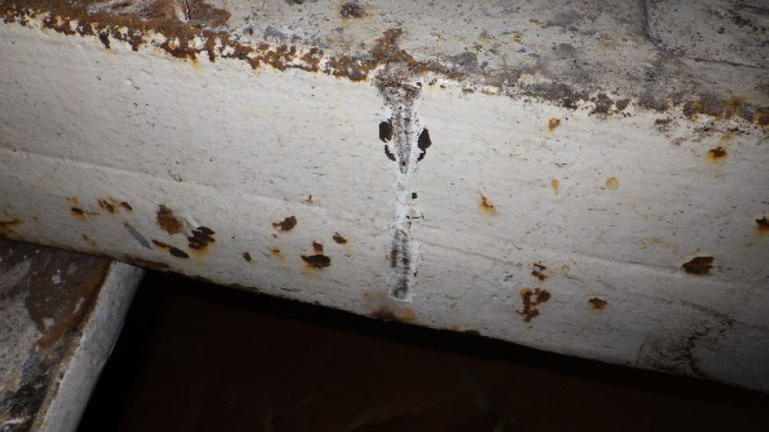
Impact Mark on Drawbar Where it Contacted the Pocket

Slide 82
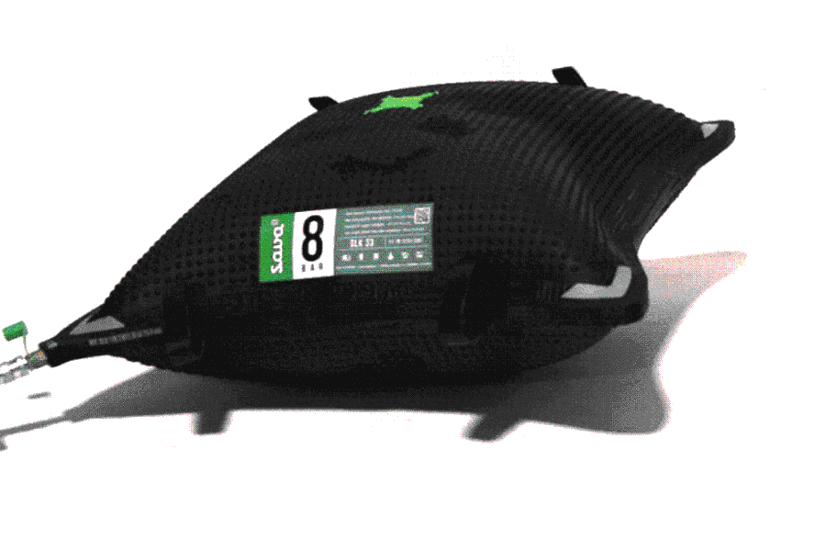
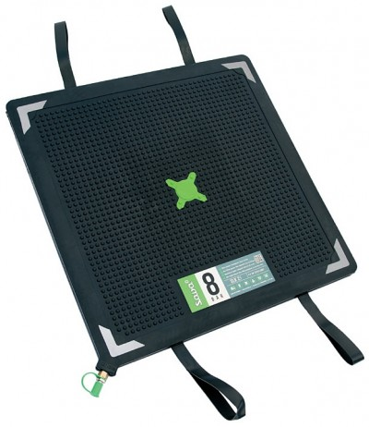
Air Lifting Bags (Airbags)
The three airbags involved in the accident were from two different manufacturers and two different sizes. The bottom airbag was a Sava, 8 bar, SFB-K 33/17, a flat airbag that measured 36 inches square. The middle airbag was a Simplex, 8 bar, SLK 70/20, a conventional airbag that measured 36 inches square. The top airbag was a Sava, 8 bar, SLK 45, conventional airbag that measured 30-1/2 inches square. Two of the three airbags were dislodged several feet from the locations where the miners placed them to rerail the power car. The investigators visually inspected the airbags with no obvious defects observed.

Slide 83
Investigators reviewed the mine operator’s written Safe Work Instructions (SWI). The locomotive operator SWI does not mention procedures for rerailing track mounted equipment or the use of airbags. The SWI for Sava lifting airbags states the following: 1) “Never place more than two lifting airbags one upon another” and 2) “Never avoid the controller and connect the pressure reducer directly to the lifting bag.” The airbags also had labels indicating the number that could be stacked on top of each other.
Investigators also reviewed both airbag manufacturers’ manuals, which contain the following requirements: 1) always use a controller with an independent air hose to each airbag to control the inflation and deflation of the airbags, 2) do not stack the air bags more than two high, 3) place the airbags on firm blocking, 4) block the airbags high enough to be within the recommended two and three quarter of an inch of the object to lift, 5) place a metal plate or fiberglass board between the airbags and distribute the load evenly, and 6) block any components on the load to be lifted to prevent movement during lifting. Based on examination and testimony, investigators determined the mine operator was not following these requirements when the accident occurred. A controller with individual air hoses to each airbag was not used. All the air hoses were connected to make one long air hose from the No. 11 locomotive to the power car, and the Midnight Shift Supervisor was placing his fingers over the inflation nozzles of two airbags to prevent deflation because there were not enough air hoses to use the controller properly. The air bags were stacked three high. The blocking material under the power car did not provide a firm foundation for the airbags and was not placed high enough so the airbags would be within the recommended two and three quarter of an inch of the power car before lifting. The placement of the airbags under the edge of the frame and under the drawbar did not evenly distribute the airbag lifting force. The drawbar was not secured against motion.
These actions did not follow the airbag manufacturers’ manuals and the mine operator’s SWI. Investigators determined that these factors contributed to the accident.

Slide 84
Examinations
The investigation team reviewed the 10 Left section track examination records and found them compliant, with no violations noted. Investigators determined that all examinations were adequate and did not contribute to the accident.
Training and Experience
The Victim had over 11 years of mining experience, including over 11 years as a locomotive operator at the Leer Mine. Investigators reviewed training records and determined he received annual refresher training in accordance with MSHA Part 48 training regulations. He also received task training on the use of airbags on November 5, 2013.
The Locomotive Operator had over 18 years of mining experience, including over 11 years as a locomotive operator at the Leer Mine. Investigators reviewed training records and determined he received annual refresher training in accordance with MSHA Part 48 training regulations. He also received task training on the use of airbags on November 5, 2013, and March 16, 2024. The Midnight Shift Supervisor had over 21 years of mining experience, including seven years as a foreman, and over two years as a midnight shift supervisor at the Leer Mine. Investigators reviewed training records and determined he received annual refresher training in accordance with MSHA Part 48 training regulations. He also actively participated in the use of the airbags but had never received training on the use of airbags.
Investigators determined the task training the Locomotive Operator received on March 16, 2024, was conducted by the Weekend Shift Foreman. According to interviews, the Weekend Shift Foreman never received training in the use of airbags at the Leer Mine, however, he had experience in the use of airbags and had received training at mines he had worked at previously. Investigators determined that with the number of deficiencies identified, the training was inadequate on the use of airbags and contributed to the accident.

Slide 85
ROOT CAUSE ANALYSIS
The accident investigation team conducted an analysis to identify the underlying causes of the accident. The team identified the following root causes, and the mine operator implemented the corresponding corrective actions to prevent a recurrence.
1. Root Cause: The mine operator did not properly install the track rails to accommodate all
equipment that would use them.
Corrective Action: The mine operator performed track repairs to increase the radius of the
curve to accommodate all equipment that will use the track.
2. Root Cause: The mine operator did not provide adequate training in the use of airbags when
rerailing track mounted equipment.
Corrective Action: The mine operator retrained all foremen, supervisors, and locomotive
operators in the use of airbags.
3. Root Cause: The mine operator did not have adequate written guidance to ensure the proper
use of airbags to rerail track mounted equipment.
Corrective Action: The mine operator revised their written procedures for airbag use and the
airbag manufacturer retrained all foreman, supervisors, and locomotive operators in the use of airbags.

Slide 86
CONCLUSION
On August 5, 2024, at 5:55 a.m., a 57 year-old locomotive operator with 11 years of mining experience, was seriously injured when rubber air lifting bags (airbags) suddenly dislodged while work was being performed to rerail a longwall electrical power car. The unanticipated movement of the airbags caused the power car drawbar to strike the victim in the head. He died from his injuries on August 7, 2024.
The accident occurred because the mine operator did not: 1) properly install the track rails to accommodate all equipment that would use them, 2) properly train all miners on the use of airbags to rerail track mounted equipment, and 3) have adequate written guidance to ensure the proper use of airbags to rerail track mounted equipment.

Slide 87
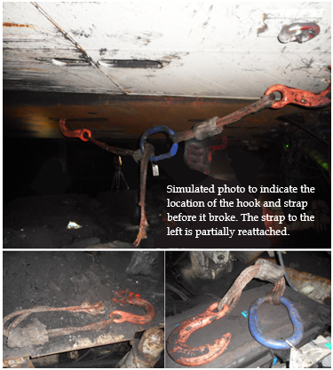
WEST VIRGINIA COAL MINE FATALITY – On September 28, 2024, a 34 year-old miner with 14 years of mining experience was injured when the hook and strap assembly broke while attached to two longwall shields. The miner died from his injuries on October 5, 2024.
Best Practices
Use blocking material under the shields or a properly sized mechanical device to help them stay level and together. Inspect equipment for abnormal wear and damage.
Follow the roof control plan.
Always remain a safe distance from any chains or slings that are under tension.

Slide 88
OVERVIEW
On September 28, 2024, at approximately 7:50 a.m., a 34-year-old electrician with 14 years of mining experience, was seriously injured while advancing longwall shields. Two longwall shields were connected with a nylon rope and hook sling. When the sling broke, a portion of the sling struck the Victim. He died from his injuries on October 5, 2024.
The accident occurred because the mine operator did not: 1) have adequate written guidance to ensure the safe advancement of the longwall shields when adverse conditions were encountered and connecting devices were used to prevent the shields from leaning and 2) train the miner on how to ensure safe advancement of the longwall shields when adverse conditions occur and connecting devices are used to prevent the shields from leaning.

Slide 89
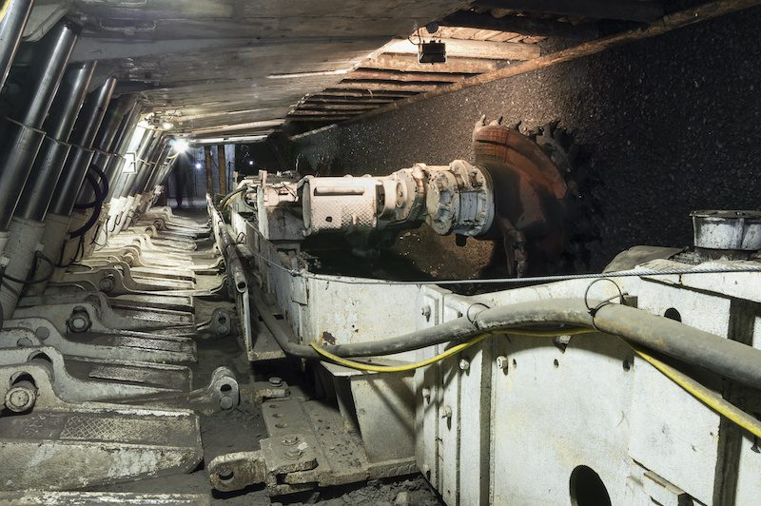
DESCRIPTION OF THE ACCIDENT
On September 27, 2024, at 11:00 p.m., the Victim started his shift and participated in a safety instruction meeting given by the Weekend Shift Foreman. This shift was a maintenance shift. According to records, the midnight shift longwall maintenance crew consisted of the Victim; Midnight Shift Maintenance Foreman/Emergency Medical Technician (EMT); an Apprentice Electrician; a Longwall Foreman (EMT); a Shield Operator; and a Longwall Electrician. The crew entered the mine and traveled to the 10 Left longwall section and arrived at approximately 12:10 a.m. on September 28, 2024. The shearer was located in the middle of the longwall face and the crew started mining towards the headgate. The crew stopped mining when the shearer reached the headgate to perform maintenance on the shearer. The Midnight Shift Maintenance Foreman also instructed the crew to repair longwall shields and perform other maintenance on the equipment during the shift. The work was completed at approximately 7:20 a.m.

Slide 90
The midnight shift longwall maintenance crew primarily performs maintenance, but the crew routinely mines coal before the dayshift longwall production crew arrives on the section. The apprentice electrician started the shearer and mined to the longwall tailgate. The Victim was following the shearer making sure the shields were advancing behind the shearer. The shearer cut out at the tailgate entry and mined back toward the headgate to the No. 146 shield. The Victim went inby the shearer to start advancing the tailgate shields and the apprentice electrician started mining back toward the tailgate for the second cutout.
According to interviews, at approximately 7:50 a.m., the apprentice electrician heard a loud boom and turned off the shearer near the No. 169 shield. He went to investigate the noise and found the Victim unconscious and breathing with an injury to the back of his head. The Victim was lying across the No. 172 shield pontoons with his head against the tailgate side of the No. 171 shield pontoon. The Apprentice Electrician called for help on the radio and rendered aid to the Victim. Another Longwall Electrician and Midnight Shift Maintenance Foreman/EMT were on the longwall face and heard the radio call for help. They went to the tailgate to assist the Apprentice Electrician. Longwall Foreman/EMT also heard the radio call for help and arrived at the tailgate shortly after to assist.

Slide 91
The dayshift longwall production crew was traveling in a personnel carrier toward the 10 Left longwall section when they heard the call for help on the radio. The Dispatcher, instructed them to go to the longwall face from the 9 Left Tailgate section (9 Left) to help with an injured miner. A Longwall Foreman/EMT; Shearer Operator; Shield Operator; , Shearer Operator; and another Shield Operator, traveled to No. 7 block in 9 Left and arrived at the No. 174 shield on the longwall face at approximately 8:05 a.m. The Victim was placed on a backboard and transported out the 9 Left entries to a personnel carrier. Two men from the dayshift crew and four men from the midnight shift crew rode with the Victim and continued to administer first aid as they traveled to the portal bottom. The Victim was transported to the surface on the elevator and his care was transferred to Taylor County Emergency Medical Services on the surface. The Victim was transported to Ruby Memorial Hospital in Morgantown, West Virginia for treatment. On October 5, 2024, at 4:16 p.m., Dr. Matthew Smith, M.D., pronounced Walls dead.

Slide 92
DISCUSSION
Accident Location:
The accident occurred on the 10 Left longwall face at the tailgate shields.
Longwall Shield Advancement
The longwall face has 174 shields and most of the shields are sequentially advanced by programmed automation. The headgate and tailgate shields are routinely lowered, advanced, and set individually in the manual mode using adjacent shield controls however, they can be cycled individually in an automatic lower, advance, and set mode from adjacent shields. Based on testimony, on an afternoon shift, on September 27, 2024, the longwall encountered soft
and uneven mine floor conditions in the tailgate that caused the tailgate shields to lean towards
the tailgate entry.
A Longwall Foreman, placed a chain and hook sling between the No. 174 and No. 173 shields and a nylon rope and hook sling between the No. 173 and No. 172 shields to
help keep the shields from leaning as they were advanced (see Appendix B). The slings help guide the shield as the ram jacks advance the shields. The slings remained attached to the shields
at the end of the afternoon shift. The investigators traveled to the tailgate shields and determined
that the mine floor had leveled out and the shields were not leaning at the time of the accident.

Slide 93
The Victim was the first person to advance the tailgate shields after the slings were installed. Based on the longwall computer data, the Victim first advanced the No. 174 shield and then automatically advanced the No. 173 shield from the No. 172 shield controls. Investigators concluded that the nylon rope and hook sling were overextended and broke when the No. 173 shield was advanced and set in automatic mode. When the nylon rope broke a portion of the sling struck the Victim. Investigators found one portion of the nylon rope and hook sling on the tail drive and the other portion of the sling consisting of the hook and D-ring on the mine floor near the Victim’s location (see Appendix C next 2 slides). Investigators concluded that the Victim was struck by the hook and/or D-ring portion of the sling.
The mine operator did not have a written policy or procedure in place to address safe operation and advancement of the longwall shields when adverse ground conditions were encountered. The mine operator used the manufacturer’s pocket guide for the operation of the longwall shield controls but this guide does not address adverse geological conditions. Investigators determined this contributed to the accident.

Slide 94
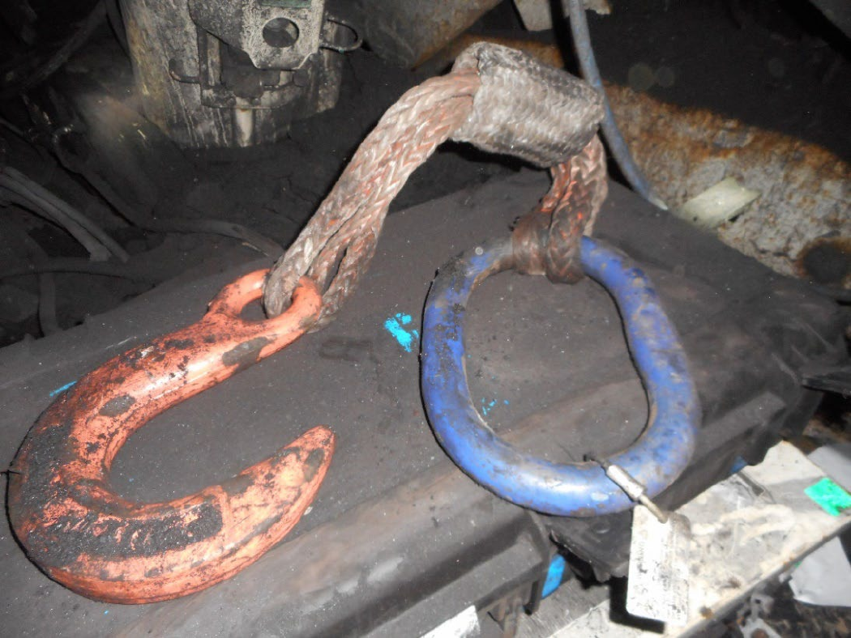
Sling Portion Found on Mine Floor

Slide 95

Sling Portion Found on the Tail Drive

Slide 96
Examinations
The investigation team reviewed the 10 Left section examination records and found them to be compliant. Investigators determined that all examinations were completed and adequate and did not contribute to the accident.
Training and Experience:
The Victim had 14 years of mining experience, including over seven years at the Leer Mine. Investigators reviewed training records and determined the Victim received annual refresher training in accordance with MSHA Part 48 training regulations.
The Victim received task training on longwall shields on March 15, 2024. However, this training did not include how to advance the longwall shields when adverse conditions were encountered and connecting devices were being used to prevent the shield from leaning. Investigators determined this contributed to the accident.

Slide 97
ROOT CAUSE ANALYSIS
The accident investigation team conducted an analysis to identify the underlying causes of the accident. The team identified the following root causes, and the mine operator implemented the corresponding corrective actions to prevent a recurrence.
1. Root Cause: The mine operator did not have a written policy or procedure in place to ensure
the safe advancement of the longwall shields when adverse conditions were encountered and connecting devices were used to prevent the shields from leaning.
Corrective Action: The mine operator developed and implemented the following written
procedures to be followed when shields are connected with slings during shield
advancement:
The shield operator will position himself at least three shields away from the shields that are connected with a device, prior to moving either of the connected shields. For example, if shields 208 and 207 are connected, the shield operator may not move either shield 208 or 207 from any position closer than shield 204 or 211. The shield will be manually operated during this time.
The shield operator will ensure that his body position is not in the direct line of fire should the connecting device fail, regardless of the distance from the connecting device.
The connecting device will only be removed once the connected shields have been advanced and pressurized to the roof and there is no tension on the connecting device.
Only suitable connecting devices, without rings, will be used on the active longwall face.
All employees involved with advancing shields using a connecting device will be instructed on the contents of this plan.

Slide 98



2. Root Cause: The mine operator did not train the miner on how to ensure safe advancement
of the longwall shields when adverse conditions occur and connecting devices are used to prevent the shields from leaning.
Corrective Action: The mine operator trained all miners that perform advancement of
longwall shields on the new written procedures.

Slide 99
CONCLUSION
On September 28, 2024, at approximately 7:50 a.m., the Victim a 34-year-old electrician with 14 years of mining experience, was seriously injured while advancing longwall shields. Two longwall shields were connected with a nylon rope and hook sling. When the sling broke, a portion of the sling struck the Victim. He died from his injuries on October 5, 2024.
The accident occurred because the mine operator did not: 1) have adequate written guidance to ensure the safe advancement of the longwall shields when adverse conditions were encountered and connecting devices are used to prevent the shields from leaning and 2) train the miner on how to ensure safe advancement of the longwall shields when adverse conditions occur and connecting devices were used to prevent the shields from leaning.

