Slide 1
Pre-shift - Onshift Examinations
What does the law require?
What is required to be entered in the record books?
What are the consequences of inadequate exams?
What are the consequences according to law?

Slide 2

Responsibility for Safety
Congress declared in the Federal Mine Safety & Health Act of 1977 the first priority of the mining industry must be the health and safety of the miner.

Slide 3
MINE FATALITY – On March 2, 2022, a miner was fatally injured when an overhang along the mine rib fell, striking the miner and pushing him against the canopy of a twin boom roof bolting machine. The miner freed himself from the fall, but later died.
Responsibility for Safety
The mine operator along with the assistance of miners have the primary responsibility to prevent the existence of unsafe and unhealthful conditions and practices in mines.
Workplace examinations are required to alert mine management to any changes in the mine ventilation system and other potentially dangerous mining conditions or hazards before accidents can happen.

Slide 4
MINE FATALITY – On February 28, 2022, a contract miner died when he was crushed between the rib and a single boom face drill. The victim was alongside the drill using the onboard tram lever controls when the accident occurred because the remote control was inoperable.
Responsibility for Safety
Each mine examiner’s task is to conduct a proper and complete examination to accomplish an accurate assessment of conditions within the mine.
Recording results of exams along with performing follow-up action to eliminate noted hazards should be routine and is necessary for accomplishing a safe mine.

Slide 5

Responsibility for Safety
The General Mine Foreman has the sole responsibility for seeing that the mine is safe and violation free to the best of his or her knowledge and ability according to law. Some of our mines today cover extensive areas and therefore, many Mine Foreman and Fire Bosses are needed to help accomplish the General Mine Foreman’s duties. The Outby Examiner can also help relieve some of the duties of the General Mine Foreman by having the authority to examine all areas outby the loading point on the section. Which also includes abandoned areas such required weekly examinations by law.

Slide 6
The mine foreman, assistant mine foreman, or fire boss shall visit and carefully examine each working place in which miners will be working at the beginning of each shift (pre-shift) before any face equipment is energized and shall examine each working place in the mine at least once every two hours each shift (on-shift) while such miners are at work in such places, and shall direct that each working place shall be secured by props, timbers, roof bolts, or other approved methods of roof support or both where necessary to the end that the working places shall be made safe. The mine foreman or his or her assistants upon observing a violation or potential violation of §22A-2-1 et seq. of this code or any regulation or any plan or agreement promulgated or entered into thereunder shall arrange for the prompt correction thereof. The foreman shall not permit any miner other than a certified foreman, fire boss, assistant mine foreman, assistant mine foreman-fire boss or pumper to be on a working section by himself or herself. Should the mine foreman or his or her assistants find a place to be in a dangerous condition, they shall not leave the place until it is made safe or shall remove the persons working therein until the place is made safe by some competent person designated for that purpose.
He or she shall place his or her initials, time and the date at or near each place he or she examines. He or she shall also record any dangerous conditions and practices found during his or her examination in a book provided for that purpose.
Working place: The term “working place” means the area of a coal mine inby the last open crosscut.
Working section: The term “working section” means all areas of the coal mine from the loading point of the section to and including the working faces.

Slide 7
MINE FATALITY – On January 14, 2022, a 44-year-old contract laborer with 13 years of total experience received fatal injuries when he fell 27 feet to a concrete surface. At the time of the accident, the contractor was on a belt conveyor in a preparation plant and was working to replace a belt conveyor roller.
Pre-shift – On shift Examinations
Purpose:
Primary means to determine effectiveness of mine ventilation system and detect hazards such as accumulations of methane.
Proper examinations protect against mine fires and explosions; oxygen deficient atmospheres; accumulations of other harmful gases; and other hazards that may endanger miners.

Slide 8
HAZARDOUS CONDITIONS
The first priority of all workplace examinations is for the person conducting the examination to examine for hazardous conditions.
For the purpose of workplace examinations, hazards are considered to be conditions that are likely to cause death or bodily injury to persons exposed to such conditions.

Slide 9
(a)(1) Except as provided in paragraph (a)(2) of this section, a certified person designated by the operator must make a pre-shift examination within 3 hours preceding the beginning of any 8-hour interval during which any person is scheduled to work or travel underground. No person other than certified examiners may enter or remain in any underground area unless a pre-shift examination has been completed for the established 8-hour interval. The operator must establish 8-hour intervals of time subject to the required pre-shift examinations.
(2) Pre-shift examinations of areas where pumpers are scheduled to work or travel shall not be required prior to the pumper entering the areas if the pumper is a certified person and the pumper conducts an examination for hazardous conditions, tests for methane and oxygen deficiency and determines if the air is moving in its proper direction in the area where the pumper works or travels. The examination of the area must be completed before the pumper performs any other work. A record of all hazardous conditions found by the pumper shall be made and retained in accordance with §75.363.
30 CFR §75.360 WV §22A-2-20
Pre-shift Examination

Slide 10
§22A-2-20. Preparation of danger signal by fire boss or certified person acting as such prior to examination; report; records open for inspection.
Fire Boss Board
(a) It is the duty of the fire boss, or a certified person acting as such, to prepare a danger signal (a separate signal for each shift) with red color at the mine entrance at the beginning of his or her shift or prior to his or her entering the mine to make his or her examination and, except for those persons already on assigned duty, no person except the mine owner, operator or agent, and only then in the case of necessity, shall pass beyond this danger signal until the mine has been examined by the fire boss or other certified person and the mine or certain parts thereof reported by him or her to be safe. When reported by him or her to be safe, the danger sign or color thereof shall be changed to indicate that the mine is safe in order that employees going on shift may begin work.

Slide 11
DANGER BOARDS
Each person designated to make the fire boss examinations shall be assigned a definite underground area of the mine, and, in making his or her examination shall examine all active working places in the assigned area and make tests with an approved device for accumulations of methane and oxygen deficiency; examine seals and doors; examine and test the roof, face and ribs in the working places and on active roadways and travelways, approaches to abandoned workings, accessible falls in active sections and areas where any person is scheduled to work or travel underground. He or she shall place his or her initials and the date at or near the face of each place he or she examines. Should he or she find a condition which he or she considers dangerous to persons entering the areas, he or she shall place a conspicuous danger sign at all entrances to the place or places. Only persons authorized by the mine management may enter the places while the sign is posted and only for the purpose of eliminating the dangerous condition. Upon completing his or her examination he or she shall report by suitable communication system or in person the results of this examination to a certified person trained as a certified miner with at least two years mining experience designated by mine management to receive and record the report, at a designated station on the surface of the premises of the mine or underground, before other persons enter the mine to work in coal-producing shifts.
He or she shall also record the results of his or her examination with ink or indelible pencil in a book prescribed by the director, kept for the purpose at a place on the surface of the mine designated by mine management. All records of daily and weekly reports, as prescribed herein, shall be open for inspection by interested persons.

Slide 12

(b) Supplemental examination. - When it becomes necessary to have workers enter areas of the mine not covered during the pre-shift examination, a supplemental examination shall be performed by a fire boss or certified person acting as such within three hours before any person enters the area. The fire boss or certified person acting as such shall examine the area for hazardous conditions, determine if air is traveling in its proper direction and test for oxygen deficiency and methane.
(c) Each examined area shall be certified by date, time and the initials of the examiner.
(d) The results of the examination shall be recorded with ink or indelible pencil by the examiner in the book referenced in subsection (a) of this section before he or she leaves the mine on that shift.
§22A-2-21. Fire bosses to have no superior officers.
In the performance of the duties devolving upon fire bosses, or certified persons acting as such, they shall have no superior officers, but all the employees working inside of such mine or mines shall be subordinate to them in their particular work.

Slide 13
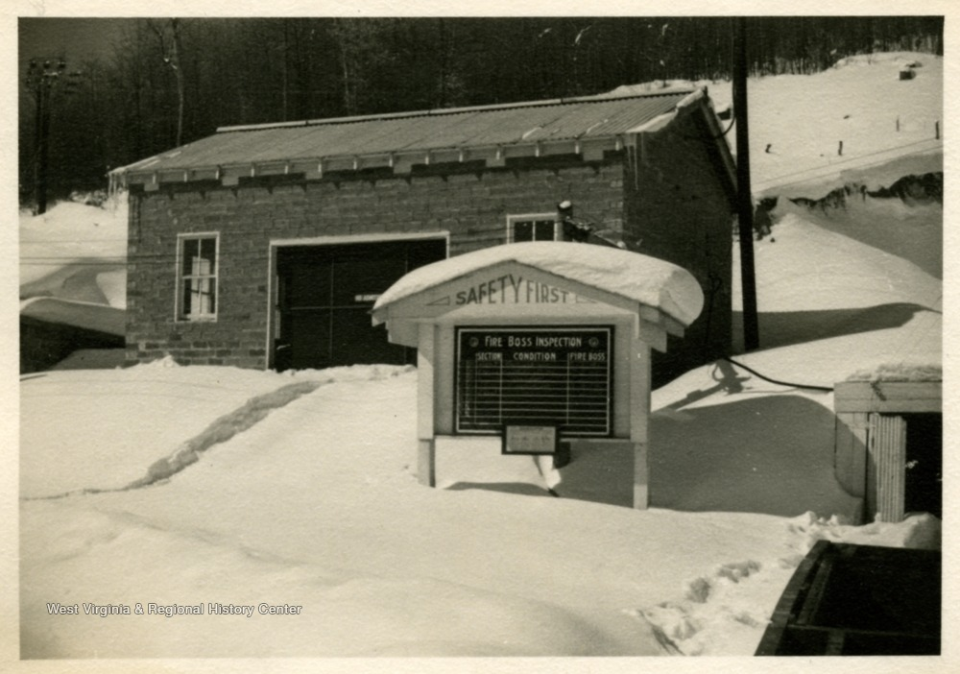
§22A-2-22. Unlawful to enter mine until fire boss reports it safe; exceptions.
No person shall enter such mine or mines for any purpose at the beginning of work upon shift therein until such signal or warning has been given by the fire boss or bosses as to the safety thereof, as by statute provided, except under the direction of the fire boss or bosses, and then for the purpose of assisting in making the mine safe: Provided, however, That miners regularly employed on a shift during which the mine is being pre-shift examined by a fire boss or certified person shall be permitted to leave or enter the mine in the performance of their duties.

Slide 14
§22A-2-23. Authority of fire boss to perform other duties.
Notwithstanding any other provision in this article contained, any person who holds a certificate issued by the office of miners’ health, safety and training certifying his or her competency to act as fire boss may perform the duties of a fire boss and any other duties, statutory or otherwise, for which he or she is qualified, in the same mine or section and on the same day or shift.
§22A-2-24. Control of coal dust; rock dusting.
(a) In all mines, dangerous accumulations of fine, dry coal and coal dust shall be removed from the mine, and all dry and dusty operating sections and haulageways and conveyors and back entries shall be rock dusted, or dust allayed by other methods as may be approved by the director.
(b) All mines or locations in mines that are too wet or too high in incombustible content for a coal dust explosion to initiate or propagate are not required to be rock dusted during the time any of these conditions prevail. Coal dust and other dust in suspension in unusual quantities shall be allayed by sprinkling or other dust allaying devices.

Slide 15

(c) In all dry and dusty mines or sections thereof, rock dust shall be applied and maintained upon the roof, floor and sides of all operating sections, haulageways and parallel entries connected thereto by open crosscuts. Back entries shall be rock dusted. Rock dust shall be so applied to include the last open crosscut of rooms and entries, and to within forty feet of faces. Rock dust shall be maintained in a quantity that the incombustible content of the mine dust that could initiate or propagate an explosion shall not be less than eighty percent. The incombustible content of mine dust in return entries shall also be equal to or greater than eighty percent.
(d) Rock dust shall not contain more than five percent by volume of quartz or free silica particles and shall be pulverized so that one hundred percent will pass through a twenty-mesh screen and seventy percent or more will pass through a two hundred mesh screen.
(e) If requested by the director, an operator shall provide records establishing the quantity of bulk and bag rock dust purchased for a period not to exceed the immediately preceding six months.

Slide 16
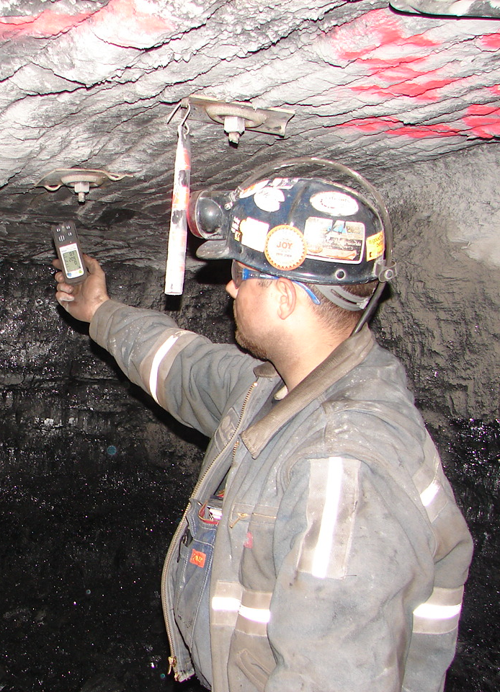
30 CFR § 75.360 WV &22A-2-20 Pre-shift examination
b) The person conducting the pre-shift examination shall examine for hazardous conditions, test for methane and oxygen deficiency, and determine if the air is moving in its proper direction at the following locations: (1) Roadways, travelways and track haulageways where persons are scheduled, prior to the beginning of the pre-shift examination, to work or travel during the oncoming shift. (2) Belt conveyors that will be used to transport persons during the oncoming shift and the entries in which these belt conveyors are located.
Mine Forman Examines the section loading point and Inby places.
Outby Examiner Examines all outby the loading point places.

Slide 17
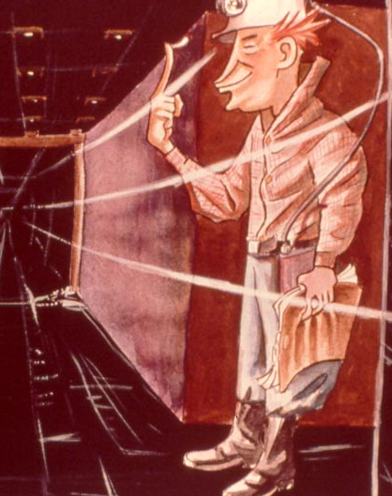
Pre-shift Examination -- continued
(3) Working sections and areas where mechanized mining equipment is being installed or removed, if anyone is scheduled to work on the section or in the area during the oncoming shift. The scope of the examination shall include the working places, approaches to worked-out areas and ventilation controls on these sections and in these areas, and the examination shall include tests of the roof, face and rib conditions on these sections and in these areas.

Slide 18
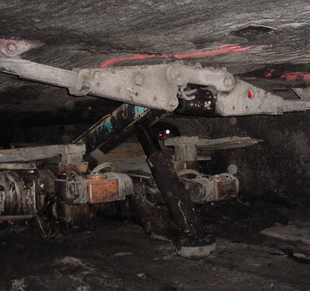
Mine Foreman
§36-26-4. On-shift Examination of Construction and Rehabilitation Work Areas.
4.1. In addition to the pre-shift examination, an on-shift examination shall be made of all construction and rehabilitation work areas between the third and fifth hours while persons are working, and such examination shall be recorded in a book prescribed for such purposes and located on the surface.
§36-26-5. Automated Temporary Roof Support (ATRS) Systems on Roof Bolting Machines used for Construction and Rehabilitation.
5.1. Where required by the Director of the Office of Miners’ Health, Safety and Training, roof bolting machines used for construction or for rehabilitation work shall be equipped with an approved automated temporary roof support (ATRS) system. However, when spot bolting is done on track haulage roads, machines shall not be required to have ATRS.

Slide 19
5.2. In determining where such ATRS system is needed, the Director shall consider the following: (a) whether the use of ATRS would pose a greater hazard than not using it; (b) whether the technology of ATRS exists to allow compliance with this rule; and (c) the conditions at the construction or rehabilitation site.
5.3. Minimum Requirements for Machines Using, or Used as, ATRS. All machines using, or used as, an automated temporary roof support system in accordance with this section shall comply with the minimum requirements for ATRS as specified in 36 CSR §10-10.

Slide 20
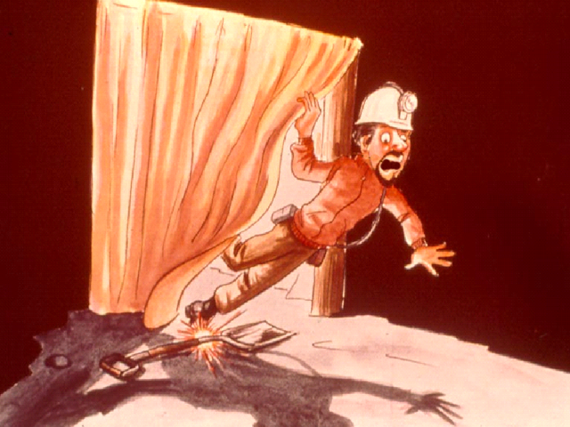
MINE FATALITY – On November 1, 2021, an electrician with 25 years of mining experience was fatally injured while traveling down a mine slope. He lost control of a four-passenger rubber-tired personnel carrier, and the vehicle crashed at the bottom of the slope, pinning the victim underneath.
30 CFR 75.360 (B) - Pre-shift Examination
WV 22A-2-20
Examine for hazardous conditions.
Test for methane and oxygen deficiency.
Determine if air is moving in its proper direction.
Location: Logan, West Virginia

Slide 21
Pre-shift Examination
Examine for hazardous conditions:
Loose roof and ribs.
Excessive levels of methane.
Oxygen deficiency.
Damaged, missing or improperly installed ventilation controls on the section.
Accumulations of loose coal or coal dust.
Rock dust not applied in required quantities.
Electrical hazards.
Fire hazards from damaged or improperly operating belt conveyors.
Other obvious fire hazards.

Slide 22
MINE FATALITY – On August 11, 2021, a 53-year-old contract truck driver with ten years’ experience was fatally injured while conducting a pre-operational examination of a truck. The rear wheels of the vehicle struck the truck driver when the truck rolled forward.
30 CFR § 75.360 WV & 22A-2-20 Pre-shift examination
(4) Approaches to worked-out areas along intake air courses and at the entries used to carry air into worked-out areas if the intake air passing the approaches is used to ventilate working sections where anyone is scheduled to work during the oncoming shift. The examination of the approaches to the worked-out areas shall be made in the intake air course immediately inby and outby each entry used to carry air into the worked-out area. An examination of the entries used to carry air into the worked-out areas shall be conducted at a point immediately inby the intersection of each entry with the intake air course.
(5) Seals along intake air courses where intake air passes by a seal to ventilate working sections where anyone is scheduled to work during the oncoming shift.

Slide 23
Worked Out Area
Working Section
X =Pre-shift Examination
Locations
For 75.360(b)(4)
C
C
C
C
C
Section
C
C
C
R
x
x
x
x
x
R
Intake to
x
x
x
x
x
x
belt
Air Passing Approaches to Worked-Out Area

Slide 24
Sealed Area
Seals Pre-shift Required
Working Section
Pre-shift Examination

Slide 25
30 CFR § 75.360 WV &22A -2-20 Pre-shift examination
Location: Marion, West Virginia
(7) Areas where trolley wires or trolley feeder wires are to be or will remain energized during the oncoming shift.
(8) High spots along intake air courses where methane is likely to accumulate, if equipment will be operated in the area during the shift.
(9) Underground electrical installations referred to in §75.340(a), except those pumps listed in §75.340(b)(2) through (b)(6), and areas where compressors subject to §75.344 are installed if the electrical installation or compressor is or will be energized during the shift.
(10) Other areas where work or travel during the oncoming shift is scheduled prior to the beginning of the pre-shift examination.

Slide 26
Pre-shift Examination Locations
High spots along intake air courses where methane is likely to accumulate, if equipment will be operated in area during shift

Slide 27
Pre-shift Examination
Battery Tractor Road
Track
Working Section
Belt
High Spots
Cavity Areas

Slide 28
Pre-shift Examination Locations
Underground electrical installations except for pumps listed in 75.340 (b)(2) through (b)(6) and compressors if energized during the shift
Transformer stations
Battery charging stations
Substations
Rectifiers
Water pumps

Slide 29

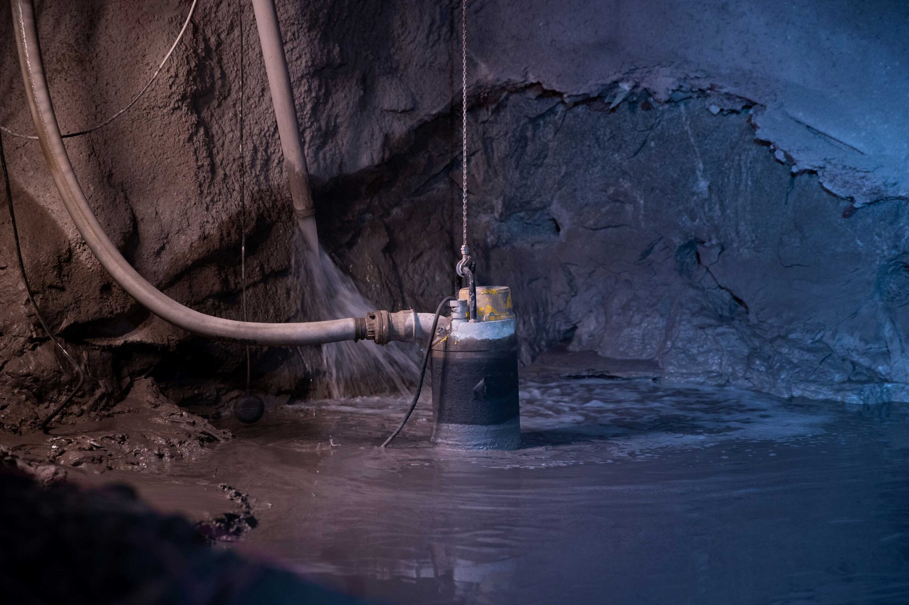
(b) This section does not apply to—
(2) Submersible pumps;
(3) Permissible pumps and associated permissible switchgear;
(4) Pumps located on or near the section and that are moved as the working section advances or retreats;
(5) Pumps installed in anthracite mines; and
(6) Small portable pumps.

Slide 30
Pre-shift Examination
Enclosed
Electrical
Installation
Battery Charger
Power Center
R
Working Section
Unattended
Compressor
Belt Drive
Power Box
Permanent
Pump

Slide 31
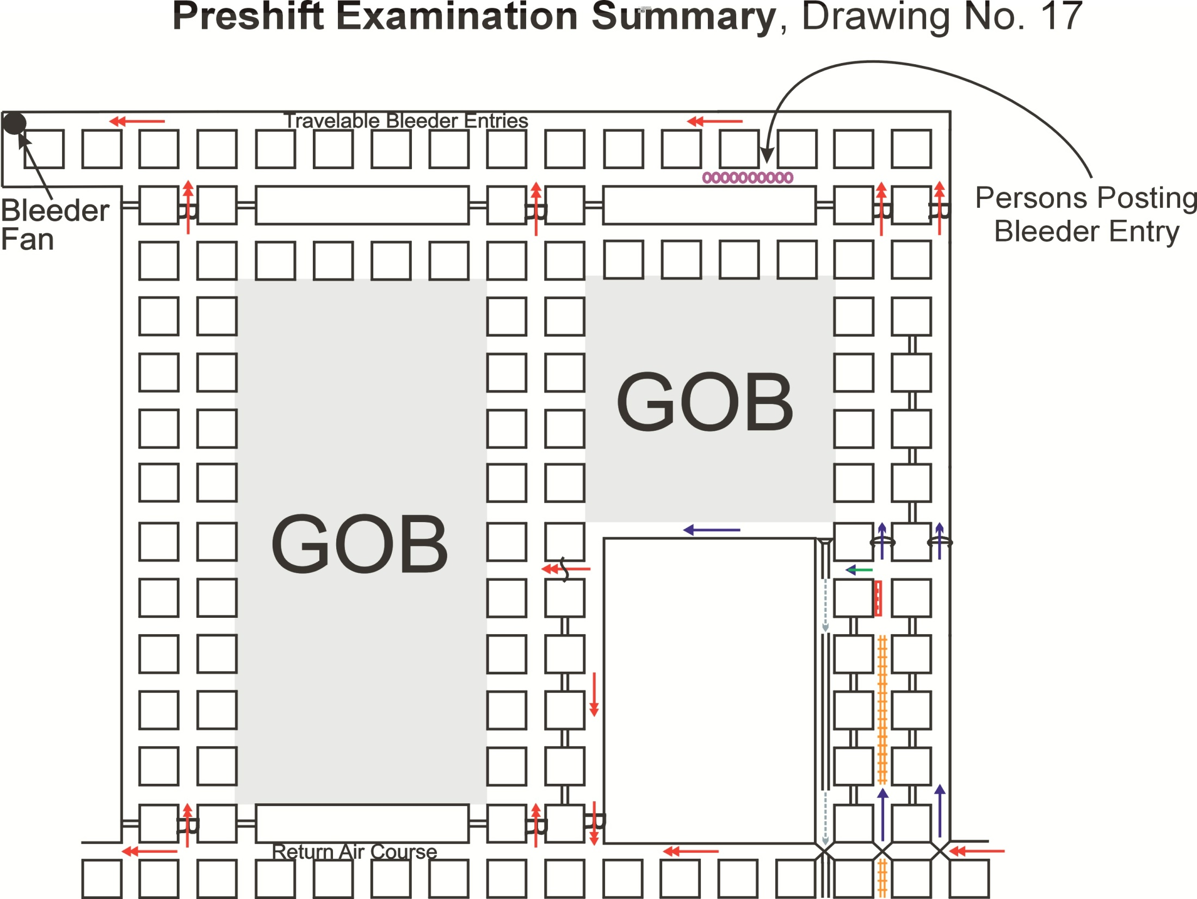

Slide 32
30 CFR § 75.360 Pre-shift examination
(c) The person conducting the pre-shift examination shall determine the volume of air entering each of the following areas if anyone is scheduled to work in the areas during the oncoming shift:
(1) In the last open crosscut of each set of entries or rooms on each working section and areas where mechanized mining equipment is being installed or removed. The last open crosscut is the crosscut in the line of pillars containing the permanent stoppings that separate the intake air courses and the return air courses.

Slide 33
30 CFR § 75.360 Pre-shift examination
(2) On each longwall or shortwall in the intake entry or entries at the intake end of the longwall or shortwall face immediately outby the face and the velocity of air at each end of the face at the locations specified in the approved ventilation plan.
(3) At the intake end of any pillar line—
(i) If a single split of air is used, in the intake entry furthest from the return air course, immediately outby the first open crosscut outby the line of pillars being mined; or
(ii) If a split system is used, in the intake entries of each split immediately inby the split point.

Slide 34
30 CFR § 75.360 Pre-shift examination
(d) The person conducting the pre-shift examination shall check the refuge alternative for damage, the integrity of the tamper-evident seal and the mechanisms required to deploy the refuge alternative, and the ready availability of compressed oxygen and air.
(e) The district manager may require the certified person to examine other areas of the mine or examine for other hazards during the pre-shift examination.
(f) Certification. At each working place examined, the person doing the pre-shift examination shall certify by initials, date, and the time that the examination was made. In areas required to be examined outby a working section, the certified person shall certify by initials, date, and the time at enough locations to show that the entire area has been examined at each working place examined, the person conducting the exam shall certify by initials, date and time that the examination was made in areas required to be examined outby the working section, examiner shall certify by initials, date and time at enough locations to show entire area has been examined. Dates, times and initials should be placed frequently and conspicuously to ensure that the entire area has been examined.

Slide 35
Pre-shift
Each working Place Does Not Apply to WV OUTBY MINE EXAMINER
30 CFR 75.360 Certification
At each working place examined, the person conducting the exam shall certify by initials, date, and time that the examination was made
In areas required to be examined outby the working section, examiner shall certify by initials, date, and time at enough locations to show entire area has been examined

Slide 36
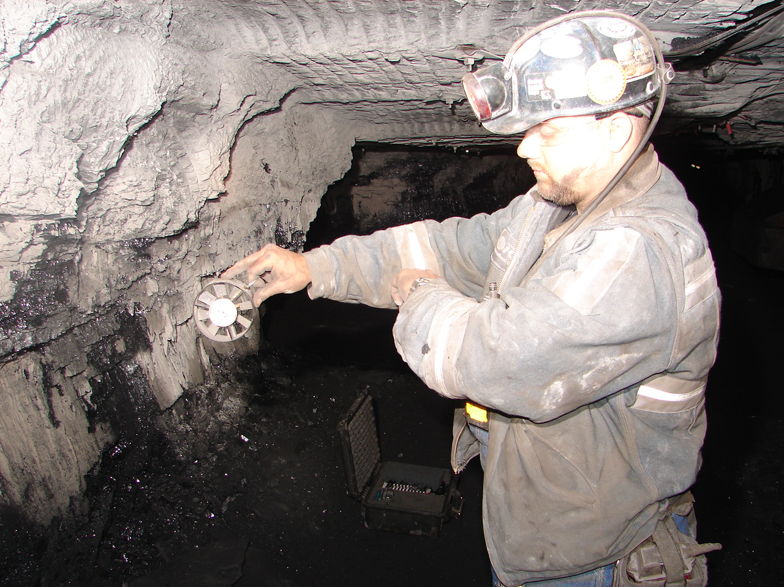
30 CFR § 75.362 On-shift examination
(a)(1) At least once during each shift, or more often if necessary for safety, a certified person designated by the operator shall conduct a test for methane and oxygen deficiency and determine if the air is moving in its proper direction.

Slide 37
30 CFR § 75.362 On-shift examination
Generally, will not apply to WV Outby Mine Examiner. Could apply if cutting overcast or etc. outby working section.
(2) A person designated by the operator shall conduct an examination to assure compliance with the respirable dust control parameters specified in the mine ventilation plan. In those instances when a shift change is accomplished without an interruption in production on a section, the examination shall be made anytime within 1 hour of the shift change. In those instances when there is an interruption in production during the shift change, the examination shall be made before production begins on a section. Deficiencies in dust controls shall be corrected before production begins or resumes. The examination shall include air quantities and velocities, water pressures and flow rates, excessive leakage in the water delivery system, water spray numbers and orientations, section ventilation and control device placement, and any other dust suppression measures required by the ventilation plan. Measurements of the air velocity and quantity, water pressure and flow rates are not required if continuous monitoring of these controls is used and indicates that the dust controls are functioning properly

Slide 38
30 CFR § 75.362 On-shift examination
(b) During each shift that coal is produced, a certified person shall examine for hazardous conditions along each belt conveyor haulageway where a belt conveyor is operated. This examination may be conducted at the same time as the pre-shift examination of belt conveyors and belt conveyor haulageways, if the examination is conducted within 3 hours before the oncoming shift.
(c) Persons conducting the on-shift examination shall determine at the following locations:
(1) The volume of air in the last open crosscut of each set of entries or rooms on each section and areas where mechanized mining equipment is being installed or removed. The last open crosscut is the crosscut in the line of pillars containing the permanent stoppings that separate the intake air courses and the return air courses.
(2) The volume of air on a longwall or shortwall, including areas where longwall or shortwall equipment is being installed or removed, in the intake entry or entries at the intake end of the longwall or shortwall

Slide 39
30 CFR § 75.362 On-shift examination
(3) The velocity of air at each end of the longwall or shortwall face at the locations specified in the approved ventilation plan.
(4) The volume of air at the intake end of any pillar line—
(i) Where a single split of air is used in the intake entry furthest from the return air course immediately outby the first open crosscut outby the line of pillars being mined; or
(ii) Where a split system is used in the intake entries of each split immediately inby the split point.
(d)(1) A qualified person shall make tests for methane—
(i) At the start of each shift at each working place before electrically operated equipment is energized; and
(ii) Immediately before equipment is energized, taken into, or operated in a working place; and
(iii) At 20-minute intervals, or more often if required in the approved ventilation plan at specific locations, during the operation of equipment in the working place.

Slide 40
30 CFR § 75.362 On-shift examination
Applies to WV Outby Mine Examiner when working outby section
(iii) The methane monitor sensor must be mounted near the inby end and within 18 inches of the longitudinal center of the ATRS support and positioned at least 12 inches from the roof when the ATRS is fully deployed.
(iv) Manual methane tests must be made at intervals not exceeding 20 minutes. The test may be made either from under permanent roof support or from the roof bolter's work position protected by the deployed ATRS.
(v) Once a methane test is made at the face, all subsequent methane tests in the same area of unsupported roof must also be made at the face, from under permanent roof support, using extendable probes or other acceptable means at intervals not exceeding 20 minutes.
(vi) The district manager may require that the ventilation plan include the minimum air quantity and the position and placement of ventilation controls to be maintained during roof bolting.

Slide 41
30 CFR § 75.362 On-shift examination
(e) If auxiliary fans and tubing are used, they shall be inspected frequently.
(f) During each shift that coal is produced and at intervals not exceeding 4 hours, tests for methane shall be made by a certified person or by an atmospheric monitoring system (AMS) in each return split of air from each working section between the last working place, or longwall or shortwall face, ventilated by that split of air and the junction of the return air split with another air split, seal, or worked-out area. If auxiliary fans and tubing are used, the tests shall be made at a location outby the auxiliary fan discharge
(g) Certification.
(1) The person conducting the on-shift examination in belt haulage entries shall certify by initials, date, and time that the examination was made. The certified person shall certify by initials, date, and the time at enough locations to show that the entire area has been examined.
(2) The certified person directing the on-shift examination to assure compliance with the respirable dust control parameters specified in the mine ventilation plan shall certify by initials, date, and time that the examination was made.

Slide 42
30 CFR § 75.363 Hazardous conditions; posting, correcting and recording.
(a) Any hazardous condition found by the mine foreman or equivalent mine official, assistant mine foreman or equivalent mine official, or other certified persons designated by the operator for the purposes of conducting examinations under this subpart D, shall be posted with a conspicuous danger sign where anyone entering the areas would pass. A hazardous condition shall be corrected immediately, or the area shall remain posted until the hazardous condition is corrected. If the condition creates an imminent danger, everyone except those persons referred to in section 104(c) of the Act shall be withdrawn from the area affected to a safe area until the hazardous condition is corrected. Only persons designated by the operator to correct or evaluate the condition may enter the posted area.

Slide 43
30 CFR § 75.363 Hazardous conditions; posting, correcting and recording.
(b) A record shall be made of any hazardous condition found. This record shall be kept in a book maintained for this purpose on the surface at the mine. The record shall be made by the completion of the shift on which the hazardous condition is found and shall include the nature and location of the hazardous condition and the corrective action taken. This record shall not be required for shifts when no hazardous conditions are found or for hazardous conditions found during the pre-shift or weekly examinations inasmuch these examinations have separate recordkeeping requirements.
(c) The record shall be made by the certified person who conducted the examination, or a person designated by the operator. If made by a person other than the certified person, the certified person shall verify the record by initials and date by or at the end of the shift for which the examination was made. Records shall be countersigned by the mine foreman or equivalent mine official by the end of the mine foreman's or equivalent mine official's next regularly scheduled working shift. The record shall be made in a secure book that is not susceptible to alteration or electronically in a computer system so as to be secure and not susceptible to alteration.

Slide 44
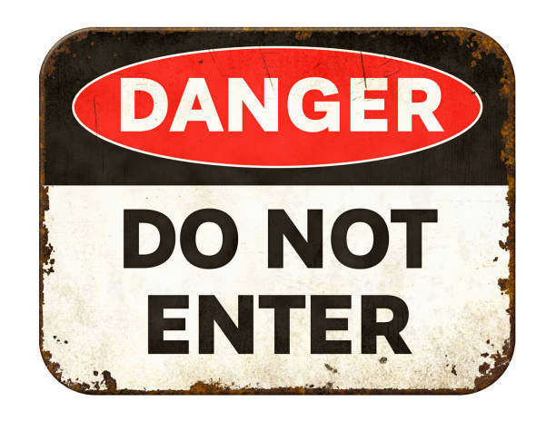
When the Examiner Finds a Hazardous Condition:
Correct or Post with a Conspicuous Danger Sign
If hazardous condition creates an imminent danger, withdraw all miners from affected area except those needed to correct the hazard.

Slide 45
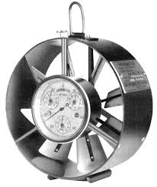
Pre-shift / Onshift Examinations
Air quantity (last open crosscut and pillar line)
9,000 cfm
Greater quantity may be required in plan
Minimum applies to sections not operating but capable of producing coal by simply energizing equipment
Air quantity (ventilation maintained during installation and removal of mechanized mining equipment)
Approved Ventilation plan specifies
Quantity
Locations
Ventilation controls required

Slide 46
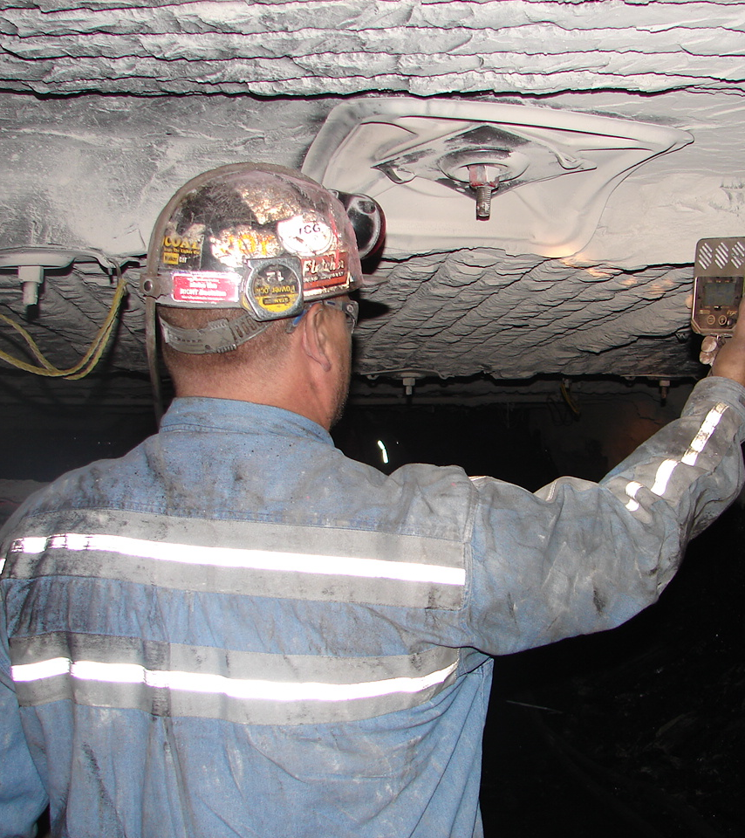
Pre-shift / Onshift Examinations
Test for methane
Tests to be made at least 12 inches from roof, face, ribs, and floor
Working places, intake air courses (includes belt entries), areas where equipment is being installed or removed
Air quality
19.5 percent oxygen – minimum
0.5 percent carbon dioxide - maximum

Slide 47
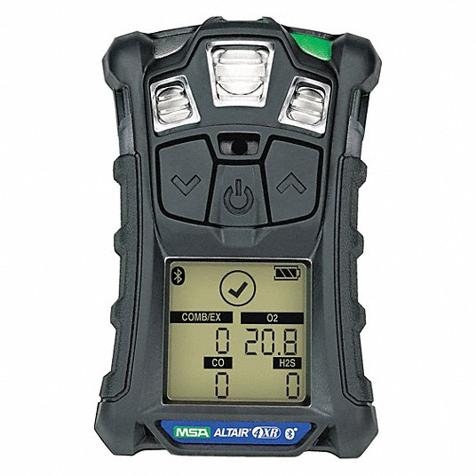
30 CFR § 75.321
Air quality
(a) The air in areas where persons work or travel shall contain at least 19.5 percent oxygen and not more than 0.5 percent carbon dioxide, and the volume and velocity of the air current in these areas shall be sufficient to dilute, render harmless, and carry away flammable, explosive, noxious, and harmful gases, dusts, smoke, and fumes.

Slide 48
30 CFR § 75.323 WV §22A-2-43 Actions for excessive methane Actions to detect and respond to excess methane.
(a)Location of tests.
Tests for methane concentrations under this
section shall be made at least 12 inches from
the roof, face, ribs, and floor.
(b)Working places and intake air courses.
(1) When 1.0 percent or more methane is present in a working place or an intake air course, including an air course in which a belt conveyor is located, or in an area where mechanized mining equipment is being installed or removed.

Slide 49
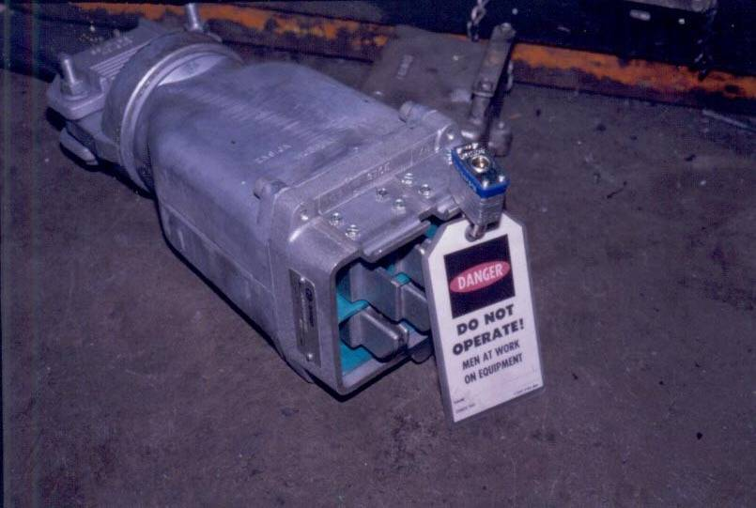
30 CFR § 75.323 Actions for excessive methane
(i) Electrically powered equipment in the affected area shall be de-energized, and other mechanized equipment shall be shut off;
(ii) Changes or adjustments shall be made at once to the ventilation system to reduce the concentration of methane to less than 1.0 percent;
and
(iii) No other work shall be permitted in the affected area until the methane concentration is less than 1.0 percent.

Slide 50
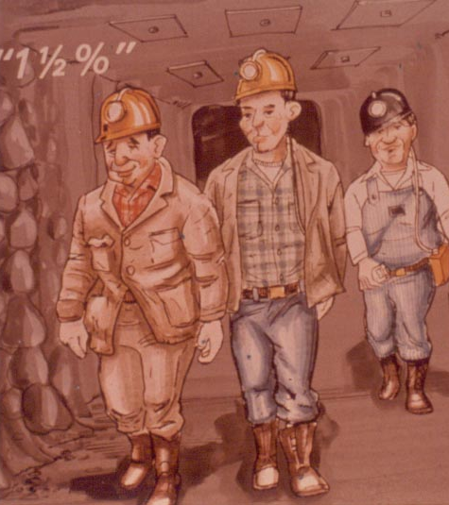
30 CFR § 75.323 Actions for excessive methane
(2) When 1.5 percent or more methane is present in a working place or an intake air course, including an air course in which a belt conveyor is located, or in an area where mechanized mining equipment is being installed or removed-
(i) Everyone except those persons referred to in Section 104(c) shall be withdrawn from the affected area; and
(ii) Electrically powered equipment in the affected area shall be disconnected at the power source.

Slide 51
30 CFR § 75.323
Actions for excessive methane
(c)Return air split.
(1) When 1.0 percent or more methane is present in a return air split, changes or adjustments shall be made at once to the ventilation system to reduce the concentration of methane in the return air to less than 1.0 percent.
(2) When 1.5 percent or more methane is present in a return air split;
(i) Everyone except those persons referred to in §104(c) of the Act
shall be withdrawn from the affected area;
(ii) Equipment in the affected area shall be de-energized, electric
power shall be disconnected at the power source, and other
mechanized equipment shall be shut off; and
(iii) No other work shall be permitted in the affected area until the
methane concentration in the return air is less than 1.0 percent

Slide 52
Methane Example
Turn off belt
De-energize power to belt and all electrical components in belt entry
Get help, notify supervisor
Improve ventilation
1.2 %
Notes:
Actions for Excessive Methane 75.323
1.0% to less than 1.5% – actions to take
52

Slide 53
Methane Example
Turn off belt
De-energize all power in the section
Get help, notify supervisor
Withdraw all personnel from the section
Improve ventilation
1.6 %
Notes:
Actions for Excessive Methane 75.323
1.0% to less than 1.5% – actions to take
53

Slide 54
Methane Example
1.2 %
Notify supervisor, get help
Improve ventilation
Notes:
Actions for Excessive Methane 75.323
1.0% to less than 1.5% – actions to take
54

Slide 55
Methane Example
De-energize all power in the section
Notify supervisor immediately
Withdraw all personnel from the section
Improve ventilation
1.6 %
Notes:
Actions for Excessive Methane 75.323
1.0% to less than 1.5% – actions to take
55

Slide 56
30 CFR § 75.400 Accumulation of combustible materials.
Coal dust, including float coal dust deposited on rock-dusted surfaces, loose coal, and other combustible materials, shall be cleaned up and not be permitted to accumulate in active workings, or on diesel- powered and electric equipment therein
30 CFR § 75.400-1 Definitions.
(a) The term coal dust means particles of coal that can pass a No. 20 sieve.
(b) The term float coal dust means the coal dust consisting of particles of coal that can pass a No. 200 sieve.
(c) The term loose coal means coal fragments larger in size than coal dust.

Slide 57
30 CFR § 75.401 Abatement of dust; water or water with a wetting agent.
Where underground mining operations in active workings create or raise excessive amounts of dust, water or water with a wetting agent added to it, or other no less effective methods approved by the Secretary or his authorized representative, shall be used to abate such dust. In working places, particularly in distances less than 40 feet from the face, water, with or without a wetting agent, or other no less effective methods approved by the Secretary or his authorized representative, shall be applied to coal dust on the ribs, roof, and floor to reduce dispersibility and to minimize the explosion hazard.
30 CFR § 75.401-1 Excessive amounts of dust.
The term "excessive amounts of dust" means coal and float coal dust in the air in such amounts as to create the potential of an explosion hazard..

Slide 58
All underground areas of a coal mine, except those areas in which the dust is too wet or too high in incombustible content to propagate an explosion, shall be rock dusted to within 40 feet of all working faces, unless such areas are inaccessible or unsafe to enter or unless the Secretary or his authorized representative permits an exception upon his finding that such exception will not pose a hazard to the miners. All crosscuts that are less than 40 feet from a working face shall also be rock dusted.
30 CFR § 75.402 Rock dusting.

Slide 59
30 CFR § 75.403 Maintenance of incombustible content of rock dust.
Where rock dust is required to be applied, it shall be distributed upon the top, floor, and sides of all underground areas of a coal mine and maintained in such quantities that the incombustible content of the combined coal dust, rock dust, and other dust shall be not less than 80 percent. Where methane is present in any ventilating current, the percent of incombustible content of such combined dust shall be increased 0.4 percent for each 0.1 percent of methane.

Slide 60
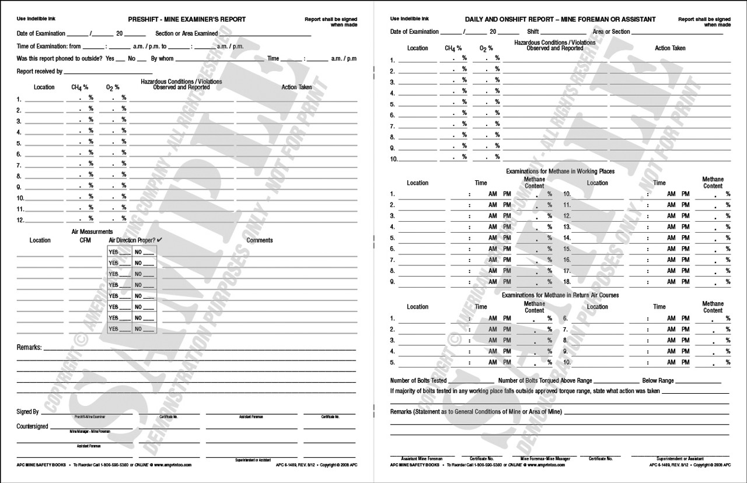
Pre-shift/Onshift Examinations
What is required to be entered in the record books?

Slide 61
30 CFR § 75.360 Pre-shift examination recordkeeping
(g) Recordkeeping. A record of the results of each pre-shift examination, including a record of hazardous conditions and their locations found by the examiner during each examination and of the results and locations of air and methane measurements, shall be made on the surface before any persons, other than certified persons conducting examinations required by this subpart, enter any underground area of the mine. The results of methane tests shall be recorded as the percentage of methane measured by the examiner. The record shall be made by the certified person who made the examination or by a person designated by the operator. If the record is made by someone other than the examiner, the examiner shall verify the record by initials and date by or at the end of the shift for which the examination was made. A record shall also be made by a certified person of the action taken to correct hazardous conditions found during the pre-shift examination. All pre-shift and corrective action records shall be countersigned by the mine foreman or equivalent mine official by the end of the mine foreman's or equivalent mine official's next regularly scheduled working shift. The records required by this section shall be made in a secure book that is not susceptible to alteration or electronically in a computer system so as to be secure and not susceptible to alteration.

Slide 62
Pre-shift - Recordkeeping
Make a record of results of each pre-shift examination including:
Hazardous conditions and their locations
Results and locations of air and methane measurements
Air measurements
Methane measurements shall be recorded as a percentage of methane

Slide 63
Pre-shift - Recordkeeping
Record of pre-shift shall be made on the surface before any persons (other than certified persons making examinations) enter the mine
Record shall be made by:
The person who made the exam, or
A person designated by the operator

Slide 64
Pre-shift - Recordkeeping
If record is made by the designated person, the examiner shall verify by initials and date the record by or at the end of the shift which the exam was made
The record shall include actions taken to correct hazardous conditions found during the pre-shift

Slide 65
Hazardous Conditions Posting/correcting/recording
The record shall be made by the person doing the examination or by a person designated by the operator
If record is made by a person other than examiner, the examiner shall verify the record by initials and date

Slide 66
Hazardous Conditions Posting/correcting/recording
The record shall also include corrective actions taken and shall be countersigned by the mine foreman or equivalent mine official
The record shall be made in a secure book that is not susceptible to alteration

Slide 67
Pre-shift - Recordkeeping
(h) Retention period. Records shall be retained at a surface location at the mine for at least 1 year and shall be made available for inspection by authorized representatives of the Secretary and the representative of miners.

Slide 68
Pre-shift - Recordkeeping
Hazards entered in the reports must show that immediate action was taken – dangered off or corrected
Violations entered in the reports:
Corrected
Reported (corrective action to be taken in a timely manner)
Two ways recordkeeping can cause problems:
When a hazard or violation is observed and not reported
When a hazard or violation is observed and reported and not acted upon

Slide 69
Pre-shift / Onshift Examinations
What are the consequences of inadequate exams?
Citations and orders

Slide 70
1977 Mine Act
Section 110 (F)
Whoever knowingly makes any false
statement, representation, or
certification in any application, record,
report, plan, or other document filed or
required to be maintained pursuant to
this Act shall, upon conviction, be
punished by a fine of not more that
$10,000, or by imprisonment for not
more than five years, or both.

Slide 71
The MSHA act: Section 110
...the Act allows MSHA to impose civil and criminal penalties on both the company and AGENTS of the mine.
Supervisors and Safety Representatives are AGENTS and can be held responsible, face monetary fines, criminal charges and even jail time.

Slide 72
The MSHA Act: Section 110
‘Knowingly’ has been defined as:
…Knowing or having reason to know.
A person has reason to know when he has information that would lead a person to acquire knowledge of the fact in question.

Slide 73
The MSHA Act: Section 110
‘Willfully’ has been defined as:
…Done knowingly and purposely by a [person] who, having a free will and choice, either intentionally disobeys the standard or recklessly disregards its requirements.

Slide 74
The MSHA Act: Section 110
110(c) - Corporate agent can be assessed a civil penalty for knowing or have reason to know of violations.
110(d) - Any operator agent who willfully violates and is convicted (criminally) can be assessed up to $250k, 1 year jail time or both.
Fines for second offenses run up to $500K.

Slide 75
The MSHA Act: Section 110
110(f) - Up to $250k, 5 years in prison or both for anyone convicted of knowingly making false statements, representation, or certification in any application, record, report, plan or other document filed or required to be maintained by the ACT.

