Slide 1
CHAPTER 4
Control Of Bleeding

Slide 2
Chapter 4-Control Of Bleeding
The loss of two pints of blood by an adult is a serious matter. The loss of three pints can cause death. At certain points in the body, fatal hemorrhages (bleeding) may occur in one to three minutes after an accident. This is true, for instance, when the two principal arteries of the neck have been severed … or the principal arteries of the arms or thighs. A rupture of cut of the main trunk of arteries of the chest and abdomen can cause death in less then 30 seconds.
Its important, then, to understand the stops used to control bleeding in an emergency. The proper action, administered quickly at the scene of an accident, can save a life.

Slide 3
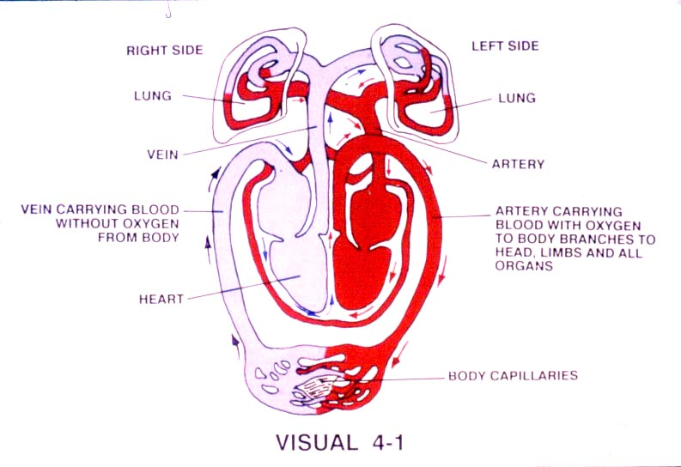

Slide 4
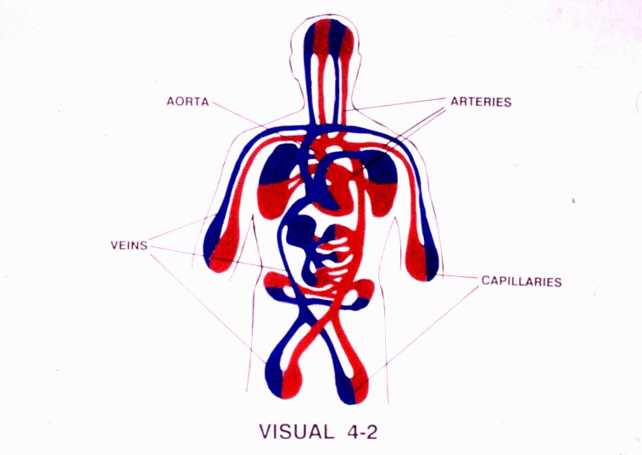

Slide 5
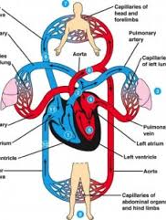
Circulatory System

Slide 6
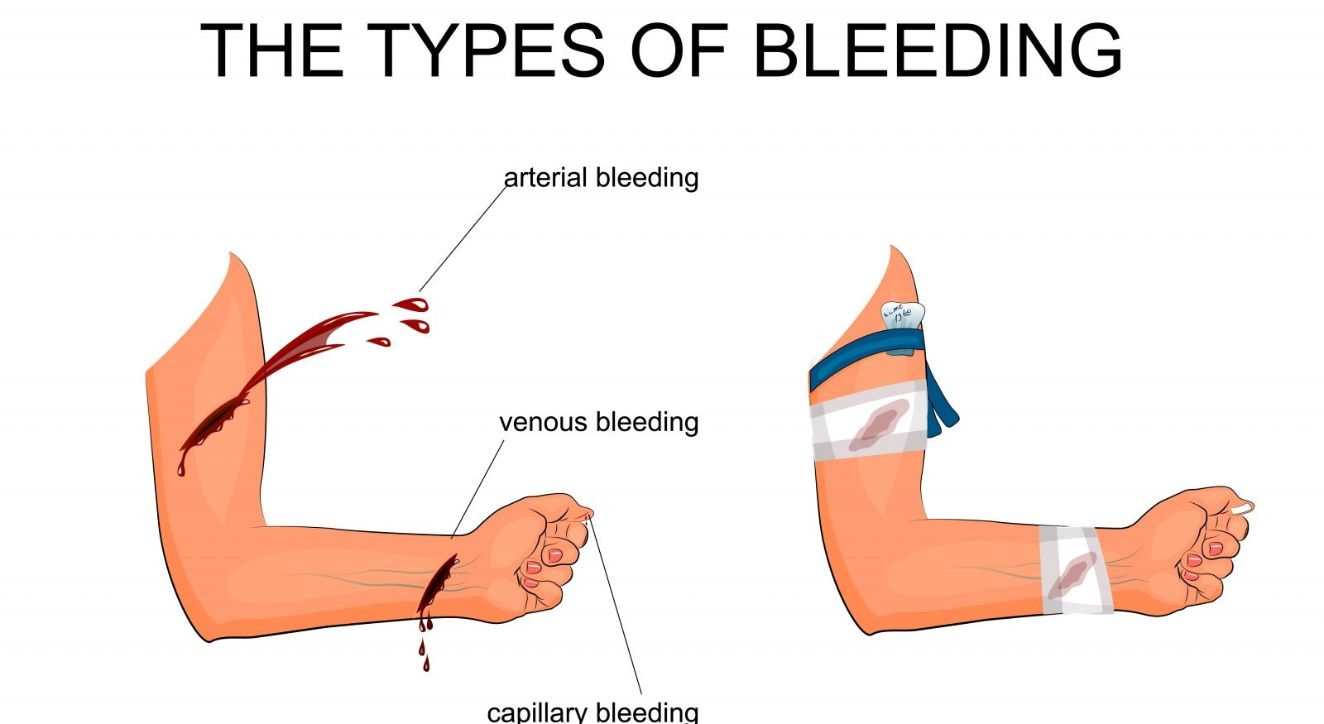

Slide 7
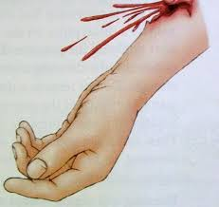
Arterial Bleeding
Bright Red
Under Pressure
May spurt from wound
Usually Severe and hard to control

Slide 8
Venous Bleeding
Dark Red
Steady Flow
Under Less Pressure
Can Be Severe But Easier To Control

Slide 9
Capillary Bleeding
Darker Than Arterial But Not As Dark AS Venous Bleeding
Oozes From Wound

Slide 10
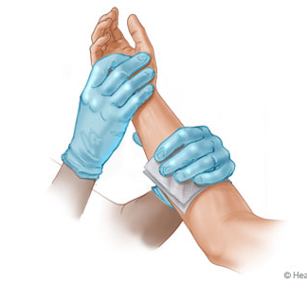
Controlling Bleeding
Direct Pressure
Elevation

Slide 11
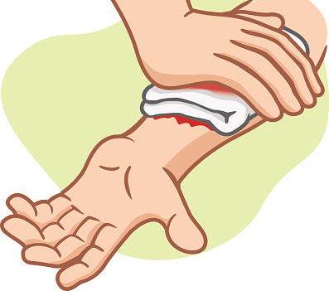
If Still Bleeding Add
More Gauze

Slide 12
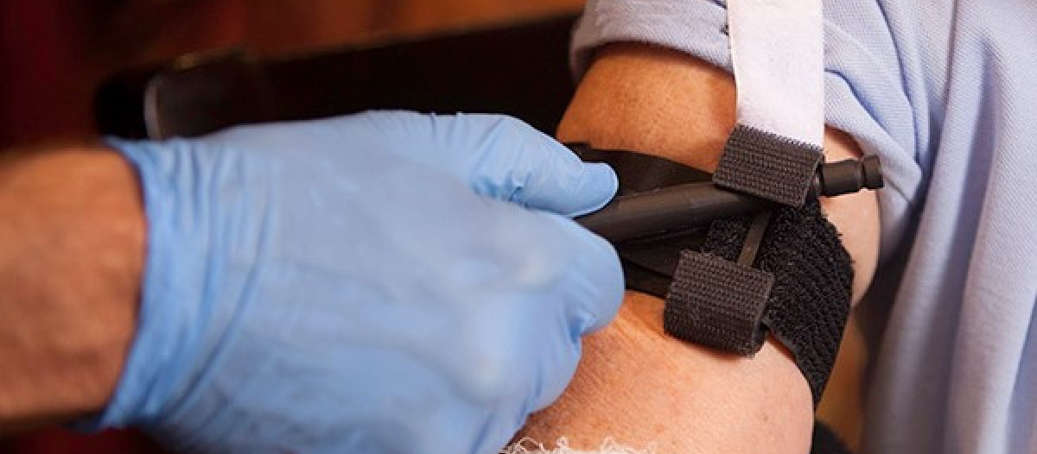
Tourniquets

Slide 13
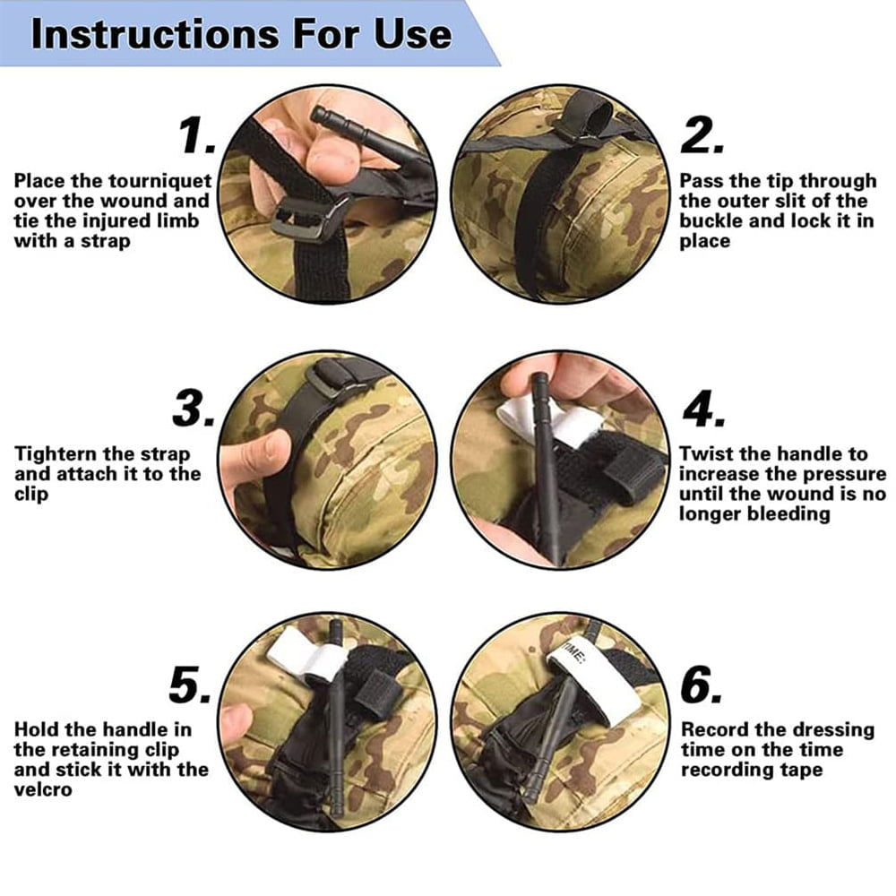

Slide 14
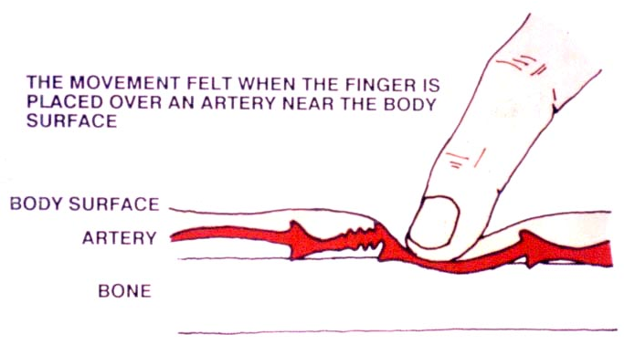
Pressure Points

Slide 15
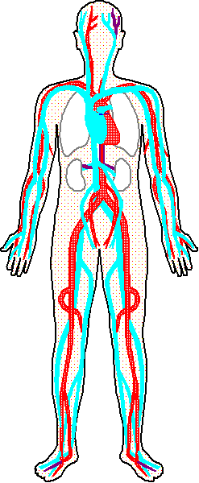
Temporal
Facial
Carotid
Auxilary
Pressure Points
Will Help Slow
The Flow Of Blood
But Rarely Stop It.
Sub-clavian
Brachial
Radial
Ulnar
Femoral
Popliteal
Pedal

Slide 16
First Aid
Lesson Menu
Chapter 1-Anatomy And Patient Assessment
Chapter 2-Artificial Ventilation
Chapter 3-Cardiopulmonary Resuscitation
Chapter 4-Control Of Bleeding
Chapter 5-Shock
Chapter 6-Wounds And Dressings
Chapter 7-Burns And Scalds
Chapter 8-Musculoskeletal Injuries
Chapter 9-Handling And Transportation

