Slide 1
MESSAGE FROM THE DIRECTOR

Slide 2
Mine emergencies can happen at any moment and can come in many different forms. Explosions, fires, face ignitions, entrapments, inundations of water or gas, roof falls, rib rolls, equipment accidents, falls, cuts, even health issues such as a heart attack could be labeled as a mine emergency.
Mine emergencies in their simplest forms create disruptions in the normal day to day processes at the mine.
Severe mine emergencies can create major disruptions, cause evacuations and confusion and can strike fear into the heart of the most seasoned coal miner.

Slide 4
Are you, the mine foreman, ready if/when an emergency happens??
How familiar are you with your area of responsibility??
How familiar are you with the entire mine?? Ventilation? Transportation? Water system? Fire Fighting Equipment, Escapeways? SCSR Cache’s?
Where is your safety equipment?? Can you, the leader, use it??
What things do you have available to use?? Where are they located??
Who can you depend on in a crisis??
Who are your EMT-M’s??
Are you familiar with your mine plans?? Have you studied them??
These are just some of the questions you need to be asking yourself.

Slide 5
Mine Emergencies – Is your Coal Mine Ready?
Mine examinations help ensure the mine is safe to operate and that the mine is prepared in case an emergency situation arises.
In an emergency situation, it is important that things are operating the way they should be. That things are located where they should be. That things are in a usable condition if/when needed.
Most mine emergencies do not destroy the entire mine but are confined to a smaller area such as the production section, conveyor belt or belt head, an area of the track or the slope bottom.
When things are well maintained and operating properly there is less chance that the emergency will grow into a much worse situation.

Slide 6
In a belt fire situation:
If the CO system is working properly and gives early warning of the fire, evacuations can begin quickly.
If the transportation system is well maintained, response time is reduced.
If water and fire fighting equipment is properly located and in usable condition the fire can be extinguished promptly.
If miners are trained and familiar with the fire fighting equipment the fire is more easily extinguished.
The situation grows more intense when there are problems with any one of these items.

Slide 10
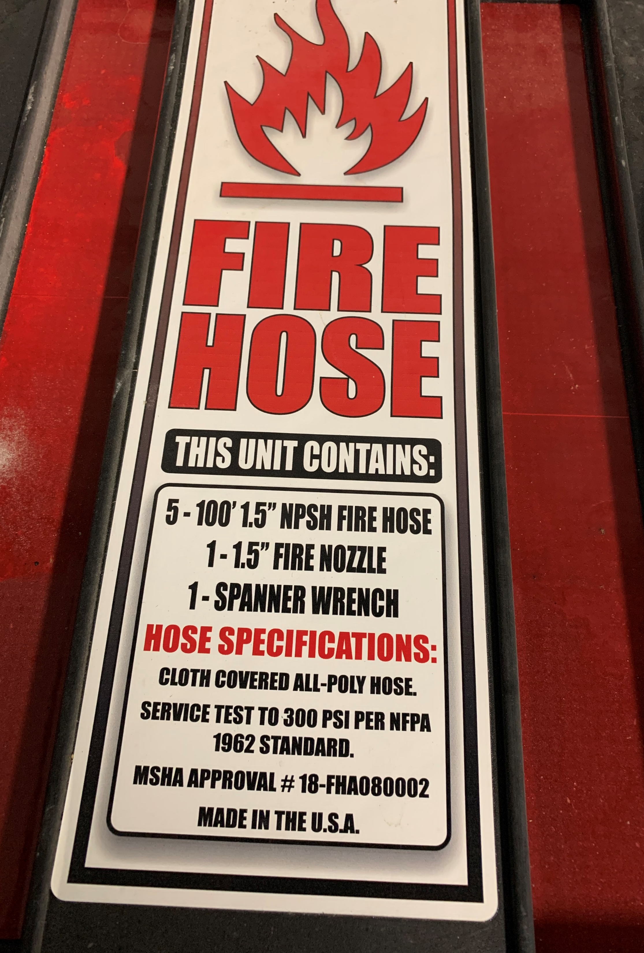
Fire Preparedness
Understanding an individual's fire fighting responsibilities in the event of a fire and knowing what to do is a crucial element of extinguishing a fire safely and effectively. How prepared is your section crew? The upcoming slides is an example of what some companies have in place.

Slide 11
Fire Preparedness
EXAMPLE
Section Foreman
Notify all persons on the section, assign duties and direct the fire fighting activities at the scene.
Left Side Continuous Miner Operator
Break waterline to the continuous miner and/or connect and install fire hose stored at belt feeder or power center. Provide water to the fire site immediately. If the section foreman is not available, the left side continuous miner operator must take charge and direct the fire fighting activities. Make certain that appropriate electrical power circuits have been de-energized prior to utilizing water for fire fighting activities.
Right Side Continuous Miner Operator
De-energize appropriate electrical power circuits to fire area and assist the Left Side Continuous Miner Operator in providing water to the fire. Coordinate de-energization of electrical circuits with the electrician/repairman.

Slide 12
Fire Preparedness
EXAMPLE
#1 Shuttle Car Operator
Go to the section telephone and notify the official in charge on the surface. Remain at the telephone and maintain communications with surface personnel.
#2 Shuttle Car Operator
Obtain all available portable fire extinguishers from emergency sled, belt feeder, oil storage station, power center and other locations and take to the fire scene immediately.
Scoop Operator/Utility Person
Obtain rock dust from the supply location and transport to the fire scene immediately.

Slide 13
Fire Preparedness
EXAMPLE
Operator’s Side Roof Bolter
Go to the fire scene immediately, make a quick check of ventilation, obtain necessary materials and construct ventilation controls in the fire area as directed by the person in charge of the fire fighting activities.
Electrician/Repairman
Obtain tools that may be needed in the fire fighting activities and make them available to the person in charge. Perform duties as directed and act as a messenger between the person in charge and the #1 Coal Haulage Operator stationed at the mine telephone. Coordinate de-energization of electrical power with the Right Side Continuous Miner Operator.

Slide 14
Fire Preparedness
Examiners
Examiners should be knowledgeable of fire protection systems including CO systems installed at their mine. Daily each fire boss shall check the functionality of each CO detection monitor. Positions and placement are also to be examined.
Examiners should check fire installations to assure all tools and equipment to fight fires are present and functioning correctly.
Examiners should check all fire suppression systems to assure system is functioning correctly, sprays orientation and placement are positioned properly and not obstructed by rock dust build up, belt strings etc..

Slide 15
Fire Preparedness
Examiners Cont.
Examiners should assure that fire extinguishers are in working order and proper placement around electrical installations.
Examiners should assure the sufficient rock dust is located around installations.
Examiners should assure that accumulations in or around belt lines shall be corrected
Examiners should correct any locations where belt is causing friction heat due to rubbing.

Slide 16
Fire Preparedness
EXAMPLE
Official In Charge On Surface
Contact the Responsible Person that may be affected and arrange for the orderly evacuation of all personnel not needed for fire fighting or support activities. Obtain additional fire fighting materials and arrange for a relief fire fighting crew. Make additional notifications, as necessary.

Slide 17
Fire Preparedness
22A-2-58 Fire Protection
(b) Fire Drills and demonstrations of various types of available fire-fighting equipment shall be held for employees at least every six (6) months.
22A-2A-704 Fire and Safety Training
(a) Rules of the commission shall provide for all underground employees at the mine to receive special instruction related to fighting fires involving diesel fuel.

Slide 18
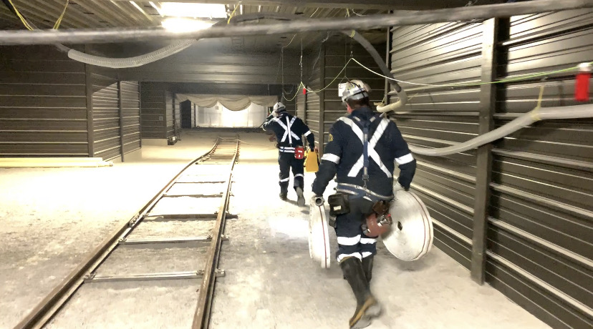
Fire Preparedness
Fire Fighting Equipment
Fire Extinguishers
Water Lines
Hoses & Nozzles
Foam Stations
Portable Pro pak

Slide 19
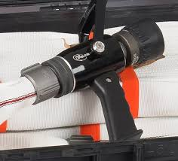
Fire Preparedness
22A-2-58 Fire Protection
(d) Each coal mine shall be provided with suitable fire-fighting equipment adapted for the size and condition of the mine. Fire-fighting equipment required under this article shall meet the following requirements.
(f) In all coal mines, waterlines shall be installed parallel to the entire length of belt conveyors and shall be equipped with fire hose outlets with valves at three-hundred-foot intervals along each belt conveyor and at tailpieces.

Slide 20
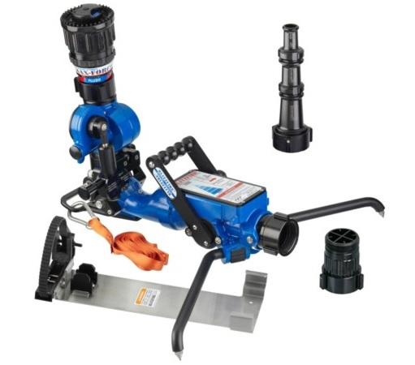
Fire Preparedness
Brass twist Nozzle
Adjustable Fire Nozzle
Remote Oscillating Nozzle
What type of Nozzles does your mine use?

Slide 21
Fire Preparedness
Know the difference!
National Pipe Straight Hose (Mining Standard)
National Standard (Common in fire depts)

Slide 22
Fire Preparedness
Mapping
State Law
22A-2-58 Fire Protection
(c) The location of pipelines, valves, and fire taps shall be shown on a map of the mine and kept available at the mine office at all times.

Slide 23
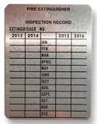
Fire Preparedness
20 Lb. Fire Extinguisher
Gauge should be in Green at the 12:00 Position
30 CFR § 77.1110 Examination and maintenance of firefighting equipment. Firefighting equipment shall be continuously maintained in a usable and operative condition. Fire extinguishers shall be examined at least once every 6 months and the date of such examination shall be recorded on a permanent tag attached to the extinguisher.
§36-23-21. Portable Firefighting Equipment.
(f) Portable fire extinguishers shall be inspected at least every six (6) months and maintained in accordance with maintenance and use of portable fire extinguishers NFPA No. 10A-1970.

Slide 24
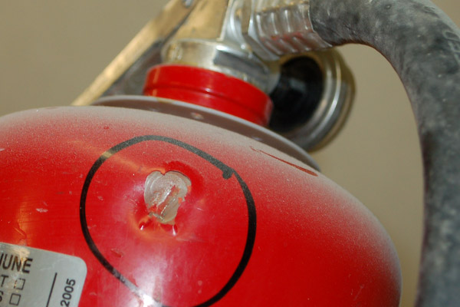
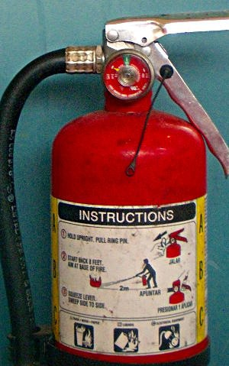
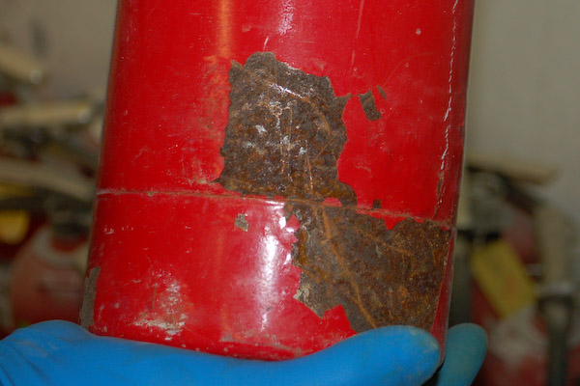
Fire Preparedness
Remove from Service
Pin Missing
Gauge Not
In The Green
Dents
Tamper Evident
Seal Broken
Rust

Slide 25
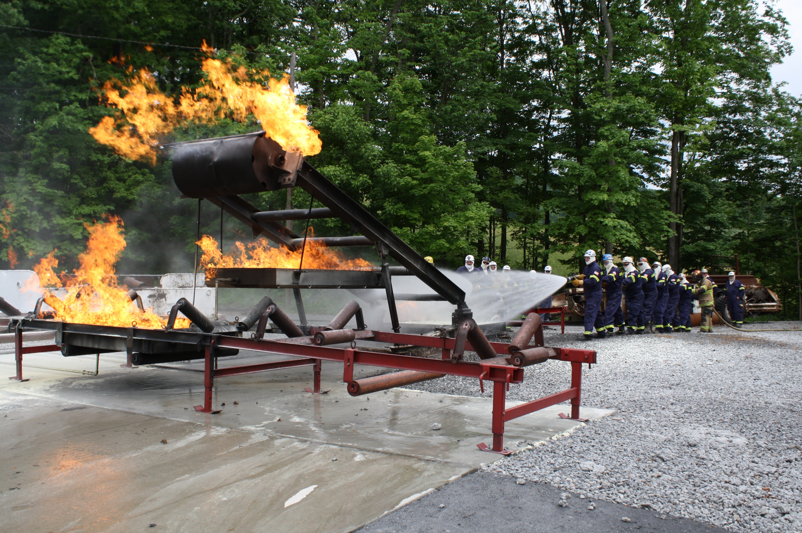
Fire Preparedness
Mine Site Training
22A-2-58 Fire Protection
(b) Fire Drills and demonstrations of various types of available fire-fighting equipment shall be held for employees at least every six (6) month.

Slide 26
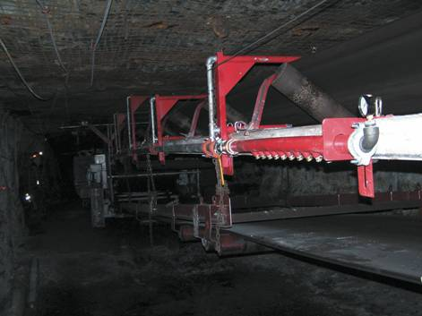
Fire Preparedness
Belt head fire suppression
22A-2-39 Belt Conveyor Installation
(j) Deluge-type water sprays, water sprinklers, dry chemical sprinkler system or foam generators (designed to be automatically activated in the event of a fire or rise in the temperature at or near the belt drive) shall be installed at each main and secondary conveyor drive that are located underground.

Slide 27
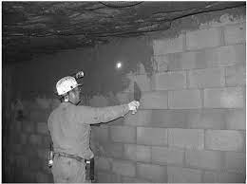
Fire Preparedness
Stoppings
22A-2-4 Ventilation of mines in general
(f) As working places advance, crosscuts for air shall be made not more than 105 feet apart. Where necessary to render harmless and carry away noxious of flammable gases, line brattice or other approved methods of ventilation shall be used so as to properly ventilate the face. All crosscuts between the main intake and return airways not required for passage of air and equipped shall be closed with stoppings substantially built with incombustible or fire-resistant material so as to keep working places well ventilated.

Slide 28
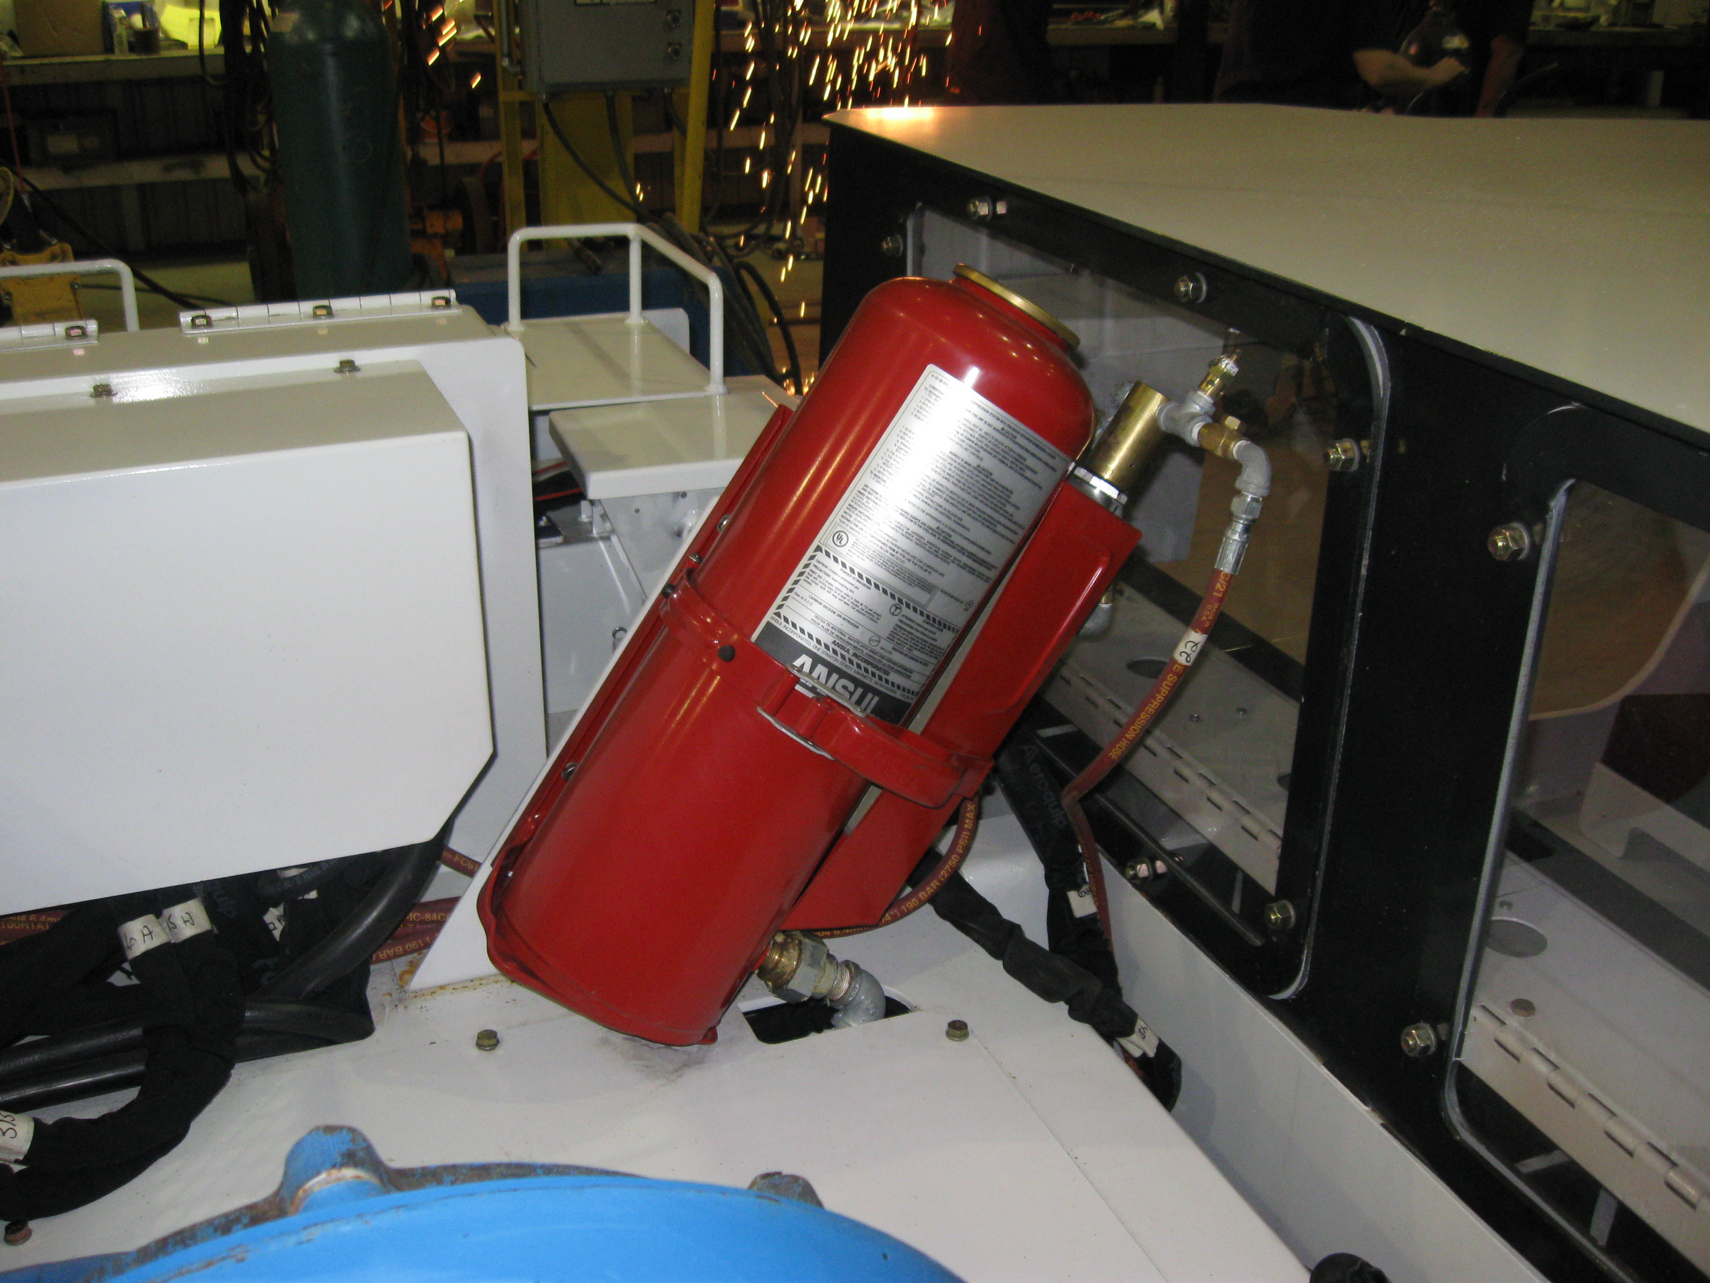
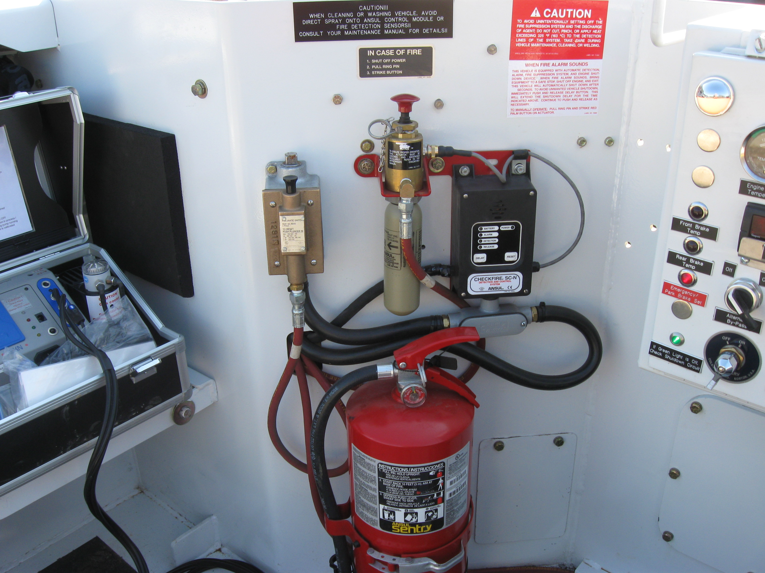
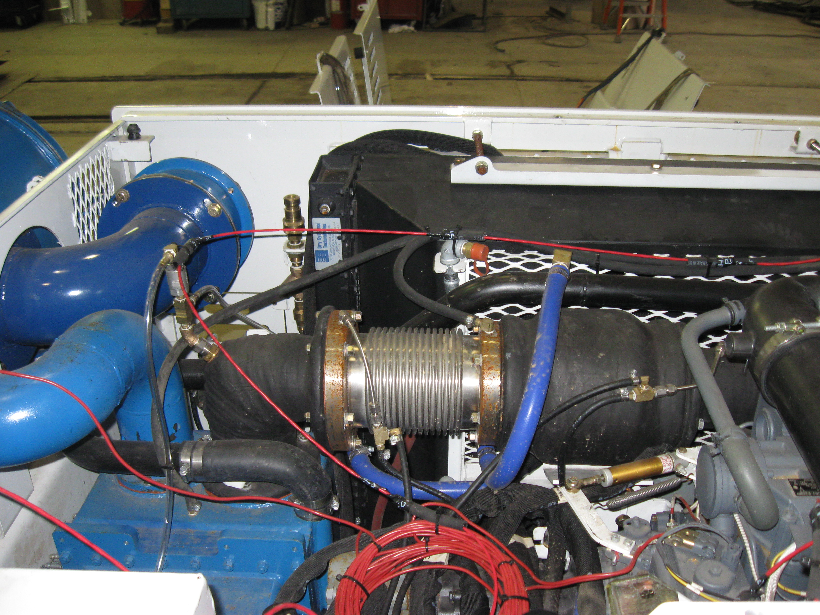
Fire Preparedness
Diesel
State Law
56-23-11
11.1 Fire suppression systems for diesel powered equipment and fuel transportation units shall meet the requirements of this section (see 11.1 – 11.6)
56-23-15
15.1 All underground employees at the mine shall receive special instruction related to fighting fires involving diesel fuel. This training may be included in annual refresher training under MSHA regulations at 30 CFR Part 48

Slide 29
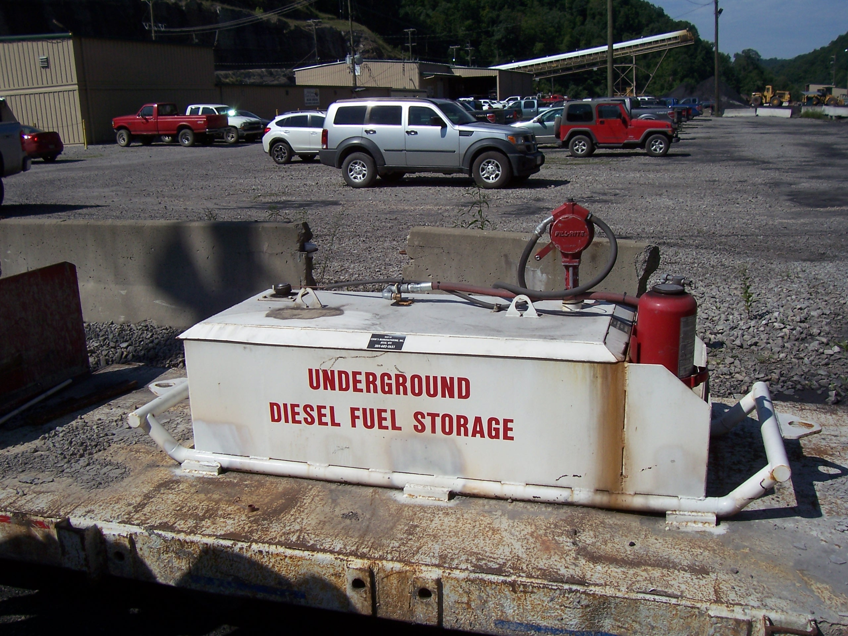
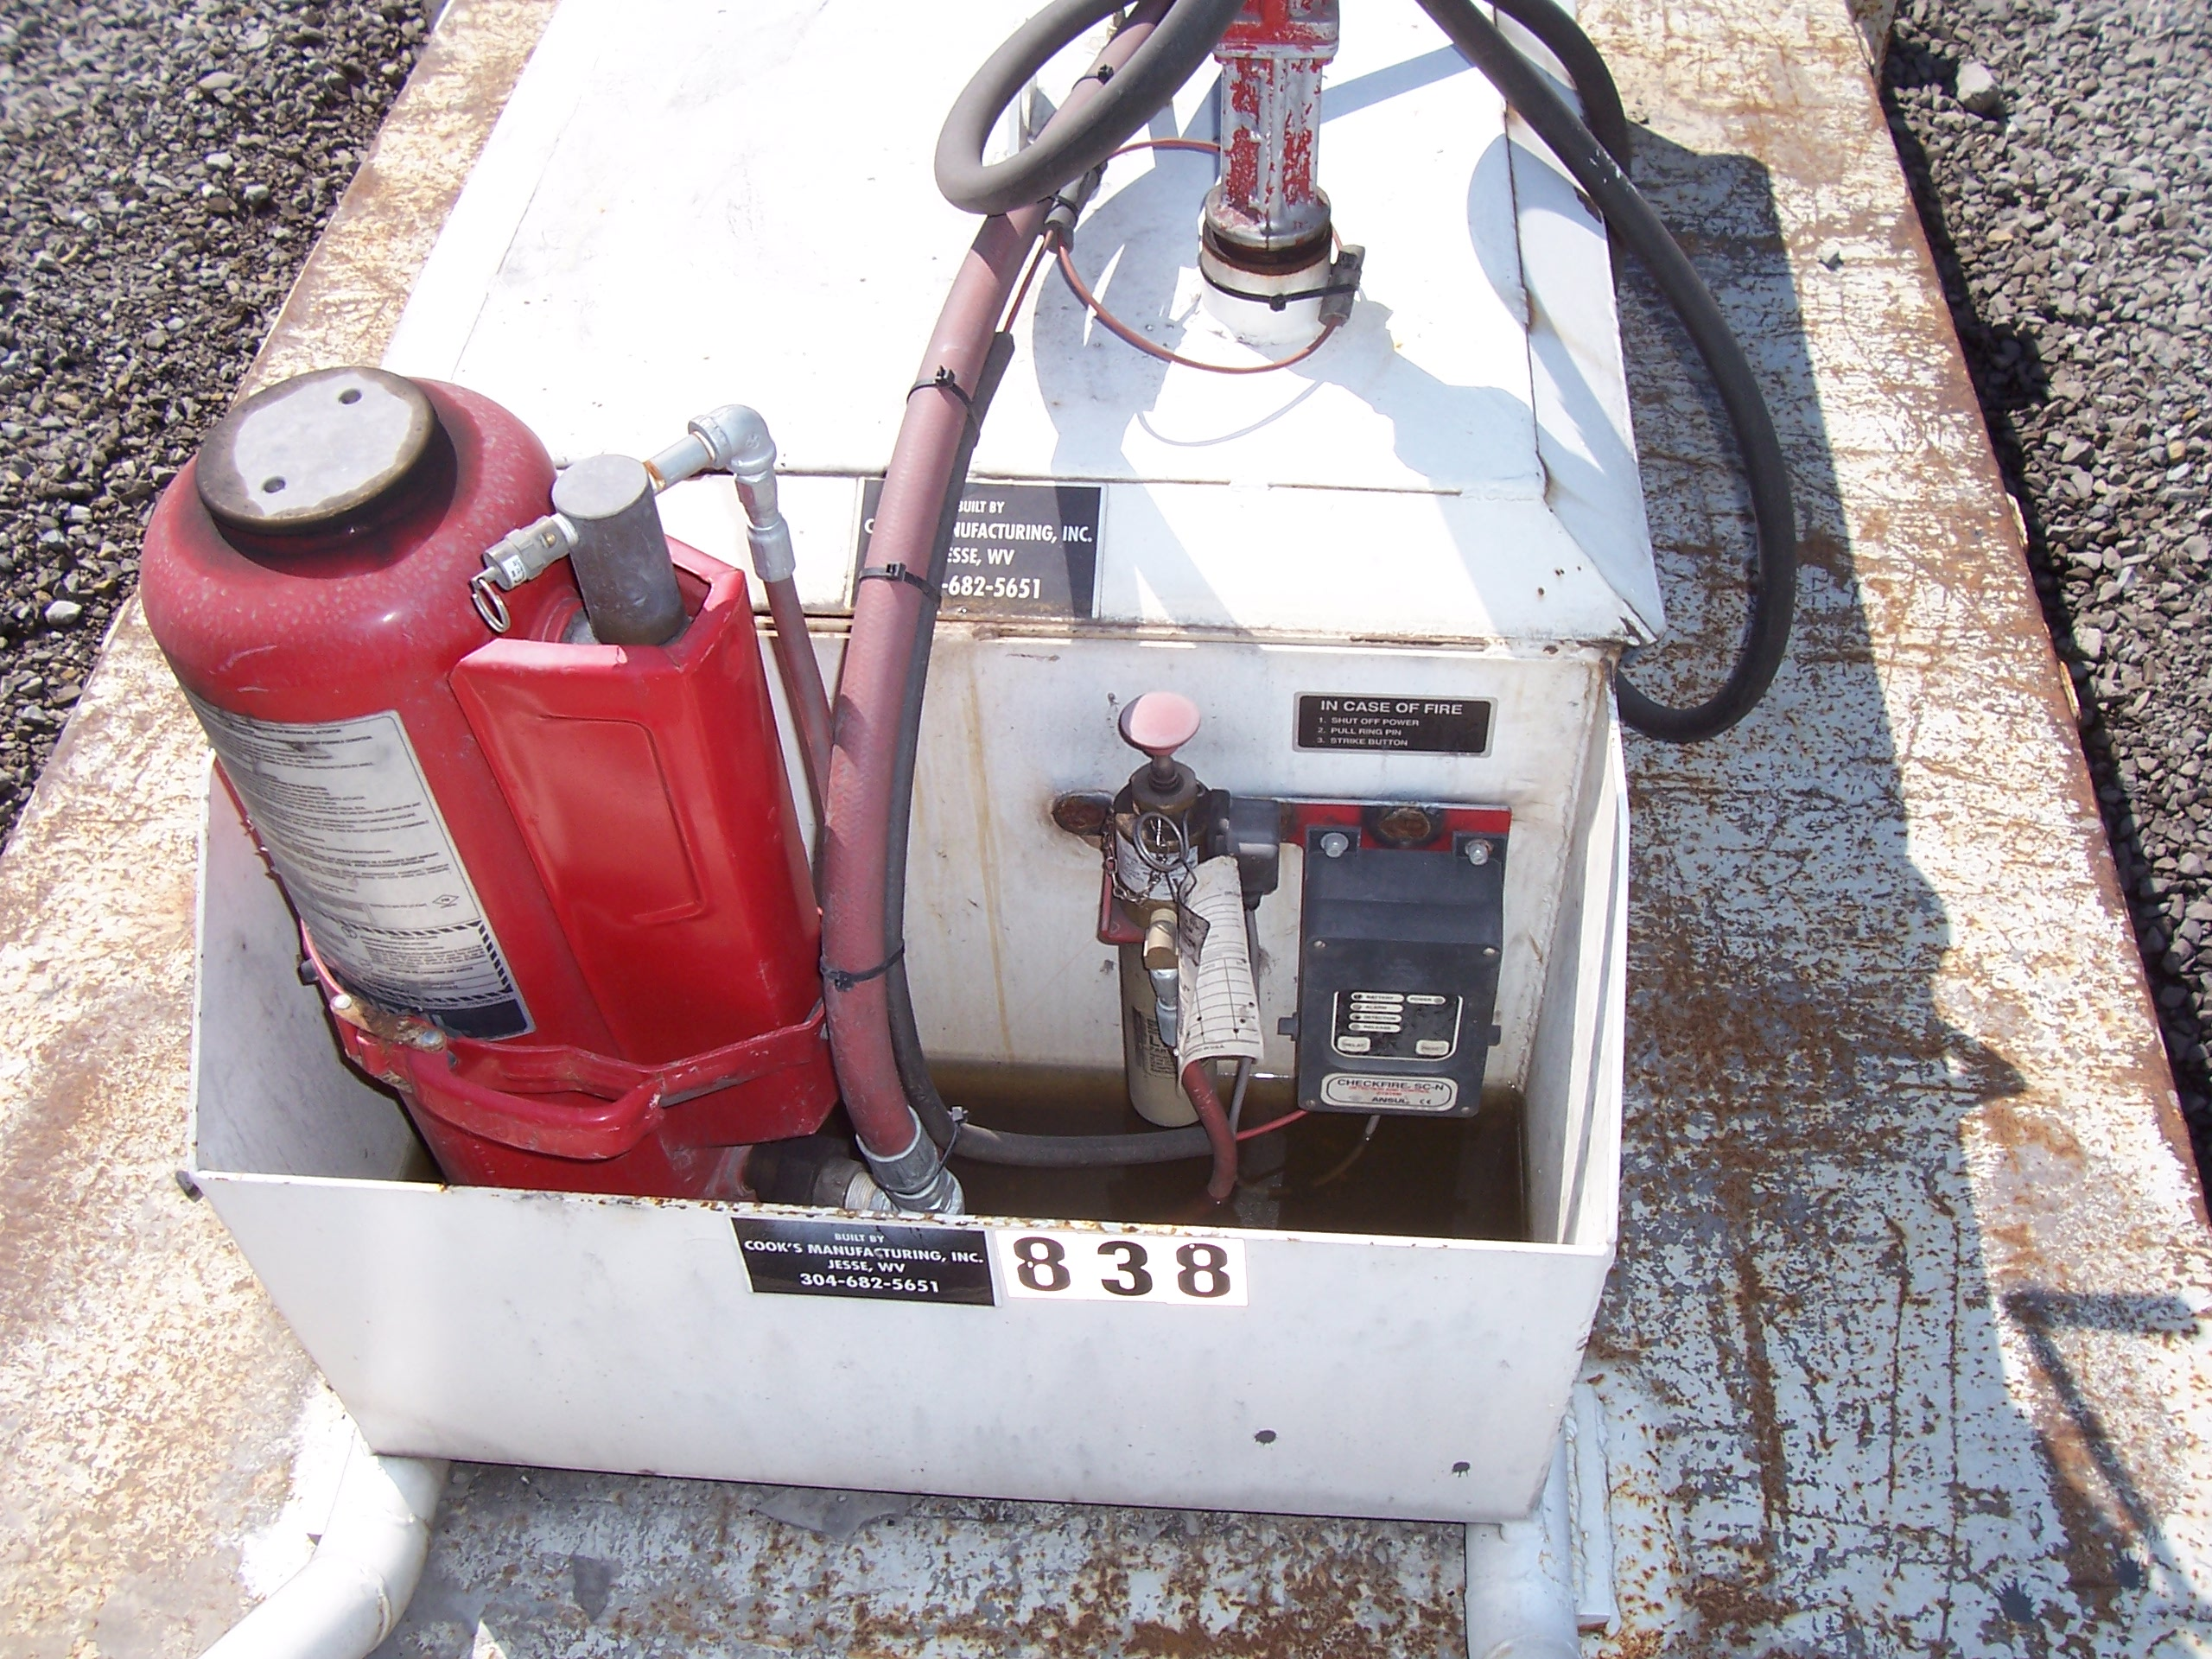
Fire Preparedness
Diesel Underground Storage
State Law
56-23-12
12.1 Fire Suppression systems for diesel fuel storage areas shall meet the requirements of this section.
12.2 The system shall be an automatic multipurpose dry-powder type fire suppression system or other system equal capability , suitable for the intended application and listed or approved by a nationally recognized independent testing laboratory.

Slide 30
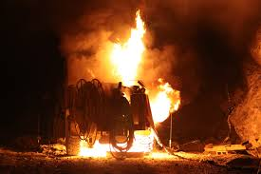
Continuing Education
Fire Prevention

Slide 31
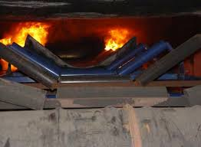
Fire Prevention
FIRE ONLY OCCURS WHEN PREVENTION FAILS!

Slide 32
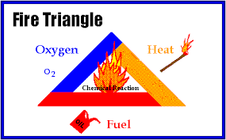
Fire Prevention
A fire needs all three legs of the triangle to sustain combustion.

Slide 33
Fire Prevention
Fuel Sources
Heat Sources
Combustible materials such as paper, oily rags, cardboard, etc.
Flammable gases such as methane, acetylene, and hydrogen
Flammable liquids such as solvents, adhesives, and petroleum-based products
Coal dust
Electrical equipment
Smoking articles such as lighters and cigarettes
Cutting and welding
Friction (frozen rollers, broken machine parts, etc.)
Spontaneous ignition

Slide 34
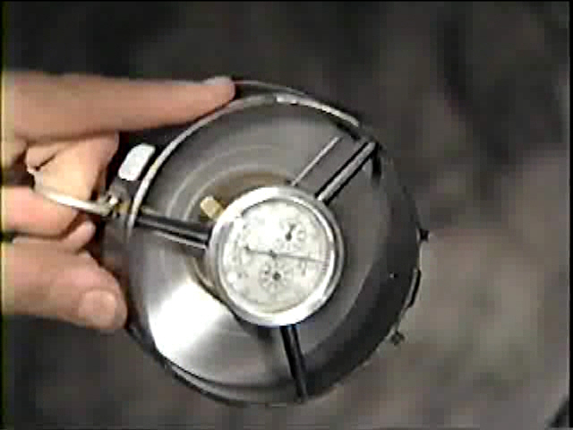
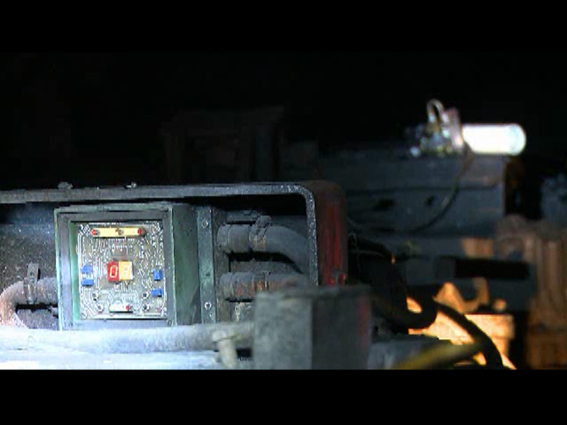
Fire Prevention
Oxygen is necessary not only for breathing but also to diffuse chemical and physical contaminants (gases, dust, heat, and humidity).

Slide 35
Fire Prevention
Discuss the laws pertaining to fire prevention for the following slides.

Slide 36
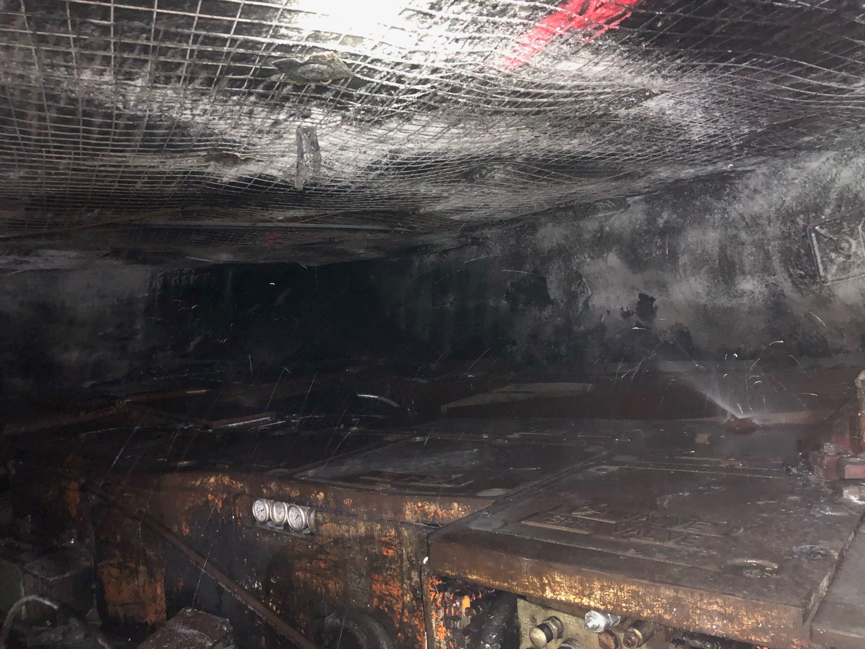
Fire Prevention on Continuous Miner
§22A-2-4. Ventilation of mines in general.
(a) The operator or mine foreman of every coal mine, whether worked by shaft, slope, or drift, shall provide and hereafter maintain for every such mine adequate ventilation. In all mines the quantity of air passing through the last open crosscut between the intake and return in any pair or set of entries shall be not less than 9,000 cubic feet of air per minute and as much more as is necessary to dilute and render harmless and carry away flammable and harmful gases. All working faces in a working section between the intake and return airway entries shall be ventilated with a minimum quantity of 3,000 cubic feet of air per minute and as much more as is necessary to dilute and render harmless and carry away flammable and harmful gases. The quantity of air reaching the last crosscut in pillar sections may be less than 9,000 cubic feet of air per minute if at least 9,000 cubic feet of air per minute is being delivered to the intake of the pillar line. The air current shall under any conditions have a sufficient volume and velocity to reduce and carry away smoke from blasting and any flammable or harmful gases. The operator shall provide to the safety committee access to anemometers and smoke tubes while performing their duties. All active underground working places in a mine shall be ventilated by a current of air containing not less than 19 and five-tenths percent of oxygen, not more than five tenths percent of carbon dioxide, and no harmful quantities of other noxious or poisonous gases.

Slide 37
Fire Prevention on Working Section
§22A-2-4. Ventilation of mines in general. Continued
(c) Properly installed and adequately maintained line brattice or other approved devices shall be continuously used from the last open crosscut of an entry or room of each working section to provide adequate ventilation to the working faces for the miners and to remove flammable, explosive and noxious gases, dust, and explosive fumes. When damaged by falls or otherwise, such line brattice or other devices shall be repaired immediately.
(d) Brattice cloth used underground shall be of flame-resistant material. The space between the line brattice or other approved device and the rib shall be large enough to permit the flow of a sufficient volume and velocity of air to keep the working face clear of flammable, explosive and noxious gases, dust, and explosive fumes.
(e) Each working unit newly developed in virgin coal hereafter, shall be ventilated by a separate split of air: Provided, That in areas already under development and in areas where physical conditions prevent compliance with this provision, the director may grant temporary relief from compliance until such time as physical conditions make compliance possible. The quantity of air reaching the last crosscut shall not be less than 9,000 cubic feet of air per minute and shall under any condition have sufficient volume and velocity to reduce and carry away smoke and flammable or harmful gases from each working face in the section.

Slide 38
Fire Prevention on Working Section
§22A-2-4. Ventilation of mines in general. Continued
(f) As working places advance, crosscuts for air shall be made not more than 105 feet apart. Where necessary to render harmless and carry away noxious or flammable gases, line brattice or other approved methods of ventilation shall be used so as to properly ventilate the face. All crosscuts between the main intake and return airways not required for passage of air and equipment shall be closed with stoppings substantially built with incombustible or fire-resistant material so as to keep working places well ventilated. In mines where it becomes necessary to provide larger pillars for adequate roof support, working places shall not be driven more than 200 feet without providing a connection that will allow the free flow of air currents. In such cases, a minimum of 12,000 cubic feet of air a minute shall be delivered to the last open crosscut and as much more as is necessary to dilute and render harmless and carry away flammable and noxious gases.

Slide 39
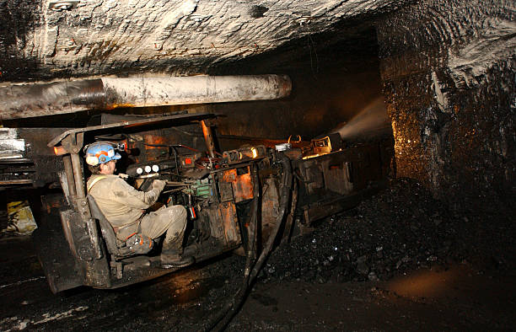
Fire Prevention on Working Section
§22A-2-24. Control of coal dust; rock dusting.
(a) In all mines, dangerous accumulations of fine, dry coal and coal dust shall be removed from the mine, and all dry and dusty operating sections and haulageways and conveyors and back entries shall be rock dusted or dust allayed by other methods as may be approved by the director.
(c) In all dry and dusty mines or sections thereof, rock dust shall be applied and maintained upon the roof, floor and sides of all operating sections, haulageways and parallel entries connected thereto by open crosscuts. Back entries shall be rock dusted. Rock dust shall be so applied to include the last open crosscut of rooms and entries, and to within forty feet of faces. Rock dust shall be maintained in a quantity that the incombustible content of the mine dust that could initiate or propagate an explosion shall not be less than eighty percent. The incombustible content of mine dust in return entries shall also be equal to or greater than eighty percent.

Slide 40
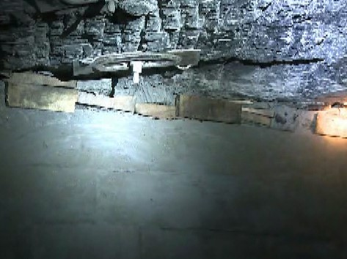
Fire Prevention on Working Section
§22A-2-4. Ventilation of mines in general.
(f) As working places advance, crosscuts for air shall be made not more than 105 feet apart. Where necessary to render harmless and carry away noxious or flammable gases, line brattice or other approved methods of ventilation shall be used so as to properly ventilate the face. All crosscuts between the main intake and return airways not required for passage of air and equipment shall be closed with stoppings substantially built with incombustible or fire-resistant material so as to keep working places well ventilated. In mines where it becomes necessary to provide larger pillars for adequate roof support, working places shall not be driven more than 200 feet without providing a connection that will allow the free flow of air currents. In such cases, a minimum of 12,000 cubic feet of air a minute shall be delivered to the last open crosscut and as much more as is necessary to dilute and render harmless and carry away flammable and noxious gases.

Slide 41
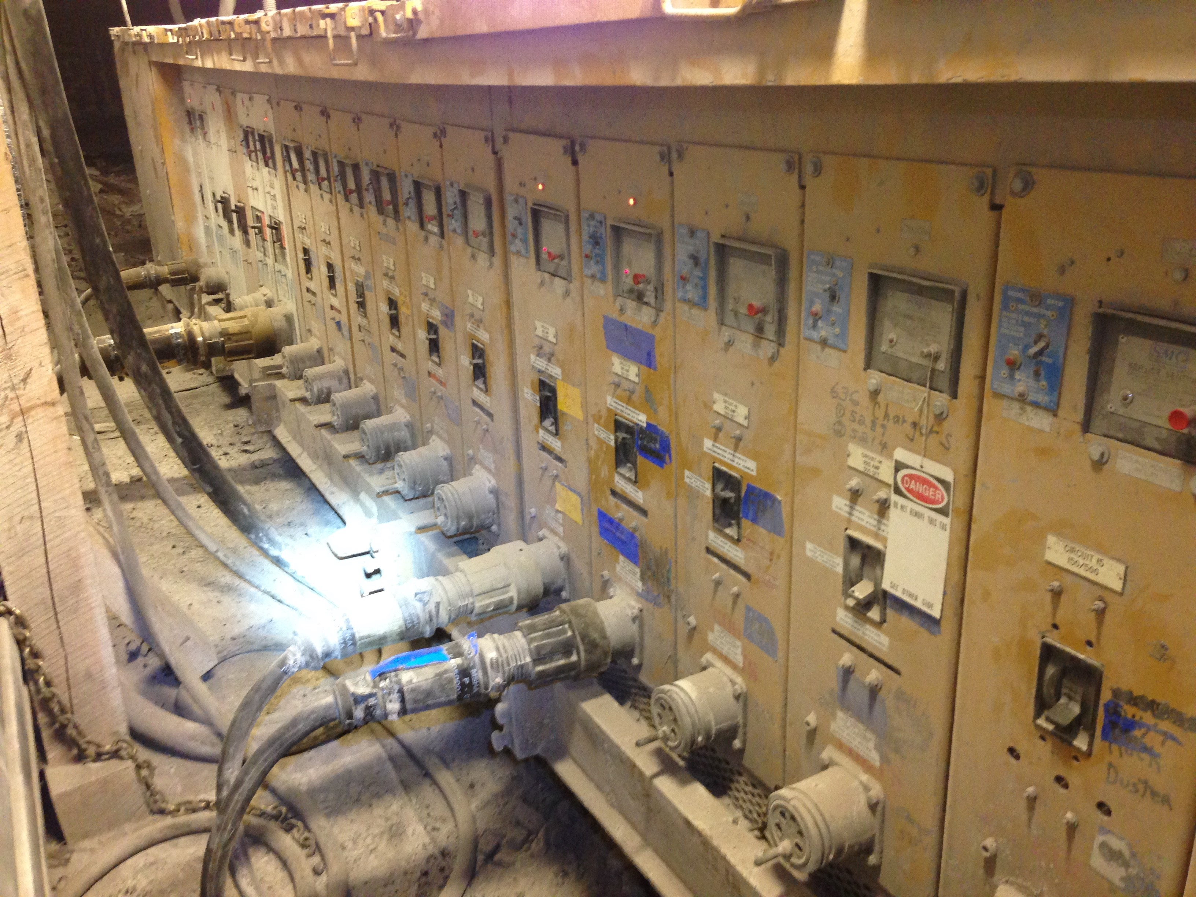
Fire Prevention at Electrical Installations
§22A-2-40. General provisions.
Operators of coal mines in which electricity is used as a means of power shall comply with the following provisions:
(20) All electric equipment shall be examined weekly, tested, and properly maintained by a qualified person to assure safe operating conditions. When a potentially dangerous condition is found on electric equipment, such equipment shall be removed from service until such condition is corrected. A record of such examinations shall be kept and made available to an authorized representative of the director and to the miners in such mine.
§22A-2-50. Procurement of dust-tight electrical equipment; fireproof construction; dust control; repairs; welding; handrails and toeboards; protection of personnel on conveyors; back guards on ladders; walkways or safety devices around thickeners.
(a) In unusually dusty locations, electric motors, switches and controls shall be of dust-tight construction or enclosed with reasonably dust-tight housings or enclosures.

Slide 42
Fire Prevention at Electrical Installations
§36-12-4. General Provisions.
Operators of coal mines in which electricity is used as a means of power shall comply with the following provisions:
4.21. All electric conductors shall be sufficient in size and have adequate current-carrying capacity and be of such construction that a rise in temperature resulting from normal operation will not damage the insulating material.
4.26. Automatic circuit-breaking devices or fuses of the correct type and capacity shall be installed so as to protect all electric equipment and circuits against short circuit and overloads. Three-phase motors and all electric equipment shall be provided with overload protection that will deenergized all three phases in the event that any phase is overloaded.
§22A-2-24. Control of coal dust; rock dusting.
(c) In all dry and dusty mines or sections thereof, rock dust shall be applied and maintained upon the roof, floor and sides of all operating sections, haulageways and parallel entries connected thereto by open crosscuts. Back entries shall be rock dusted. Rock dust shall be so applied to include the last open crosscut of rooms and entries, and to within forty feet of faces. Rock dust shall be maintained in a quantity that the incombustible content of the mine dust that could initiate or propagate an explosion shall not be less than eighty percent. The incombustible content of mine dust in return entries shall also be equal to or greater than eighty percent.

Slide 43
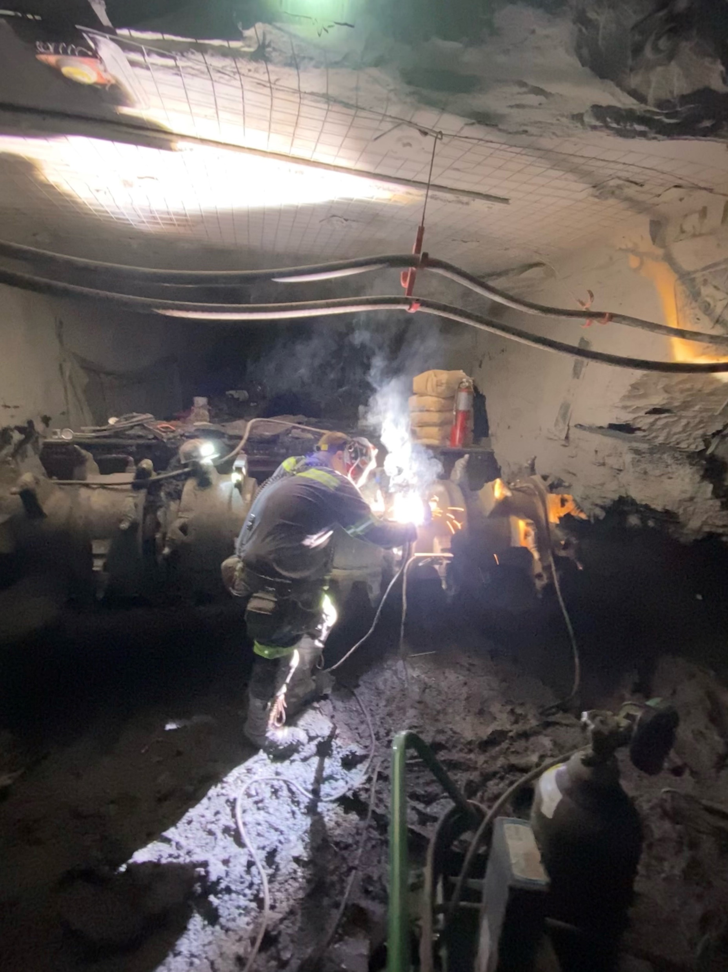
Fire Prevention while Cutting and Welding
§22A-2-46. Welding and cutting.
(c) Welding and cutting may be done in mines: Provided, That all equipment and gauges are maintained in safe condition and not abused, that suitable precautions are taken against ignition of methane, coal dust, or combustible materials, that means are provided for prompt extinguishment of fires accidentally started, and that only persons who have demonstrated competency in welding and cutting are entrusted to do this work. Adequate eye protection shall be used by all persons doing welding or cutting, and precautions shall be taken to prevent other persons from exposure that might be harmful to their eyes. A suitable wrench designed for compressed tanks shall be provided to the person authorized to use the equipment.
(g) In all mines a certified person, pursuant to section twelve of this article, shall examine for gas with permissible flame safety lamps or other approved detectors before and during welding or cutting. The safety of the equipment and methods used in such cases shall be subject to approval of the director. If equipment is mobile, it shall be removed outby the last open breakthrough before cutting and welding may be performed on such equipment.

Slide 44
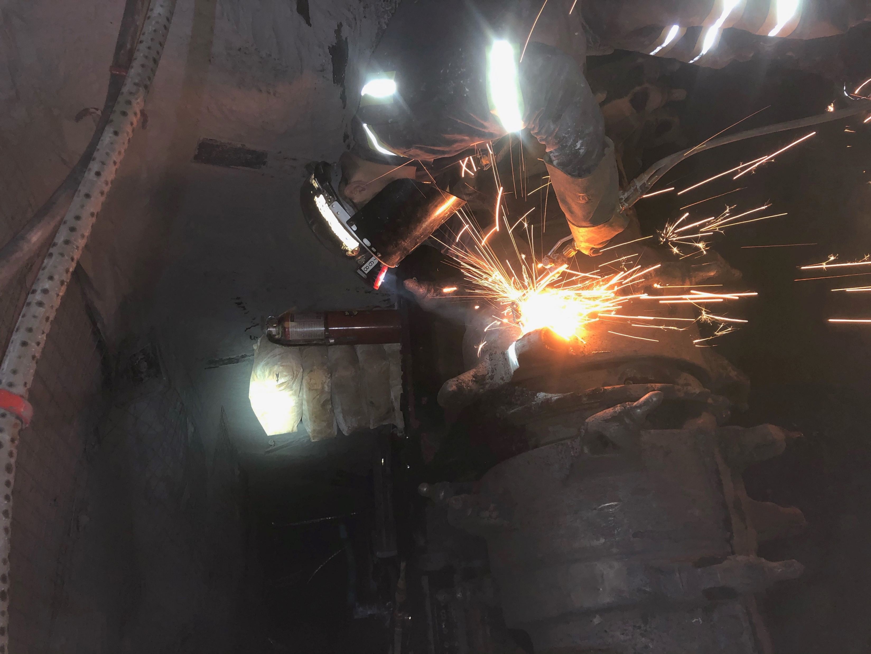
Fire Prevention while Cutting and Welding
§22A-2-50. Procurement of dust-tight electrical equipment; fireproof construction; dust control; repairs; welding; handrails and toeboards; protection of personnel on conveyors; back guards on ladders; walkways or safety devices around thickeners.
(f) Welding shall not be done in dusty atmospheres and dusty locations shall be well cleaned, and firefighting apparatus shall be readily available during welding.
§36-14-5. Cutting and Welding in Mines.
5.1. When cutting and welding has been performed in any area of an underground coal mine, that area shall be examined for any hot spots immediately after the work is completed. A second examination for hot spots shall be conducted within 2 hours, but no sooner than 30 minutes after the first examination has been completed. The second examination shall be performed by a qualified person and recorded in a book provided for that purpose by a certified person.

Slide 45
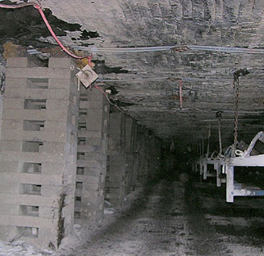
Fire Prevention on Belt Haulage
§22A-2-39. Belt conveyor; installation; maintenance; examination of belt conveyors and belt entries.
(a) On or after the first day of July, one thousand nine hundred seventy-one, all conveyor belts acquired for use underground shall be flame-resistant conveyor belts.
(e) All belt conveyors shall be inspected by a certified belt examiner, mine foreman-fireboss or assistant mine foreman-fireboss for frozen rollers and fire hazards following the last production shift each week, also before holidays, vacation periods, as hereinafter provided, with records kept of daily inspection.
(f)(1) Belt conveyors on which coal is transported on any shift shall be examined during each coal-producing shift. Such examination shall be made of belt conveyors and belt conveyor entries for unsafe conditions including, but not limited to, mine gases, frozen rollers, hazardous roof or rib conditions and fires.
(j) Deluge-type water sprays, water sprinklers, dry chemical sprinkler system or foam generators (designed to be automatically activated in the event of a fire or rise in the temperature at or near the belt drive) shall be installed at each main and secondary conveyor drive that are located underground.

Slide 46
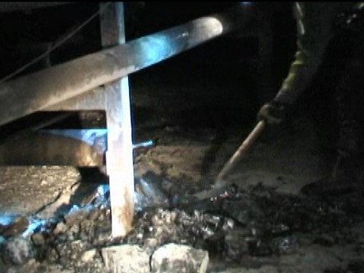
Fire Prevention on Belt Haulage
§22A-2-24. Control of coal dust; rock dusting.
(a) In all mines, dangerous accumulations of fine, dry coal and coal dust shall be removed from the mine, and all dry and dusty operating sections and haulageways and conveyors and back entries shall be rock dusted or dust allayed by other methods as may be approved by the director.
(c) In all dry and dusty mines or sections thereof, rock dust shall be applied and maintained upon the roof, floor and sides of all operating sections, haulageways and parallel entries connected thereto by open crosscuts. Back entries shall be rock dusted. Rock dust shall be so applied to include the last open crosscut of rooms and entries, and to within forty feet of faces. Rock dust shall be maintained in a quantity that the incombustible content of the mine dust that could initiate or propagate an explosion shall not be less than eighty percent. The incombustible content of mine dust in return entries shall also be equal to or greater than eighty percent.
§22A-2-39. Belt conveyor; installation; maintenance; examination of belt conveyors and belt entries.
(f)(1) Belt conveyors on which coal is transported on any shift shall be examined during each coal-producing shift. Such examination shall be made of belt conveyors and belt conveyor entries for unsafe conditions including, but not limited to, mine gases, frozen rollers, hazardous roof or rib conditions and fires.

Slide 47
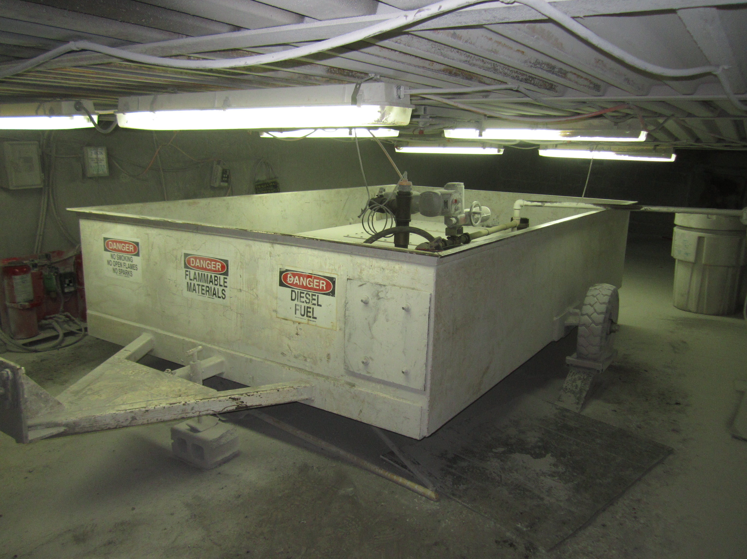
Fire Prevention for Diesel Fuel Storage
§56-23-8. Fuel Storage Facilities.
8.1. An underground diesel fuel storage facility shall be any facility designed and constructed to provide for the storage of any mobile diesel fuel transportation unit(s) or the dispensing of diesel fuel.
8.2. Diesel-powered equipment shall be used underground only with fuel that meets the standards of the most recently approved EPA guidelines for over-the-road-fuel. Additionally, the fuel shall also meet the ASTM D975 fuel standards with a flash point of one hundred degrees Fahrenheit or greater at standard temperature and pressure. The operator shall maintain a copy of the most recent delivery receipt from the supplier that will prove that the fuel used underground meets the standard listed above.
8.3. Underground diesel fuel storage facilities shall meet the following general requirements:
8.3.1. Fixed underground diesel fuel storage tanks are prohibited.
8.3.2. No more than five hundred gallons of diesel fuel shall be stored in each underground diesel fuel storage facility.
8.4. Underground diesel fuel storage facilities shall be located as follows:
8.4.1. At least one hundred feet from shafts, slopes, shops and explosives magazines;
8.4.2. At least twenty-five feet from trolley wires, haulage ways, power cables and electric equipment not necessary for the operation of the storage facilities; and
8.4.3. In an area that is as dry as practicable.

Slide 48
Fire Prevention for Diesel Fuel Storage
§56-23-8. Fuel Storage Facilities. Continued
8.5. Underground diesel fuel storage facilities shall meet the construction requirements and safety precautions enumerated in this section.
8.5.1. Underground diesel fuel storage facilities shall meet all of the following:
8.5.1.a. Be constructed of noncombustible materials and provided with either self-closing or automatic closing doors.
8.5.1.b. Be ventilated directly into the return air course using noncombustible materials.
8.5.1.c. Be equipped with an automatic fire suppression system complying with section 12 of this rule. The director may approve an alternate method of complying with section 12 of this rule on a mine by mine basis.
8.5.1.f. Be included in the pre-shift examination.
8.5.2. Welding or cutting other than that performed in accordance with subdivisions
8.5.2.a. and 8.5.2.b. below shall not be done within fifty (50) feet of a diesel fuel storage facility. When it is necessary to weld, cut or solder pipelines, cylinders, tanks or containers that may have contained diesel fuel, the following requirements shall apply:
8.5.2.a. Cutting or welding shall not be performed on or within containers or tanks that have contained combustible or flammable materials until such containers or tanks have been thoroughly purged and cleaned or inerted and a vent or opening is provided to allow for sufficient release of any buildup pressure before heat is applied.
8.5.2.b. Diesel fuel shall not be allowed to enter pipelines or containers that have been welded, soldered, brazed or cut until the metal has cooled to ambient temperature.

Slide 49
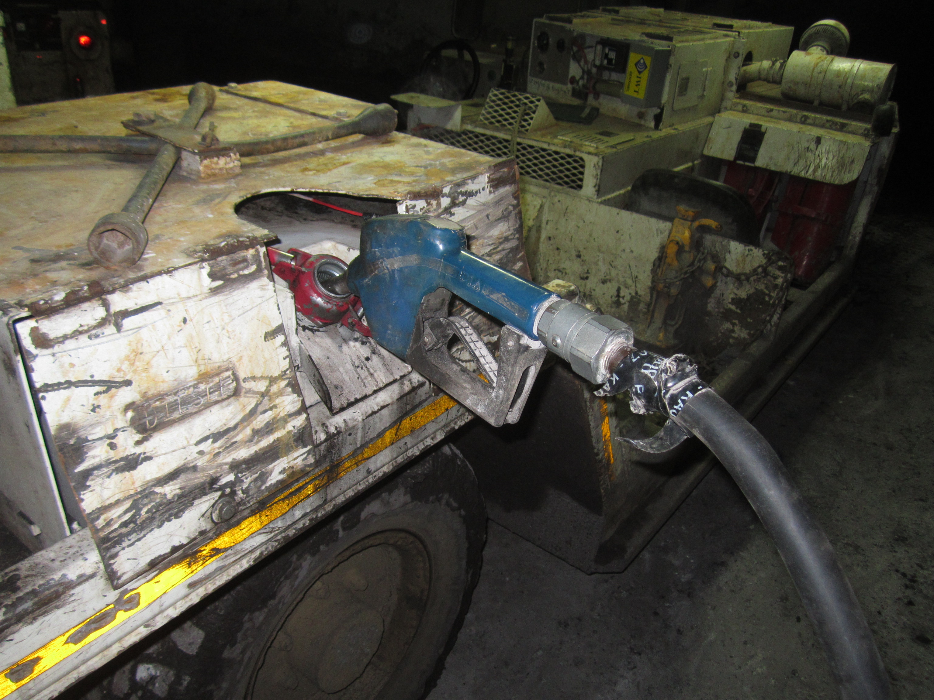
Fire Prevention for Diesel Fuel Transfer
§56-23-9. Transfer of Diesel Fuel.
9.1. Diesel fuel shall be transferred as provided in this section.
9.2. When diesel fuel is transferred by means of a pump and a hose equipped with a nozzle containing a self-closing valve, a powered pump may be used only if:
9.2.1. The hose is equipped with a nozzle containing a self-closing valve without a latch-open device; and
9.2.2. The pump is equipped with an accessible emergency shutoff switch.
9.3. Diesel fuel shall not be transferred using compressed gas.
9.4. Diesel fuel shall not be transferred to the fuel tank of diesel-powered equipment while the equipment’s engine is running.
9.5. Diesel fuel piping systems shall be designed and operated as dry systems.
9.6. All piping, valves and fittings shall meet the following:
9.6.1. Be capable of withstanding working pressures and stresses.
9.6.2. Be capable of withstanding four times the static pressures.
9.6.3. Be compatible with diesel fuel.
9.6.4. Be maintained in a manner that prevents leakage.

Slide 50
Fire Prevention for Diesel Fuel Transfer
§56-23-9. Transfer of Diesel Fuel. Continued
9.7. Vertical pipelines shall have manual shutoff valves installed at the surface filling point and at the underground discharge point.
9.8. Unburied diesel fuel pipelines shall not exceed three hundred feet in length and shall have shutoff valves located at each end of the unburied pipeline.
9.9. Horizontal pipelines shall not be used to distribute fuel throughout the mine.
9.10. Diesel fuel piping systems shall be used only to transport fuel from the surface directly to a single underground diesel fuel transfer point.
9.11. When boreholes are used, the diesel fuel piping system shall not be located in a borehole with electric power cables.
9.12. Diesel fuel pipelines located in any shaft shall be included as part of the required examination of the shaft.
9.13. Diesel fuel piping systems located in entries shall not be located on the same side of the entry as electric cables or power lines.
9.14. Diesel fuel pipelines shall not be located in any trolley-haulage entry, except that they may cross the entry perpendicular if buried or otherwise protected in steel conduit or an equivalent from damage and sealed.
9.15. Diesel fuel piping systems shall be protected to prevent physical damage.

Slide 51
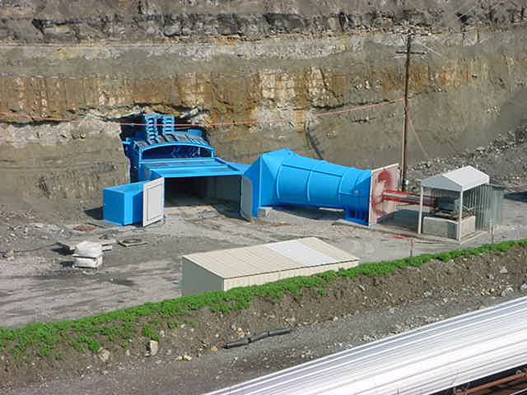
Fire Prevention from the Surface
§22A-2-3. Fans.
(b) All main fans installed after the effective date of this article shall be located on the surface in fireproof housings offset not less than 15 feet from the nearest side of the mine opening, equipped with fireproof air ducts, provided with explosion doors or a weak wall, and operated from an independent power circuit. In lieu of the requirements for the location of fans and pressure-relief facilities, a fan may be directly in front of, or over a mine opening: Provided, That such opening is not in direct line with possible forces coming out of the mine if an explosion occurs: Provided, however, That there is another opening having a weak wall stopping or explosion doors that would be in direct line with forces coming out of the mine. All main fans shall be provided with pressure-recording gauges or water gauges. A daily inspection shall be made of all main fans and machinery connected therewith by a certified electrician and a record kept of the same in a book prescribed for this purpose or by adequate facilities provided to permanently record the performance of the main fans and to give warning of an interruption to a fan.
§36-1-15. Ventilation - Fans.
15.1. Ventilation fans shall be:
15.1.2. Installed in fireproof housing and connected to the shaft and/or slope opening with fireproof air ducts.

Slide 52
Fire Prevention from the Surface
§22A-2-40. General provisions.
Operators of coal mines in which electricity is used as a means of power shall comply with the following provisions:
(30) Each ungrounded exposed power conductors that leads underground shall be equipped with suitable lightning arrestors of approved type within one hundred feet of the point where the circuit enters the mine. Lightning arrestors shall be connected to a low-resistance grounding medium on the surface which shall be separated from neutral ground by a distance of not less than twenty-five feet.
§22A-2-42. Telephone service or communication facilities.
Telephone service or equivalent two-way communication facilities shall be provided in all mines at least one of which shall be in service at all times as follows:
(a) A telephone or equivalent two-way communication facility shall be located on the surface within five hundred feet of all main portals, and shall be installed either in a building or in a box-like structure designed to protect the facilities from damage by inclement weather. At least one of these communication facilities shall be at a location where a responsible person who is always on duty when miners are underground can hear the facility and respond immediately in the event of an emergency. “Two-way communication facility” shall mean a system maintained to allow voice contact to come in and out of the working section at all times.

Slide 53
Fire Prevention from the Surface
§22A-2-50. Procurement of dust-tight electrical equipment; fireproof construction; dust control; repairs; welding; handrails and toeboards; protection of personnel on conveyors; back guards on ladders; walkways or safety devices around thickeners.
(b) After the first day of July, one thousand nine hundred seventy-one, all structures erected on the surface within one hundred feet of any mine opening shall be of fireproof construction.

Slide 54
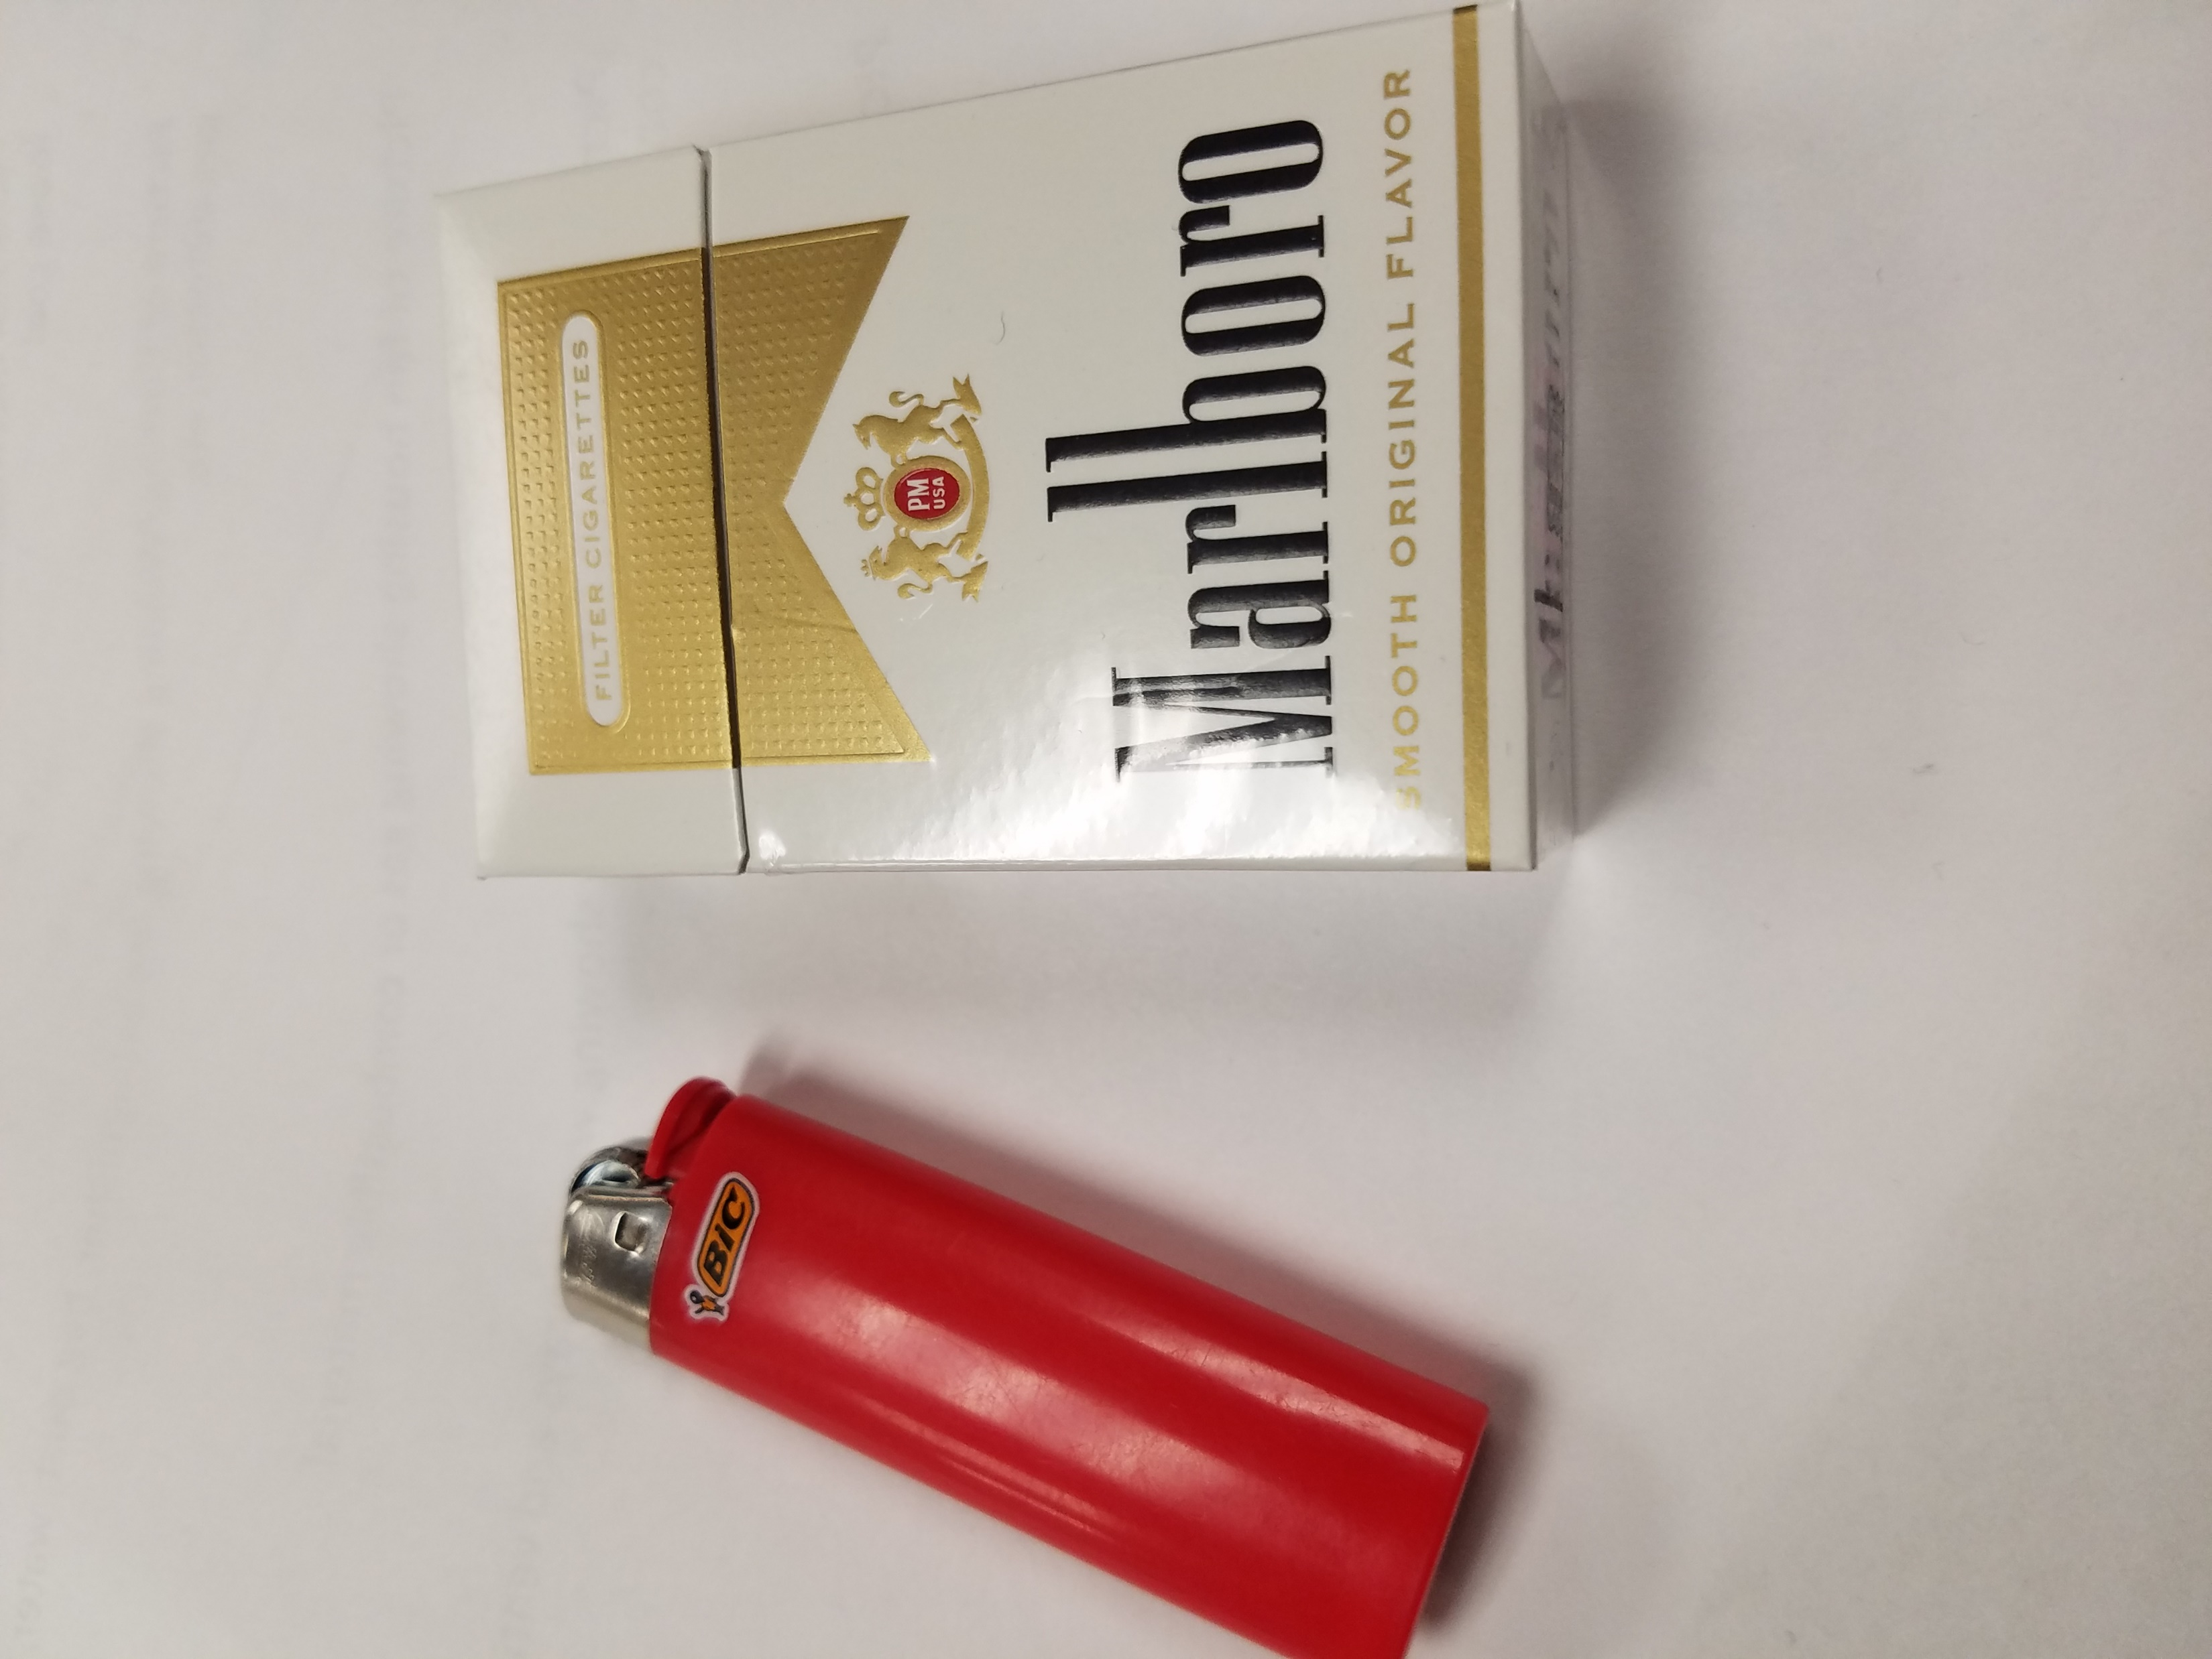
Fire Prevention from the Surface
§22A-2-57. No act permitted endangering security of mine; search for intoxicants, matches, etc.
(b) Open lights, smoking, and smokers’ articles, including matches, are prohibited in all mines. No person shall at any time enter mines with or carry therein any matches, pipes, cigars, cigarettes, or any device for making lights or fire not authorized or approved. The operator shall at frequent intervals search, or cause to be searched, any person, including his clothing and material belongings, entering or about to enter the mine, or inside the mine, to prevent such person from taking or carrying therein any of the above-mentioned articles.

Slide 55
Fire Prevention can be more than Fire prevention!

Slide 56
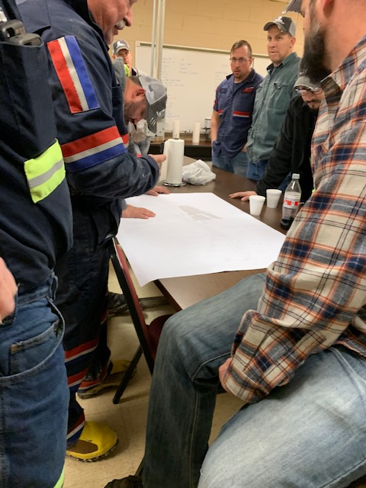
Continuing Education
Responsible Person

Slide 57
Responsible Person
Being a certified person can put a lot of responsibility on a person in performing their job. A certified person could find themselves being ask to serve as the Responsible person at a mine along with their daily jobs. When that time comes, you as a certified Foreman must know what it takes to perform that duty and should never except those duties unless you have had the proper training. The following set of slides will inform you on what is required to be a Responsible Person but does not take the place of Responsible person training.

Slide 58
Responsible Person
While persons are underground, a
responsible person designated by the
operator shall always be at a surface
location where each main mine fan signal
can be seen or heard.

Slide 59
Responsible Person
For each shift that miners work
underground, there shall be in attendance
a responsible person designated by
the mine operator to take charge during
mine emergencies involving a fire,
explosion, or gas or water inundation

Slide 60
Responsible Person
The responsible person shall have current knowledge of the assigned location and expected movements of miners underground, the operation of the mine ventilation system, the locations of the mine escapeways and refuge alternatives, the mine communications system, any mine monitoring system if used, locations of firefighting equipment, the mine’s Emergency Response Plan, the Mine Rescue Notification Plan, and the Mine Emergency Evacuation and Firefighting Program of Instruction evacuation

Slide 61
Responsible Person
The responsible person shall be trained annually in a course of instruction in mine emergency response, as prescribed by MSHA’s Office of Educational Policy and Development. The course will include topics such as the following:

Slide 62
Responsible Person
(i) Organizing a command center;
(ii) Coordinating firefighting personnel;
(iii) Deploying firefighting equipment;
(iv) Coordinating mine rescue personnel;
(v) Establishing fresh air base;
(vi) Deploying mine rescue teams;
(vii) Providing for mine gas sampling
and analysis;
(viii) Establishing security;
(ix) Initiating an emergency, mine
evacuation;
(x) Contacting emergency personnel;
and
(xi) Communicating appropriate information
related to the emergency.

Slide 63
Responsible Person
Mine Specific information a Responsible Person shall have knowledge about.
Emergency response Plan (EPR)
Emergency Notification Plan
Emergency Evacuation and Fire Fighting Plan
Mine Maps- with ventilation system and escapeway systems
Information or training materials for mine specific Atmospheric Monitoring System (AMS), if applicable
SCSR Storage Plan
Ventilation Plan
Any other site-specific plans, materials, and/or policies related to mine emergency preparedness and readiness training.

Slide 64
Responsible Person
The operator shall certify by signature and date after each responsible person has completed the training and keep the certification at the mine for 1 year.

Slide 65
Responsible Person
The responsible person shall initiate and conduct an immediate mineevacuation when there is a mine emergency which presents an imminent danger to miners due to fire or explosion or gas or water inundation. Only properly trained and equipped persons essential to respond to the mine emergency may remain underground

Slide 66
Responsible Person
The mine operator shall instruct all miners of the identity of the responsible person designated by the operator for their work shift. The mine operator shall instruct miners of any change in the identity of the responsible person before the start of their work shift

Slide 67
Responsible Person
Best Practices
Make sure your responsible persons have the proper training
MSHA required training
Responsible persons should attend Mine Rescue MERD training exercises for hands on training. These exercises are held annually by the Mine Rescue team providing coverage for your mine.

Slide 68
Responsible Person
The next two slides are the only places in the WV law that a responsible person is talked about. The requirements of a Responsible Person required by MSHA require annual retraining and a record that that training be kept for one year at the mine site. That training does not follow you to another mine because parts of the training is mine specific.

Slide 69
The dispatcher’s only duty shall be to direct traffic: Provided, That the dispatcher’s duties may also include those of the responsible person required by §22A-2-42 of this code: Provided, however, That the dispatcher may perform other duties which do not interfere with his or her dispatching responsibilities and do not require him or her to leave the dispatcher’s station except as approved by the Mine Safety and Technical Review Committee.

Slide 70
A telephone or equivalent two-way communication facility shall be located on the surface within five hundred feet of all main portals and shall be installed either in a building or in a box-like structure designed to protect the facilities from damage by inclement weather. At least one of these communication facilities shall be at a location where a responsible person who is always on duty when miners are underground can hear the facility and respond immediately in the event of an emergency. “Two-way communication facility” shall mean a system maintained to allow voice contact to come in and out of the working section at all times.

Slide 71
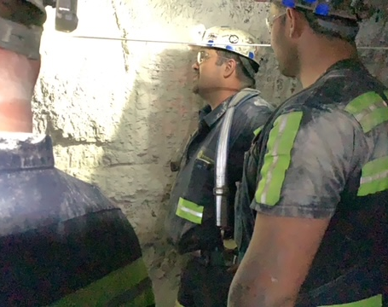
Continuing Education
Evacuations

Slide 72
Evacuations
Each operator of an underground coal mine shall adopt and follow a mine emergency evacuation and firefighting program that instructs all miners in the proper procedures they must follow if a mine emergency occurs

Slide 73
Evacuations
(a) For each shift that miners work
underground, there shall be in attendance
a responsible person designated by
the mine operator to take charge during
mine emergencies involving a fire,
explosion, or gas or water inundation

Slide 74
Evacuations
That responsible person shall have current knowledge of the assigned location and expected movements of miners underground, the operation of the mine ventilation system, the locations of the mine escapeways and refuge alternatives, the mine communications system, any mine monitoring system if used, locations of firefighting equipment, the mine’s Emergency Response Plan, the Mine Rescue Notification Plan, and the Mine Emergency Evacuation and Firefighting Program of Instruction evacuation

Slide 75
Evacuations
The approved program shall include a specific plan designed to instruct miners on all shifts on the following:

Slide 76
Evacuations
1. Evacuating the mine for mine emergencies that present an imminent danger to miners due to fire, explosion, or gas or water inundation;

Slide 77
Evacuations
2.Evacuating all miners not required for a mine emergency response.

Slide 78
Evacuations
3. The rapid assembly and transportation of necessary miners, fire suppression equipment, and rescue apparatus to the scene of the mine emergency

Slide 79
Evacuations
4. The use, care, and maintenance of self-rescue devices, including hands-on training in the complete donning and transferring of all types of self-rescue devices used at the mine.

Slide 80
Evacuations
5. The deployment, use, and maintenance
of refuge alternatives.

Slide 81
Evacuations
6. Scenarios requiring a discussion of options and a decision as to the best option for evacuation under each of the various mine emergencies (fires, explosions, or gas or water inundations).
These options shall include:

Slide 82
Evacuations
A. Encountering conditions in the mine or circumstances that require immediate donning of self-rescue devices.

Slide 83
Evacuations
B. Traversing undercasts or overcasts; Switching escapeways, as applicable; Negotiating any other unique
escapeway conditions; and Using refuge alternatives.
Hands on Refuge alternative training shall be conducted annually during miner's expectation training.

Slide 84
Evacuations
C. Location and use of the fire suppression and firefighting equipment and materials available in the mine

Slide 85
Evacuations
D. Location of the escapeways, exits, routes of travel to the surface, including the location of continuous directional
lifelines or equivalent devices

Slide 86
Evacuations
RA
SCSR CACHE

Slide 87
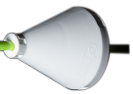
Evacuations
Branch Line
Directional Cone Every 100 FT
SCSR Storage Cache
Reflector Every 25 FT
Refuge Alternative
Man Door

Slide 88
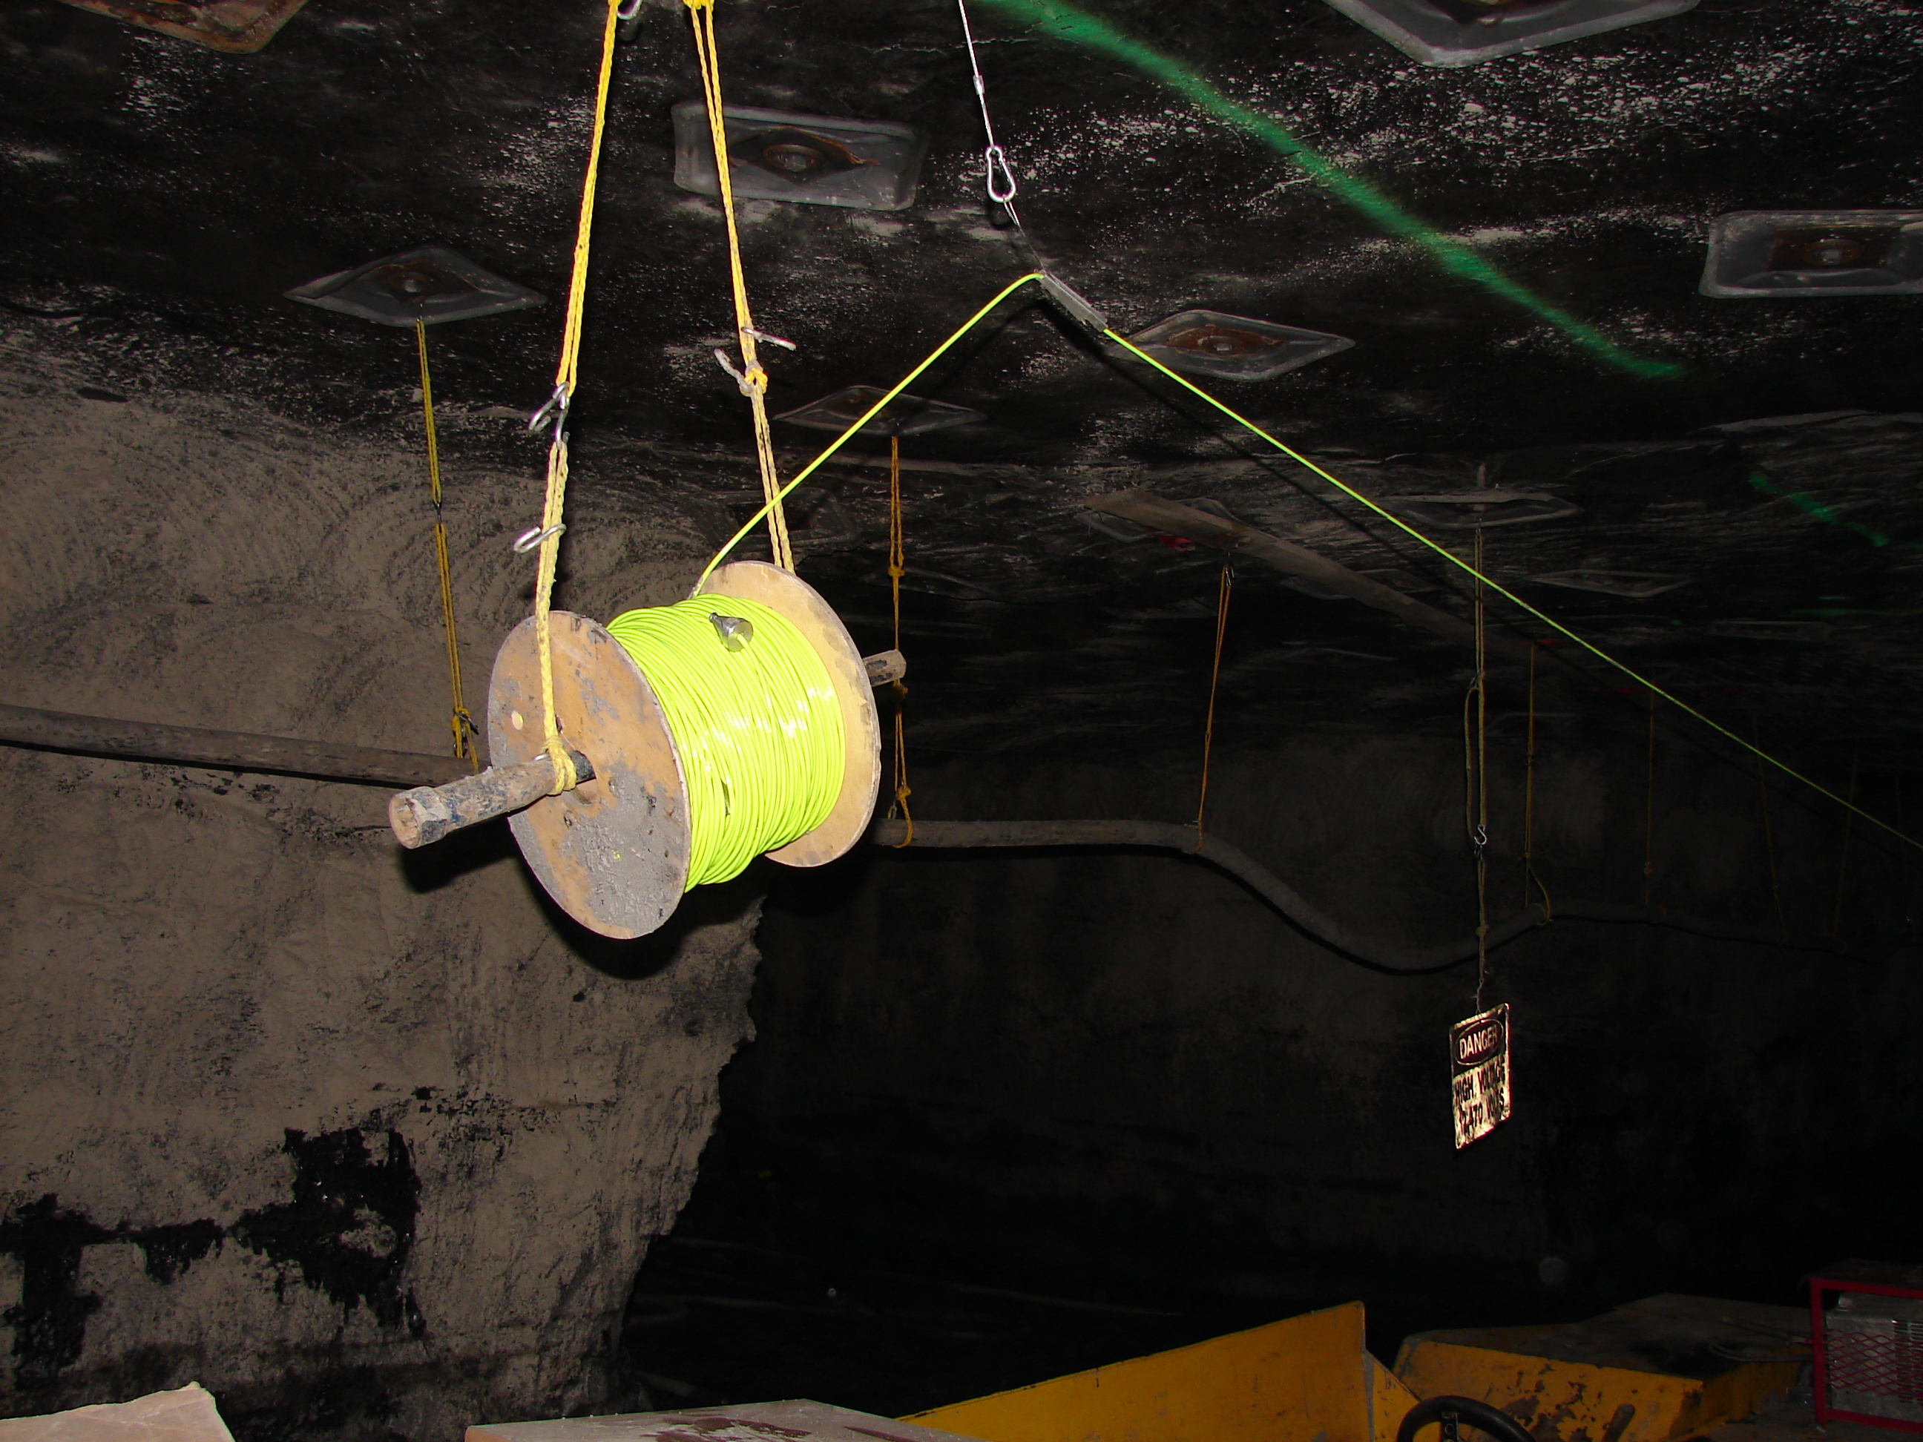

Slide 89
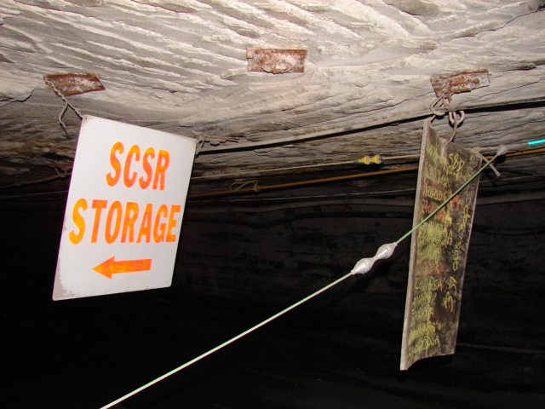

Slide 90
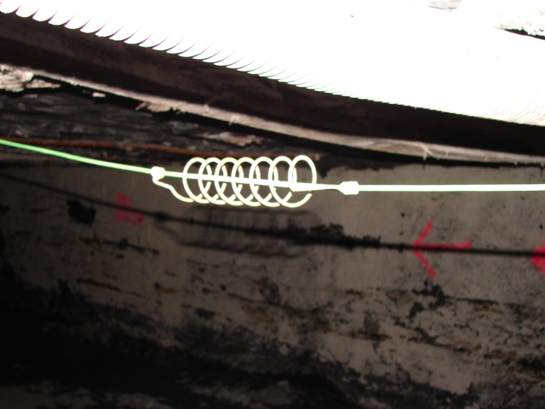

Slide 91
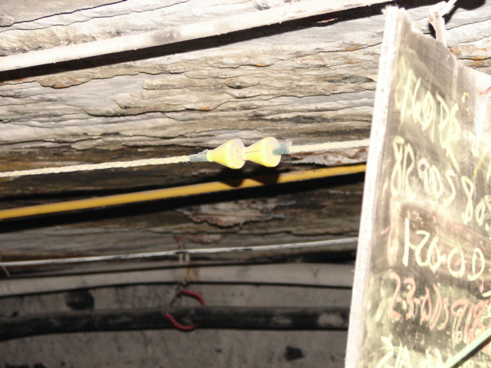

Slide 92
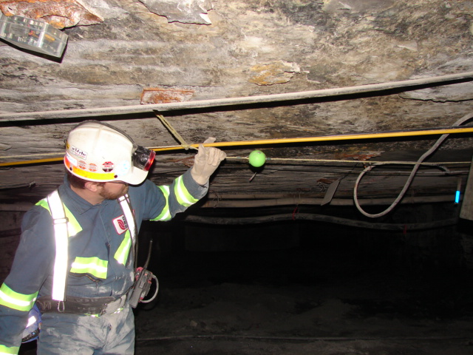

Slide 94
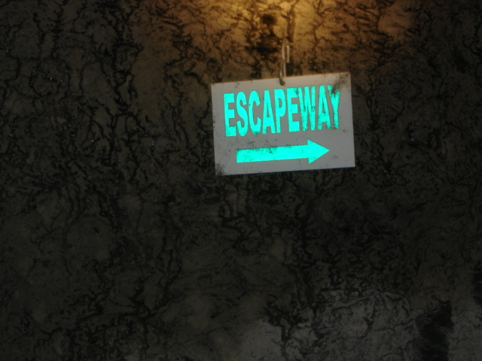

Slide 95
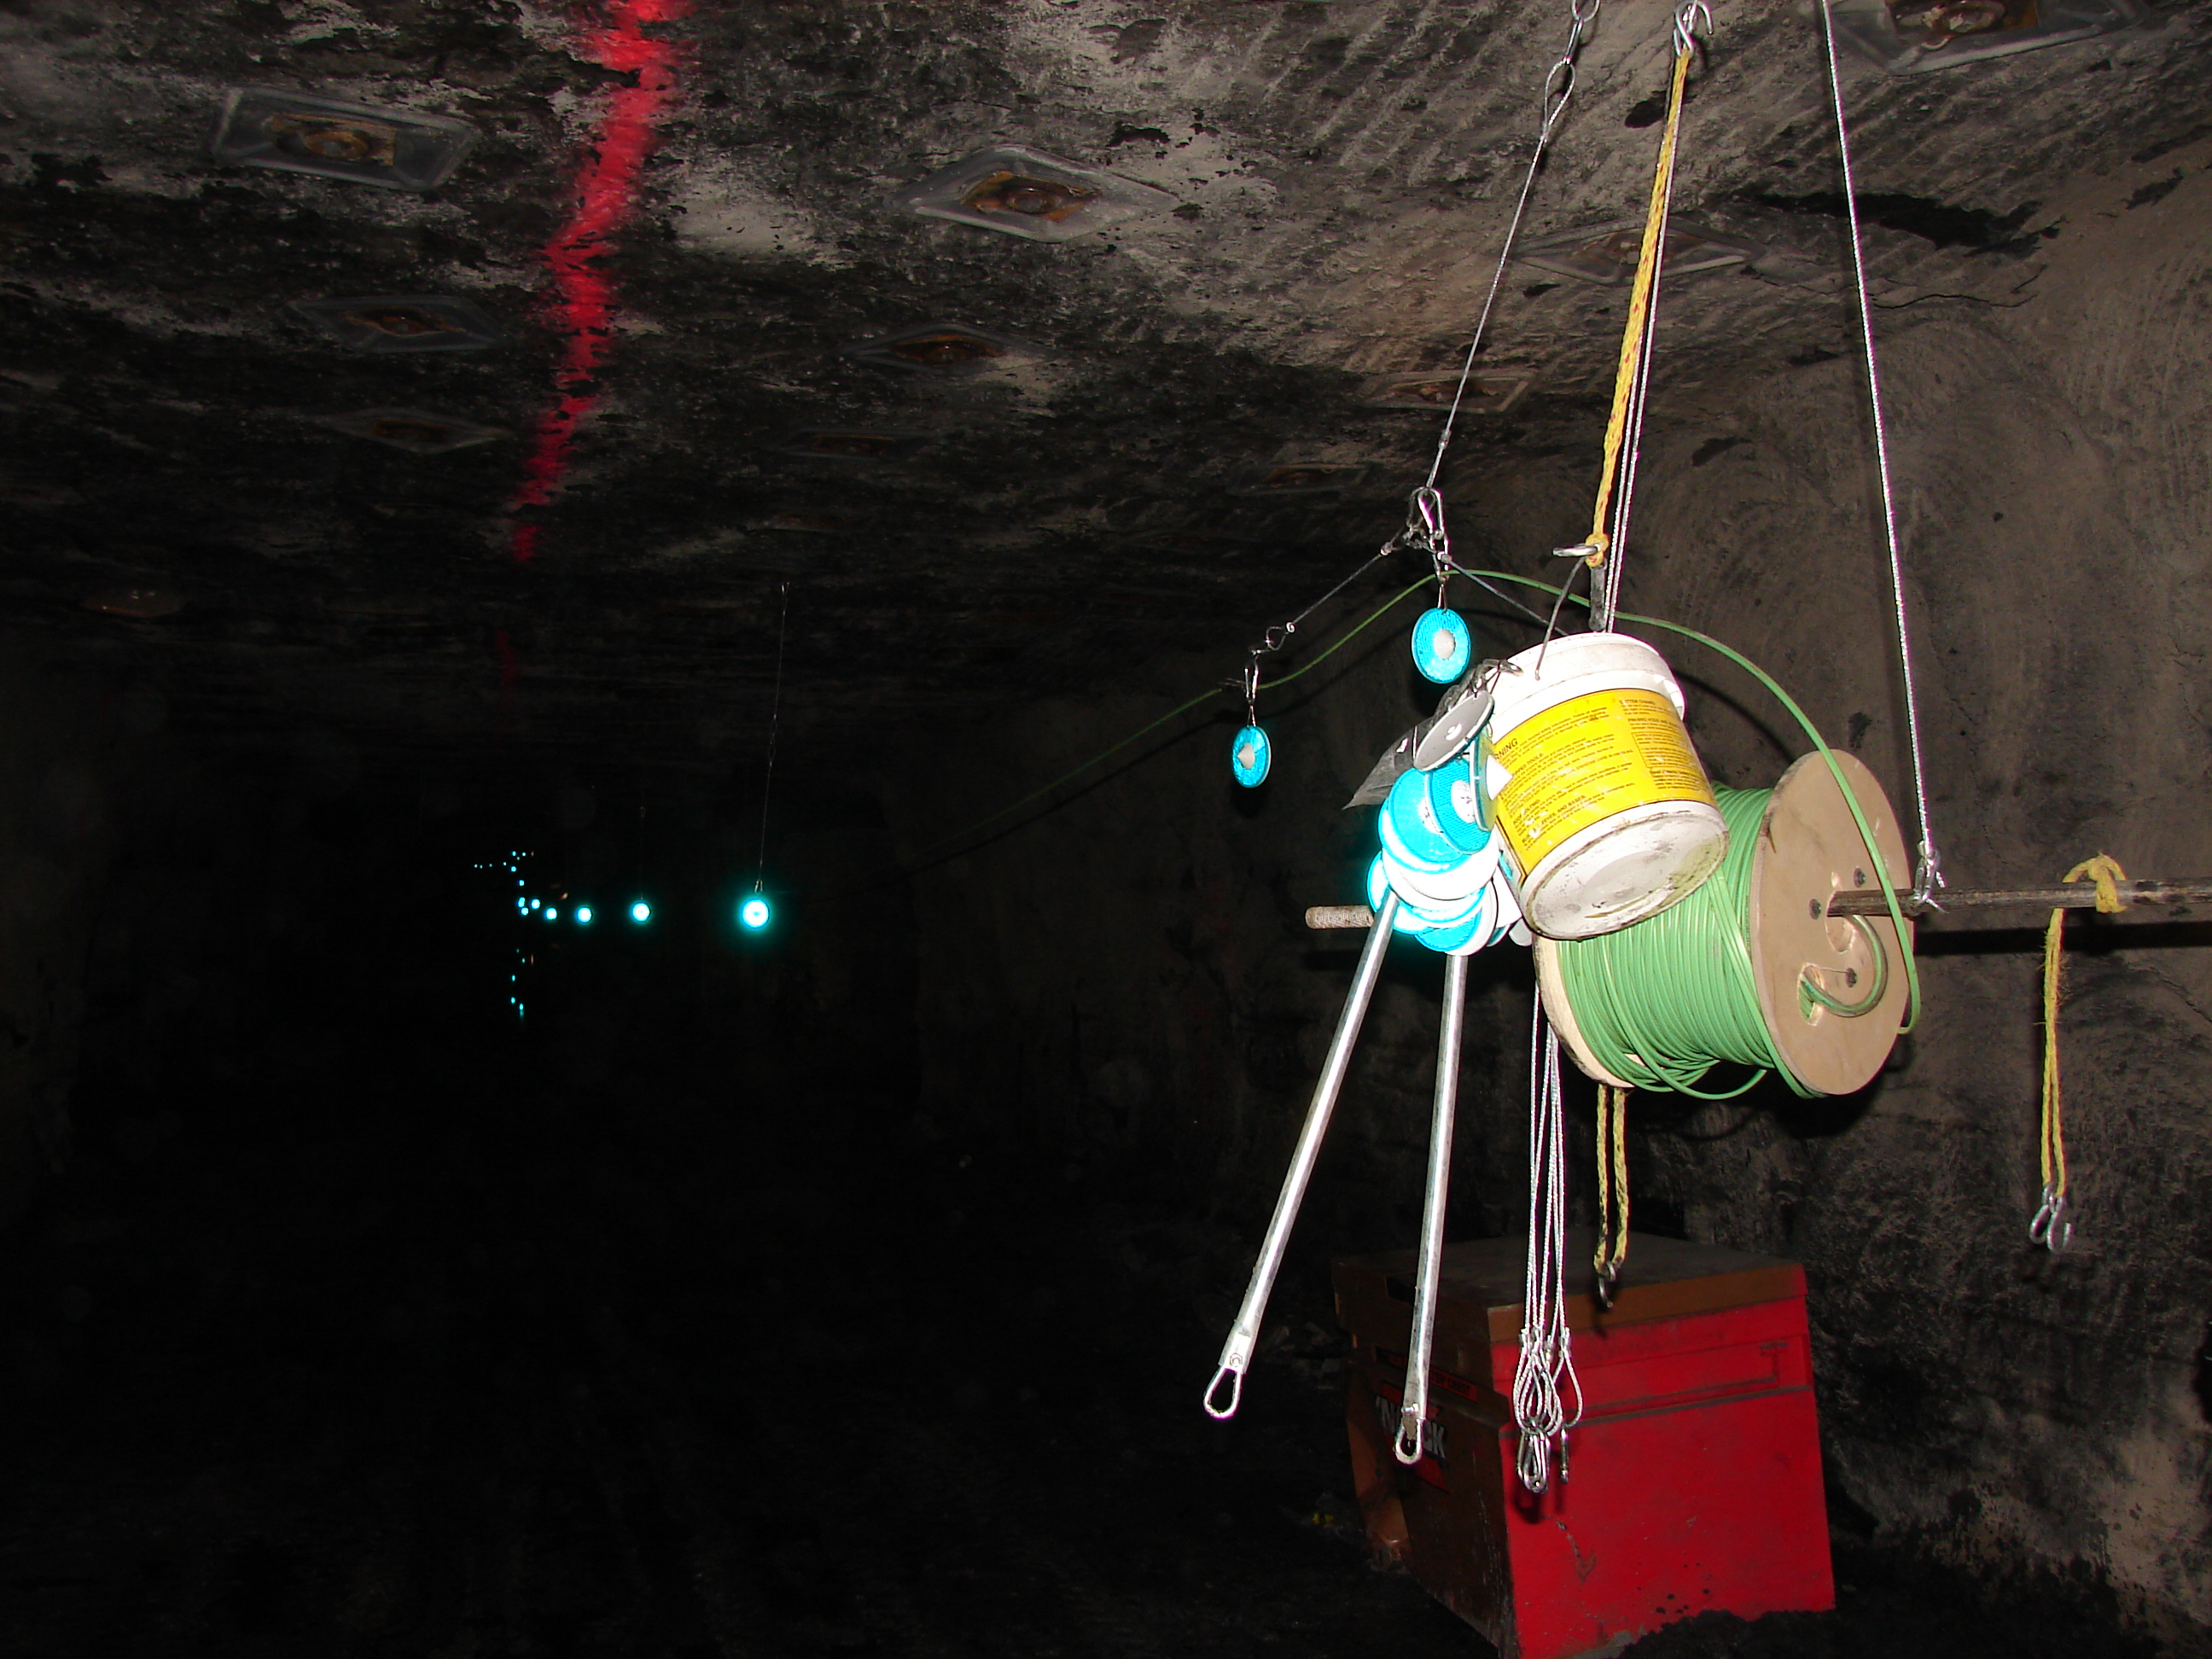
PRIMARY ESCAPEWAY = INTAKE
GREEN REFLECTORS

Slide 96
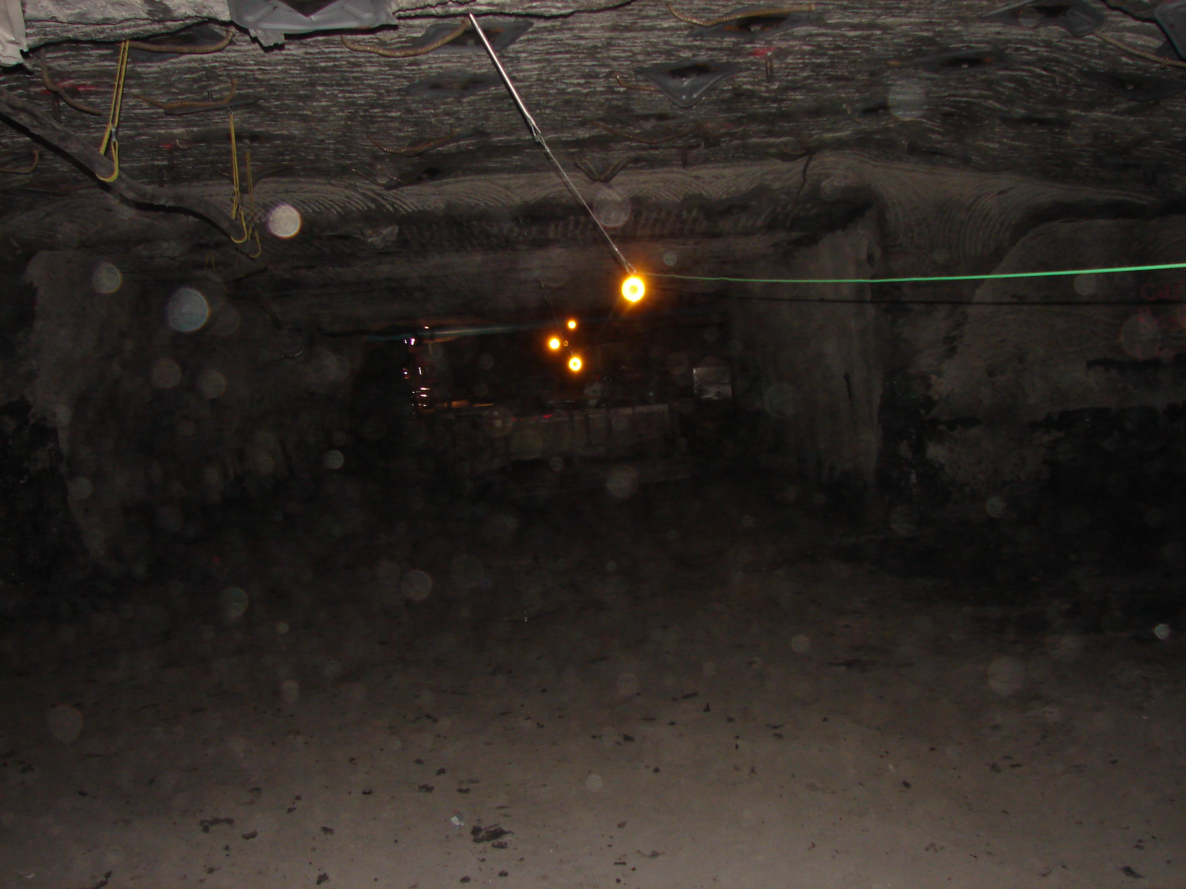
SECONDARY ESCAPEWAY = TRAVELWAY
AMBER REFLECTORS

Slide 97
Evacuations
E. A review of the mine map; the escapeway system; the escape, firefighting, and emergency evacuation plan in effect at the mine; and the locations of refuge alternatives and abandoned areas.

Slide 98
Evacuations
F. A description of how miners will receive annual expectations training that includes practical experience in donning and transferring SCSRs in smoke, simulated smoke, or an equivalent environment and breathing
through a realistic SCSR training unit or device that provides the sensation of SCSR airflow resistance and heat.

Slide 99
Evacuations
A summary of the procedures related to deploying refuge alternatives.
A summary of the construction methods for 15 psi stoppings constructed prior to an event.
I. A summary of the procedures related to refuge alternative use.

Slide 100
Evacuations
J. Instructors. (1) The mine operator shall designate a person who has the ability, training, knowledge, or experience to conduct the mine emergency evacuation instruction and drills in his or her area of expertise.

Slide 101
Evacuations
K. Persons conducting SCSR donning and transferring training shall be able to effectively train and evaluate whether miners can successfully don the SCSR and transfer to additional SCSR devices.

Slide 102
Evacuations
I. Using continuous directional lifelines
or equivalent devices, tethers, and doors;

Slide 103
Evacuations (WV LAW)
Lifeline cords installed in primary escape-ways shall be attached to each storage cache container
and extend from the last permanent stopping to the surface or nearest escape facility, excluding belt and
track entries, and must:
7.3.1. Be made of flame-resistant material;
7.3.2. Be marked with reflective material every twenty-five (25) feet;
7.3.3. Be located in such a manner for miners to use effectively to escape; and
7.3.4. Have directional indicators signifying the route of escape placed at intervals not exceeding one hundred (100) feet.

Slide 104
Evacuations
Fire drills and demonstrations of various types of available firefighting equipment shall be held for employees at least every six (6) months ( WV Law)
MSHA requires that fire/ evacuations drills be conducted quarterly.

Slide 105
Continuing Education
Firefighting

Slide 106
Understanding Fire
Three things must be present at the same time to produce fire:
Enough OXYGEN to sustain combustion
Enough HEAT to reach ignition temperature
Some FUEL or combustible material
Together, they produce the CHEMICAL REACTION that is fire
COOL
Take away any of these things and the fire will be extinguished
SUFFOCATE
STARVE
1. Remove OXYGEN it suffocates
2. Remove HEAT it cools
3. Remove FUEL it starves

Slide 107
Understanding Fire
It is very important to be aware of what is on fire before we can extinguish the fire!!!

Slide 108
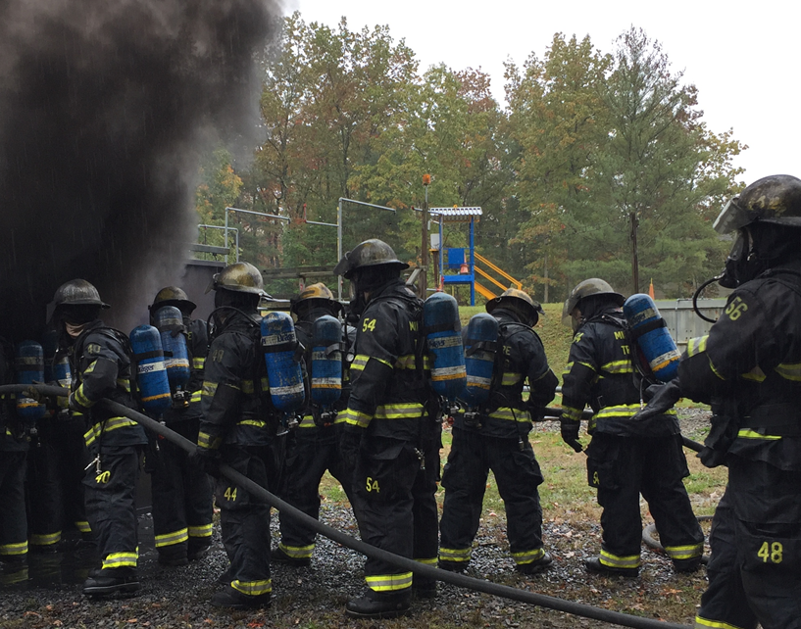
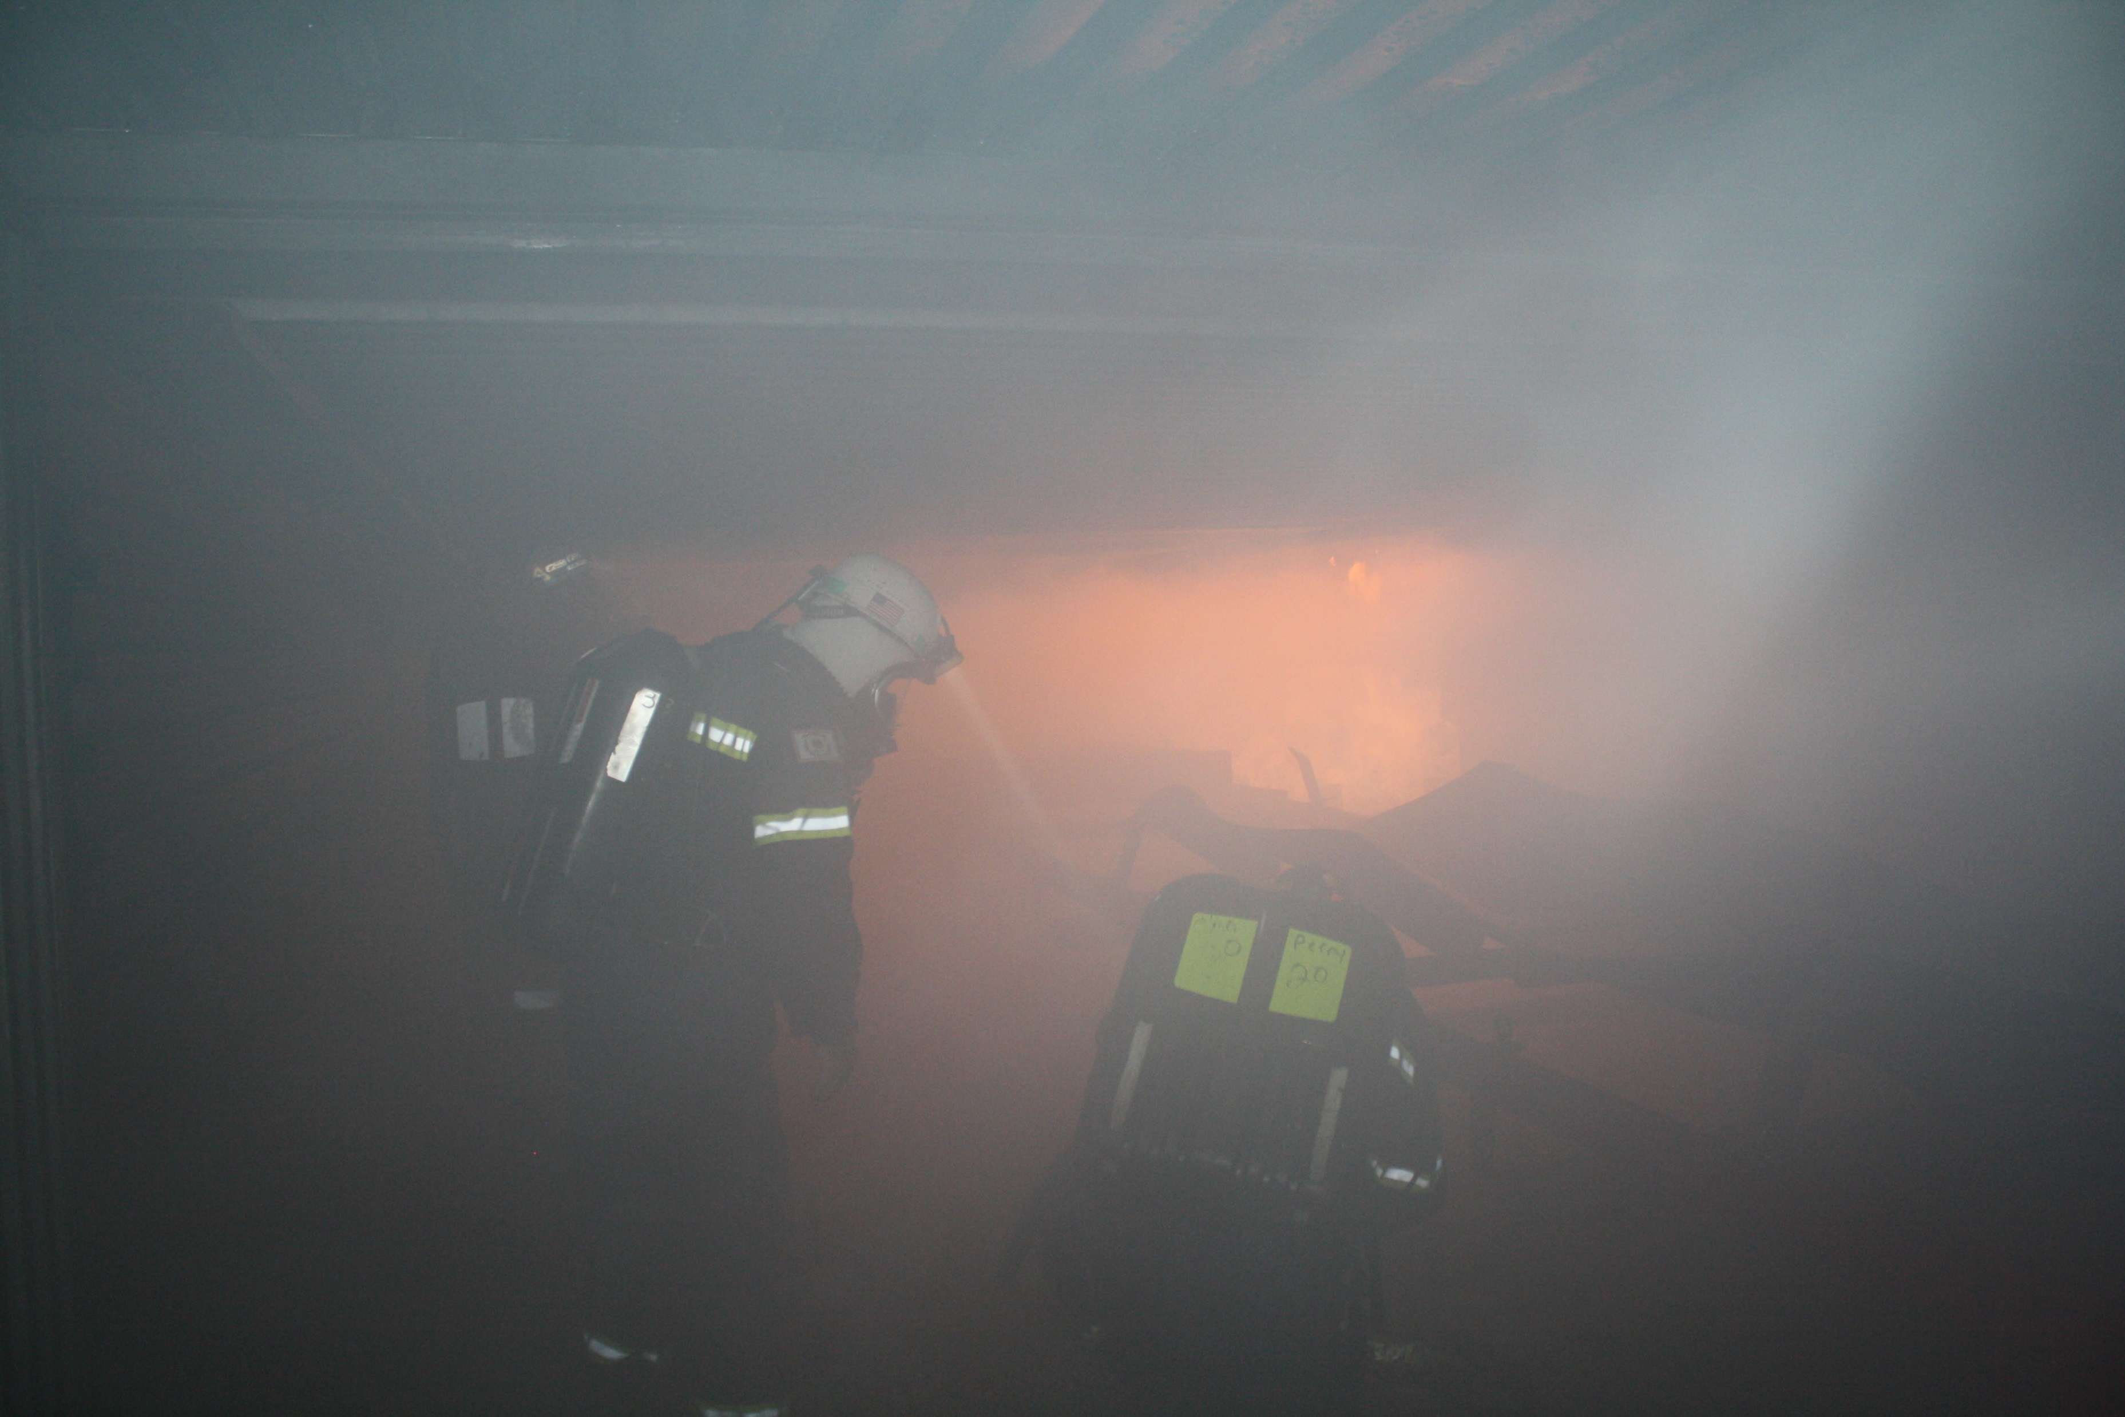
Safety Precautions Involved With Fighting Fire
Mine fires can produce intensive heat that can cause critical or fatal burns.
Fire will produce smoke and high concentrations of toxic gasses in which we can not breathe.
Be sure to wear the proper PPE when present in these conditions.
The CSE SRLD, Drager Oxy K Plus, Ocenco EBA 6.5, and Ocenco M-20 are used for escape purposes only and not for fire fighting!

Slide 109
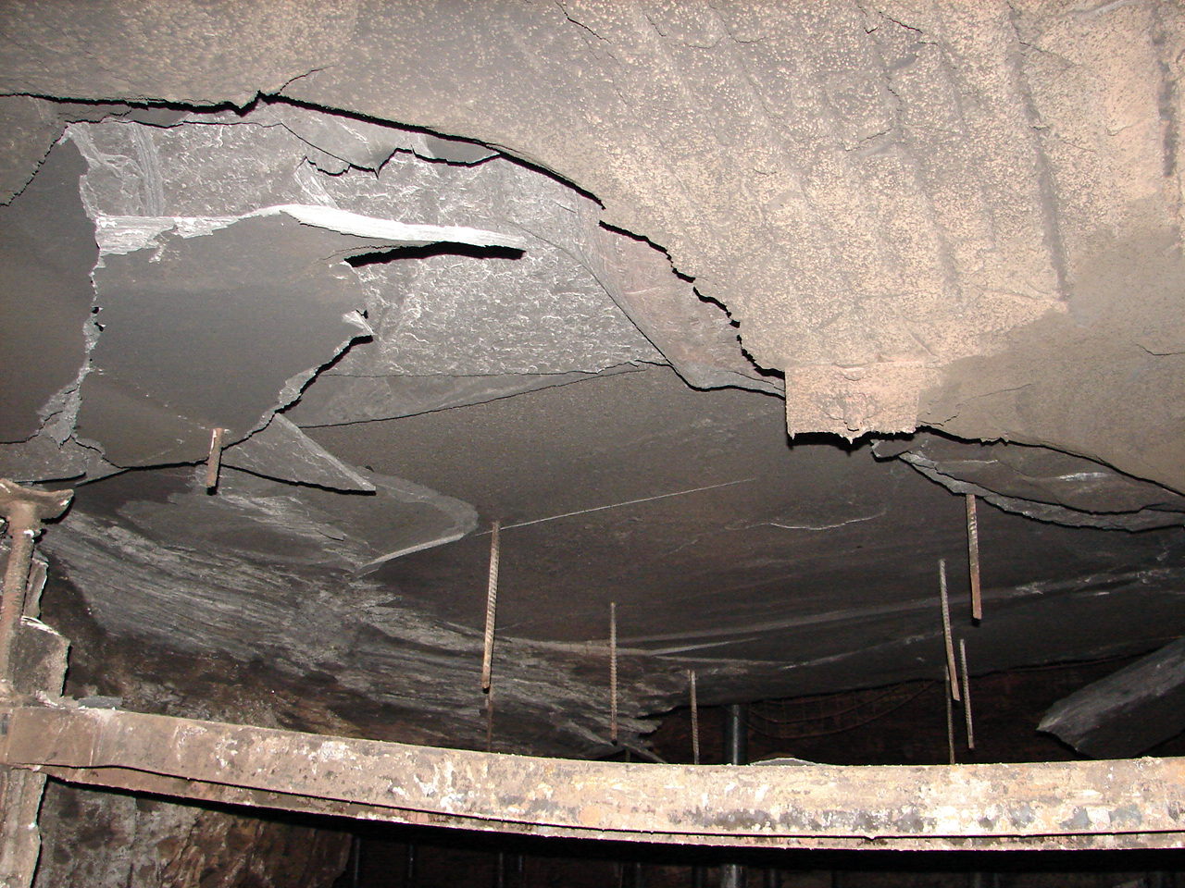
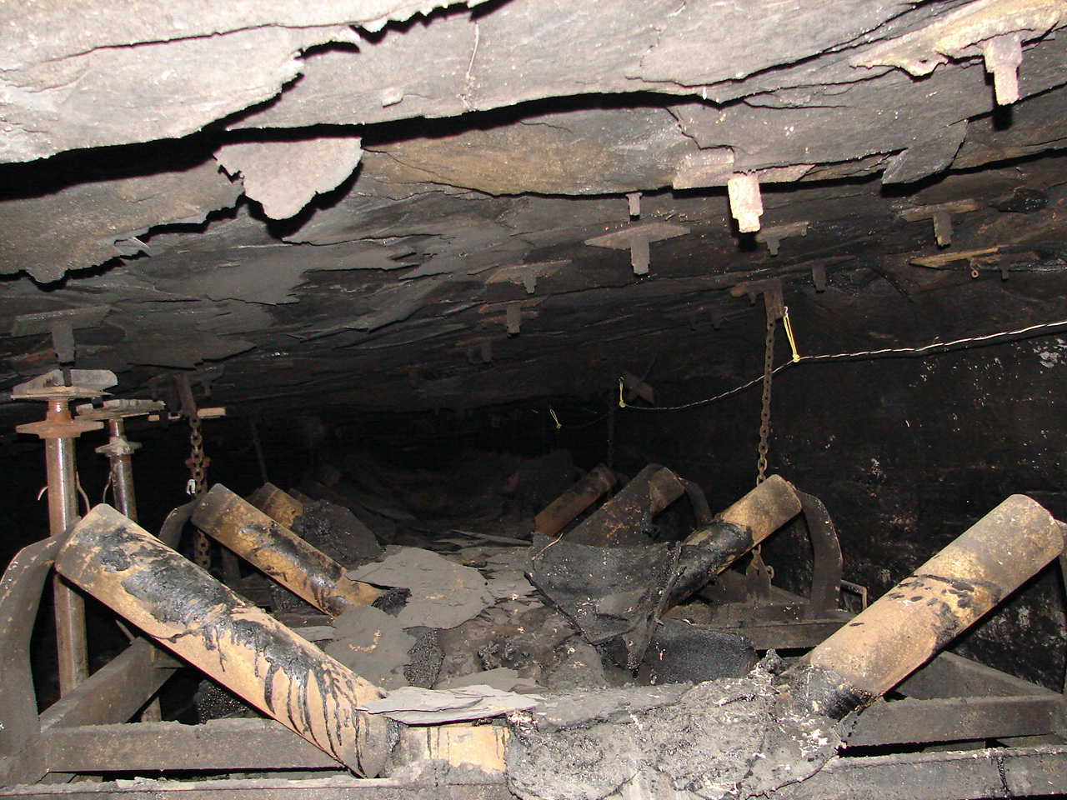
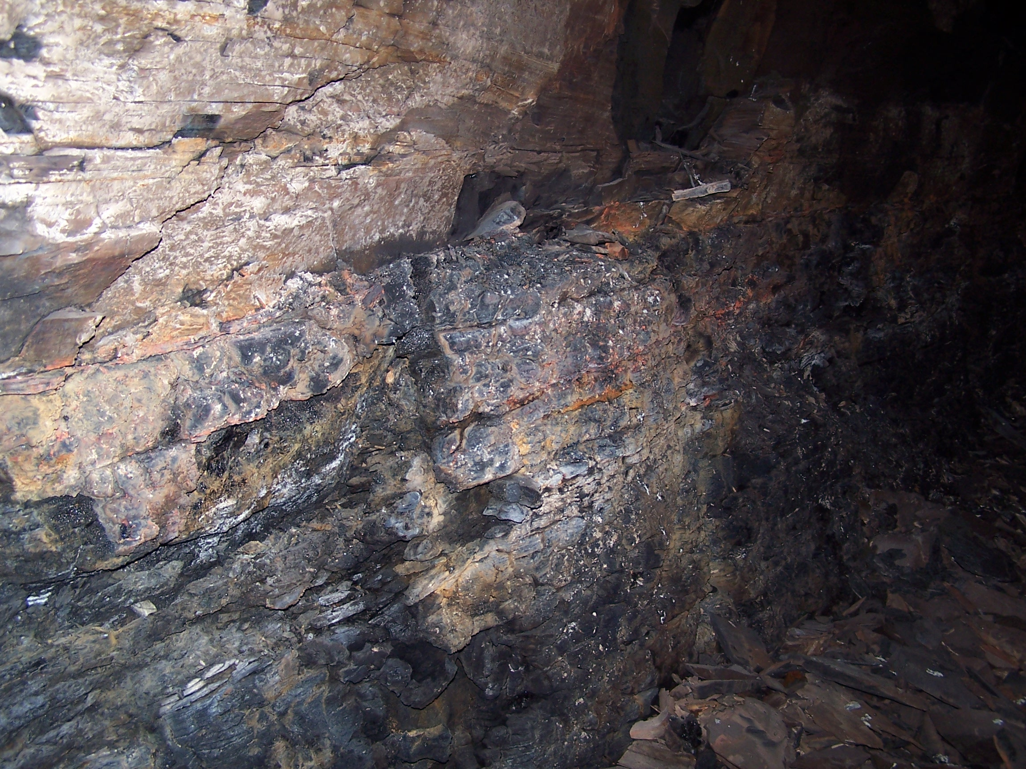
Safety Precautions Involved With Fighting Fire
Roof and Ribs!
High heat along with burning of head-coal will compromise the integrity of the roof material.
Fire burning wood supports such as timbers or cribs will compromise the roof support.
High heat and burning of the coal in the ribs will compromise the stability of the ribs.

Slide 110
Understanding Fire Movement and Progression
Remember Air
Currents Will Affect
Fire Movement and Progression

Slide 111
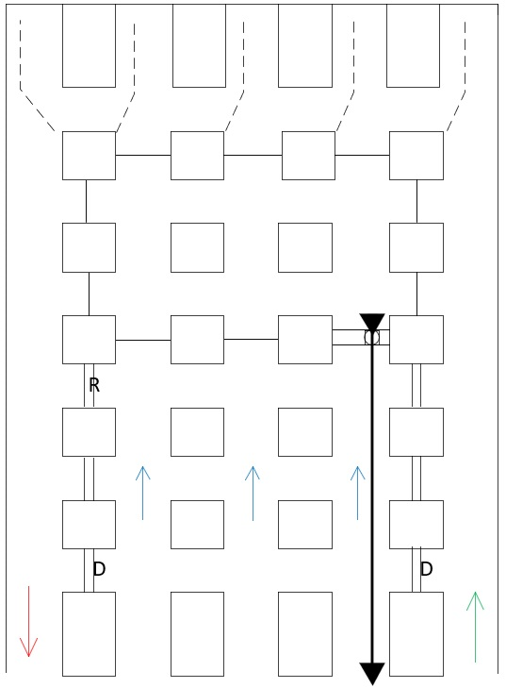
Understanding Fire Movement and Progression
This is an example of how fire can travel and progress with inby air direction.
It is estimated that fire can progress in size by doubling every five minutes.
Air quantity, mine gasses, coal dust, coal quality, and other contributing factors will affect fire movement and fire progression.

Slide 112
Understanding Fire Movement and Progression
This is an example of how fire can travel and progress with outby air direction.
It is estimated that fire can progress in size by doubling every five minutes.
Air quantity, mine gasses, coal dust, coal quality, and other contributing factors will affect fire movement and fire progression.
As a fire intensifies and the temperature increases permanent stoppings may not stop fire movement. If a stopping is not properly plastered and cap wedges or other building materials are exposed, they may burn causing the stopping to collapse.

Slide 113
Fire Development
Growth – The growth stage is where the structures fire load and oxygen are used as fuel for the fire. There are numerous factors affecting the growth stage including where the fire started, what combustibles are near it, ceiling height and the potential for “thermal layering”. It is during this shortest of the 4 stages when a deadly “flashover” can occur; potentially trapping, injuring or killing firefighters.
Fully Developed – When the growth stage has reached its max and all combustible materials have been ignited, a fire is considered fully developed. This is the hottest phase of a fire and the most dangerous for anybody trapped within.
Decay – Usually the longest stage of a fire, the decay stage is characterized a significant decrease in oxygen or fuel, putting an end to the fire. Two common dangers during this stage are first – the existence of non-flaming combustibles, which can potentially start a new fire if not fully extinguished. Second, there is the danger of a backdraft when oxygen is reintroduced to a volatile, confined space.
Incipient (Ignition) – This first stage begins when heat, oxygen and a fuel source combine and have a chemical reaction resulting in fire. This is also known as “ignition” and is usually represented by a very small fire which often (and hopefully) goes out on its own, before the following stages are reached. Recognizing a fire in this stage provides your best chance at suppression or escape.

Slide 114
Decision Making
When a fire is detected, Call for HELP
and contact the responsible person!
Follow all your company’s approved plans
and operating guidelines!

Slide 115
Decision Making
When a fire is detected, a decision must be made!
Can I safely extinguish this fire, or should everyone evacuate?

Slide 116
Decision Making
Without the proper PPE and Training you should only attempt to extinguish a fire that is in the Incipient (Ignition) Stage.
If the fire progresses to the Growth Stage and you feel the fire is out of control everyone needs to evacuate the area to fresh air!

Slide 117
Direct Fire Attack
Direct attack is a firefighting operation involving the application of extinguishing agents directly onto the burning fuel.
When using the direct attack try to position yourself in the upwind (fresh air) side of the fire.

Slide 118
Using a Fire Extinguisher
P
A S S

Slide 119
Using a Fire Extinguisher
When using an ABC dry chemical fire extinguisher stand between 8 and 10 feet away from the fire and sweep back and forth at the base of the fire.
Remember when using an ABC dry chemical fire extinguisher, you only have approximately 1 second per pound of use. A 10-pound fire extinguisher will only give you approximately 10 seconds of use.
8 to 10 Feet
After the fire goes out continue to use the fire extinguisher. Don’t stop using the extinguisher just because you feel the fire is out.

Slide 120
Using a Hand Line
The fire tap should be flushed before the firehose is connected.
Before the nozzle is connected to the firehose the firehose should first be flushed.
When using a hand line, you should always have help!
You should keep an arm’s length of distance between the nozzleman and the backup person to ensure easier movements.
You should both hold the hose at the same level and be on the same side of the hose.
The nozzleman should hold the nozzle at a full arm’s length out in front of him or her to ensure easier movements.

Slide 121
Using a Hand Line
When using a hand line stand approximately 15ft to 20ft (or as safely as possible) away from the fire.
Adjust the fog pattern to where the water pattern is slightly wider than the fire.

Slide 122
Using a Hand Line
A straight stream pattern can cause the fire to spread and allow the heat and flame to wrap around and burn the individual.
A full fog pattern is used to protect the individual but is not the most effective to extinguish the fire.

Slide 123
Using a Hand Line With a Foam Inductor
When using a foam inductor, you should always follow the manufacture recommendations!

Slide 124
Hand Line Foam Inductor
Flow Regulator
Nozzle Types
Green – Class A percentage
Red – Class B Percentage
Straight Stream Nozzle
Rated Flow 12 GPM
Minimum operating condition 7 GPM (40 psi)
Max Operating condition 27 GPM (500 psi)
50ft @ 100psi
Low Expansion Nozzle
Medium Expansion Nozzle
9ft @ 100psi
37ft @100psi

Slide 125
Fire Fighting with Foam
Class A Foams
Class B Foams
Class A Foam is specially formulated to make water more effective for firefighting. The surfactants in Class A foam significantly reduce water's surface tension and, when mixed with air, create a superior foam blanket that surrounds fuels with a thick layer of water.
Class B firefighting foams are commercial surfactant solutions that have been (and continue to be) stored and used for fire suppression, fire training, and flammable vapor suppression
Low Expansion
Ratio 20:1
Effective most class B fires
High Expansion
Ratio 200:1 – 1000:1
Used for most confined spaces

Slide 126
Hand Line Foam Inductor
Fire fighting foam packs are great tools to have readily available in areas that are susceptible to fires, such as belt heads, take-ups, oil storage areas etc.….
How Foam Works
Foam Prevents air from mixing with vapors, it eliminates vapor release, separates flames, and cools the fuel surface

Slide 127
Using a Hand Line With a Foam Inductor
After applying foam, precautions should be taken to never walk through or disturb the applied foam. This will allow the barrier to be broken and oxygen to regain entry to the fire area.

Slide 128
Indirect Fire Attack
Indirect attack is a firefighting operation involving the application of extinguishing agents to reduce the buildup of heat released from a fire without applying the agent directly onto the burning fuel (P. 1830, NFPA Glossary of Terms, 2018 Edition.) This form of fire attack involves directing fire streams toward the ceiling of a compartment to generate a large amount of steam to cool the compartment. Converting the water to steam displaces oxygen, absorbs the heat of the fire, and cools the hot gas layer sufficiently enough for firefighters to safely enter and make a direct attack on the fire.

Slide 129
Indirect Fire Attack
Examples of Indirect Fire Attack devices:
Water Curtain
Remote Oscillating Nozzle
Indirect fire attack devices can use large amounts of water. Remember because this could take away your water supply for the use of direct fire attack!

Slide 130
Indirect Fire Attack
Installing an Indirect Fire Attack Device with inby air direction:
An Indirect Fire Attack Device should be installed as close to the fire area in which you can do so safely.

Slide 131
Indirect Fire Attack
Installing an Indirect Fire Attack Device with outby air direction:
An Indirect Fire Attack Device should be installed as close to the fire area in which you can do so safely.

Slide 132
Indirect Fire Attack
Building a Seal:
In some cases, the fire area can be sealed to contain the fire to a specific area and to exclude oxygen from the fire and eventually smother it.
Temporary seals are often installed before permanent seals are erected in order to seal off a fire area as quickly as possible using accessible materials such as curtain and pogo sticks or timbers.
Usually, permanent seals are erected just outby the temporary seals so determining the location is very important.
Temporary seals can be built around a fire area to allow a large expansion foam generator to be used.

